Slide 1
Heavy quarkonia in AdS/QCD
Y. Kim (KIAS)
YK, J.-P. Lee, S. H. Lee, Phys. Rev. D75:114008, 2007.
YK, B.-H. Lee, C. Park, and S.-J. Sin, hep-th/08081143.

Slide 2
Plan
Why heavy quarkonia?
Bottom-up AdS/QCD
Heavy quarkonium in bottom-up
Holographic heavy quark potential
Summary

Slide 3
Why heavy quarkonium?
QCD (QGP):
AdS/QCD:
Reveals non-perturbative nature of QGP.
Matsui, Satz (1986):
J/psi will completely disappear just above T_{c} due to the color screening.
Asakawa, Hatsuda(2003):
J/psi will survive well above T_{c} up to ~ 2 T_{c}.
Due to HPT, AdS BH is not stable below T_{c} .
No T dependence of hadrons?
Heavy quarkonia above T_{c} .

Slide 4
“In the bottom-up approach, one looks at QCD first and then attempts to guess its 5D-holographic dual.”
Bottom-up AdS/QCD

Slide 5
AdS/CFT Dictionary
4D CFT (QCD) ←→ 5D AdS
4D generating functional ←→ 5D (classical) effective action
Operator ←→ 5D bulk field
[Operator] ←→ 5D mass
Current conservation ←→ gauge symmetry
Large Q ←→ small z
Confinement ←→ Compactified z
Resonances ←→ Kaluza-Klein states

Slide 6
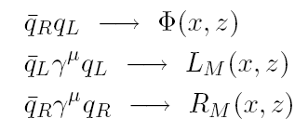
5D field contents
Operator → 5D bulk field
[Operator] → 5D mass

Slide 7
Confinement
Polchinski & Strassler, 2000
Confinement → IR cutoff in 5th direction

Slide 8
Hard wall model

Slide 9
The model describes
.

Slide 10
Example: 4D vector meson mass

Slide 11
Soft wall model

Slide 12
Deconfinement tempreature: Hawking-Page transition in a cut-off AdS₅
E. Witten, Adv. Theor. Math. Phys. 2, 505 (1998),
C. P. Herzog, Phys. Rev. Lett.98, 091601 (2007)
Gravitational action:~N_{c}² , Meson action:~N_{c}

Slide 13
1. thermal AdS:
2. AdS black hole:
Transition between two backgrounds
(De)confinement transition

Slide 14
z_{h}
z₀
z=0

Slide 15
Heavy quarkonium in bottom-up

Slide 16
Soft wall model

Slide 17
Dissociation temperature

Slide 19
Prediction from the bottom-up AdS/QCD model
Deconfinement + temperature effects
YK, J.-P. Lee, and S. H. Lee, PRD (2007)

Slide 20
Holographic heavy quark potential
1. Gluon condensation and heavy quarkonium
are both telling us about the non-perturbative nature of QGP.
Temperature dependence of gluon condensation is conveyed into
the temperature dependence of heavy quarkonium in QCD sum rule
[K. Morita and S. H. Lee, PRL (2008) ]
3. So there should be a close relation between the two.

Slide 21
A deformed AdS due to the gluon condensate
The dilaton couples to the gluon operator trG² :
non-zero gluon condensate in QCD → the dilaton will have a non-trivial background.

Slide 22
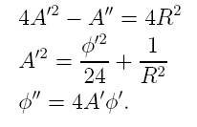
Einstein equation and the dilaton EoM with the following Ansatz:

Slide 23
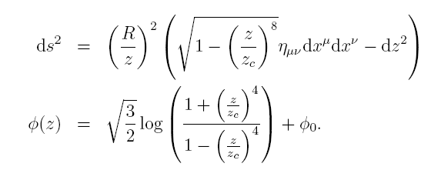
:dAdS

Slide 24
* Here, z_{c} is nothing but the gluon condensate via AdS/CFT:
Klebanov and Witten ‘99
For small z (d=4)
: →

Slide 26
AdS black hole type solution
YK, B.-H. Lee, C. Park, and S.-J. Sin, JHEP (2007)

Slide 27
dBH
→
→

Slide 28
HQ potential in the deformed AdS
Let’s see how the gluon condensate affects the HQp.

Slide 29
Hong Liu@INT2008-01

Slide 30
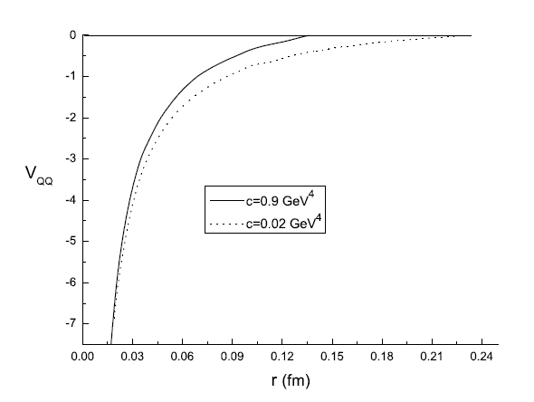

Slide 31
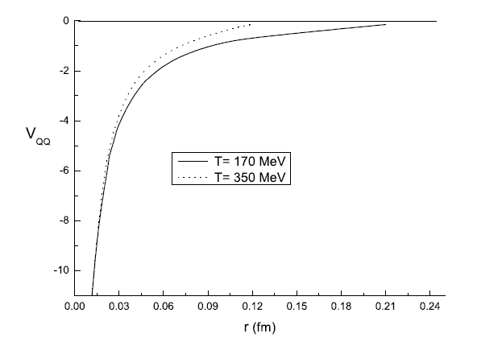

Slide 32
Summary
A prediction from the AdS/QCD model and the holographic potential study: the mass of heavy quarkonum drops at and/or very near Tc, but is increases afterwards with increasing temperature.
Stringy set-up? D3/D7, etc

