Slide 1
Charm & bottom measurement
@ RHIC
Shingo Sakai
Univ. of California, Los Angeles

Slide 2
Outline
Non-photonic e result in AuAu
b/c separation in non-photonic electron
by electron-hadron correlations @ pp
Bottom production
Discuss heavy flavor energy loss in the
dense matter

Slide 3
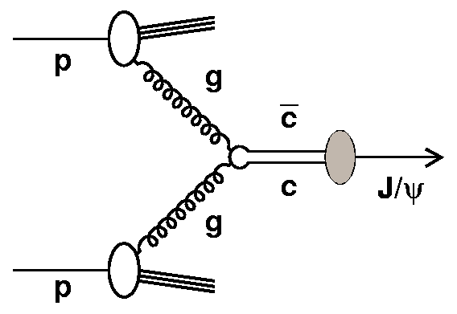
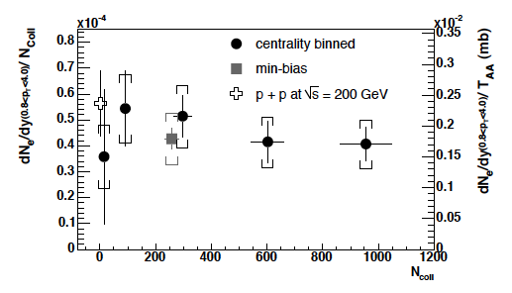
Heavy flavor & HIC
Heavy quarks (charm & bottom)
are produced by gluon fusion in
the initial collisions.
Total charm yields in AuAu
collisions @ RHIC is scaled
by binary collisions
heavy quarks are produced
before the medium formed
and through the matter.
probe of QCD matter
D mesons
, Ψ’, χ
PRL 94, 082301 (2005)
AuAu 200 GeV

Slide 4
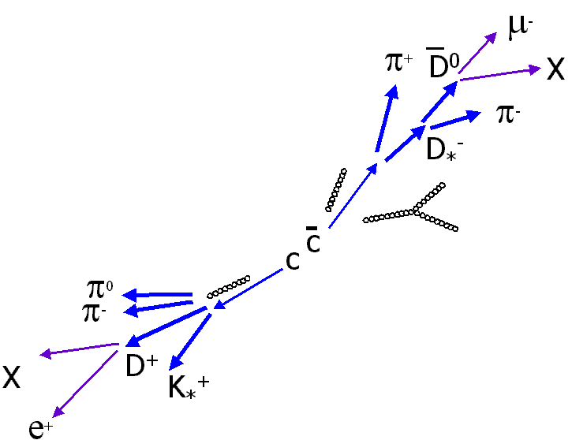
Charm quark study @ RHIC
Heavy flavor production has been
studied by measuring electrons
decay from charm and bottom
(non-photonic electron)
at RHIC
Measured electron
    Photonic electron
    - photon conversion
    - Dalitz decay
    Non-photonic electron
    - primarily semi-leptonic decay
    of mesons containing c & b
BR D⁰->Kπ (3.85±0.10 %)
BR D±->e+X (17.2 %)
D meson
M = 1.869 [GeV]
τ~ 10⁻¹² [s]
c_{τ} ~ 300 [μm]

Slide 5
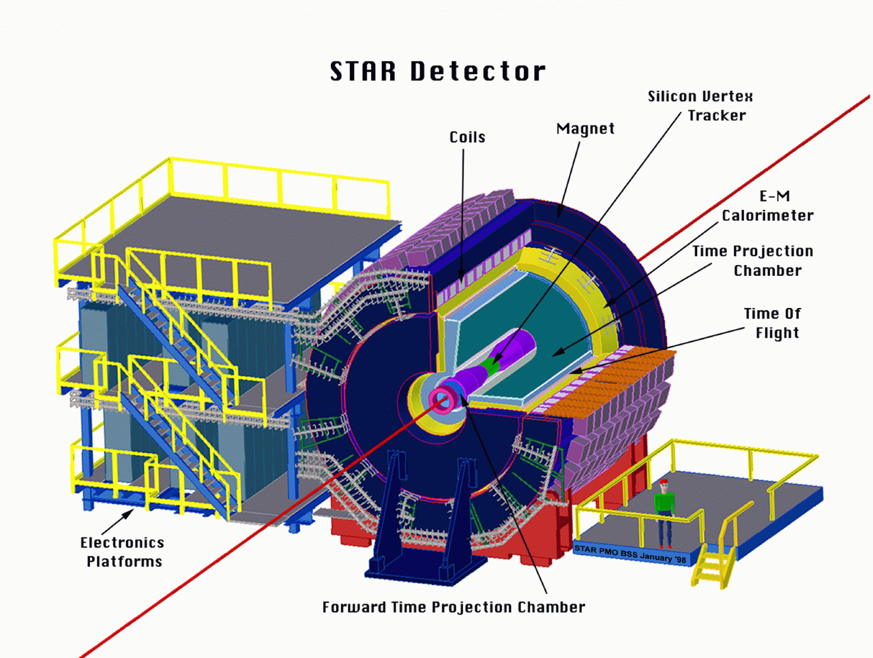
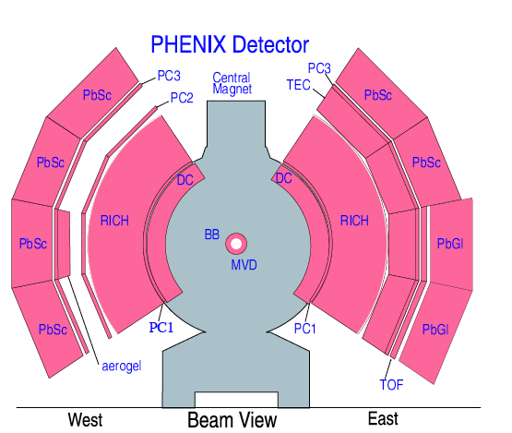
PHENIX vs. STAR detector
electron ID is carried with
DC + PC ; momentum
RICH ; ring image
EMC ; energy
TPC ; momentum, dE/dx
EMC ; energy
SMD ; shower shape

Slide 6
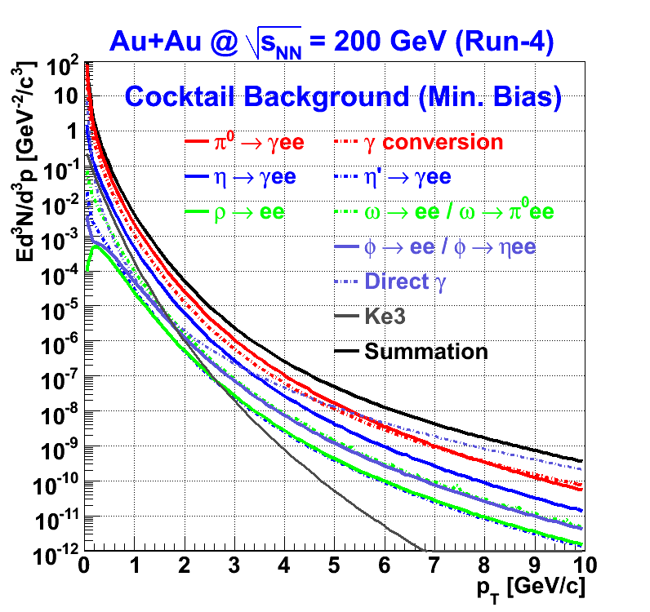
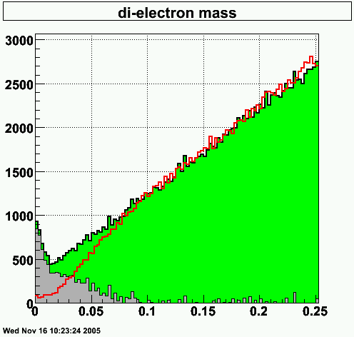
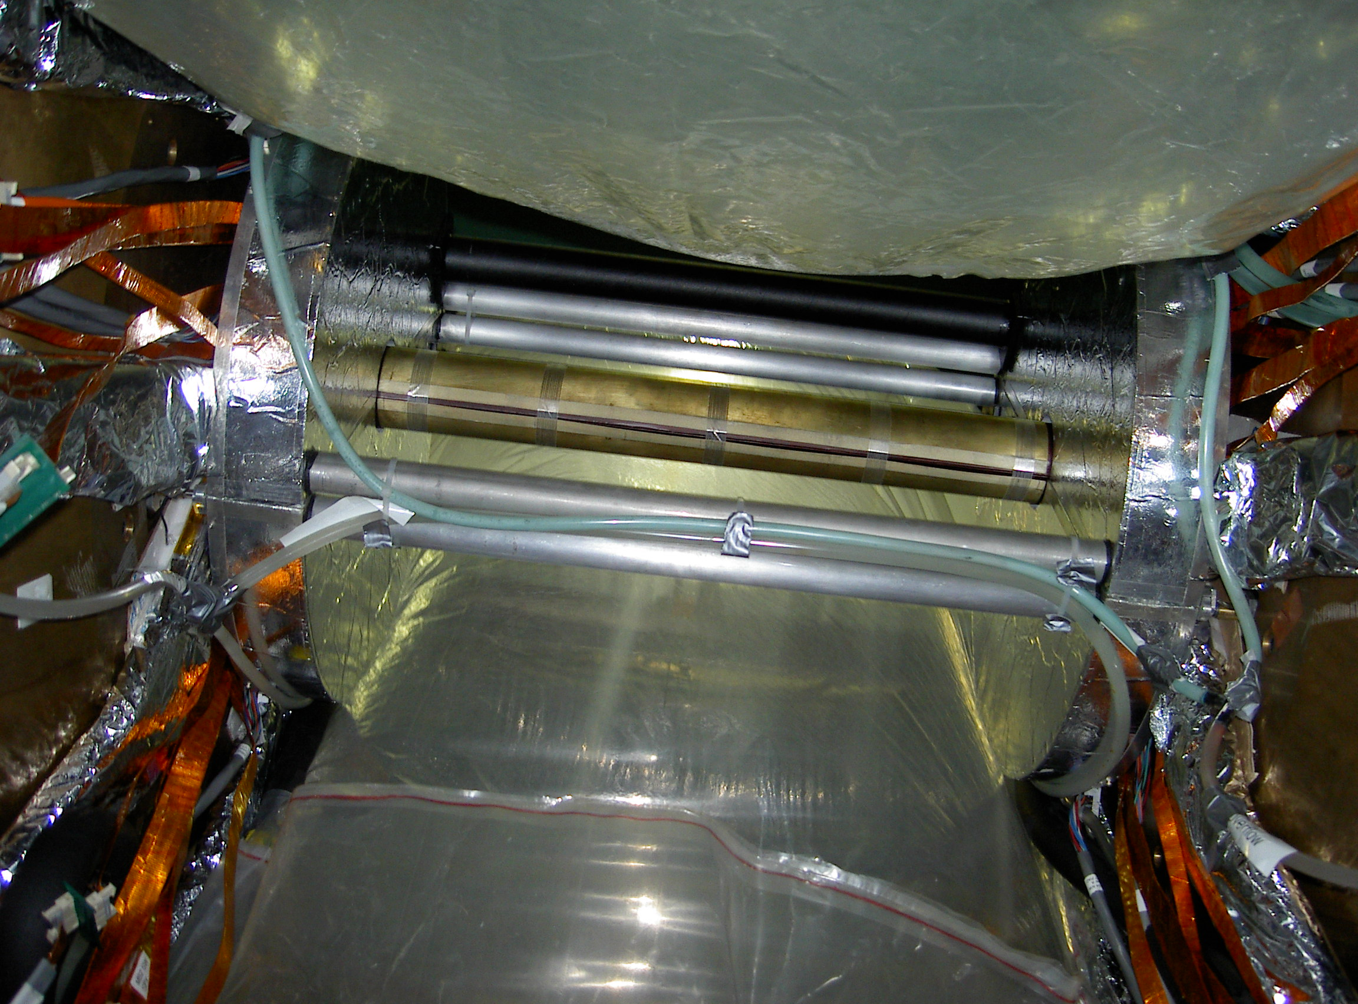
Photonic electron determination
Main background in electron measurement is photonic electron
photonic e
Invariant mass
Reconstruct photonic
electron by calculating
Inv. Mass of ee
(STAR)
Cocktail method
Calculate photonic
electron by using
measured photonic
sources
(PHENIX)
Converter method
Install additional
converter.
Then compare
yield w. w/o
converter (PHENIX)

Slide 7
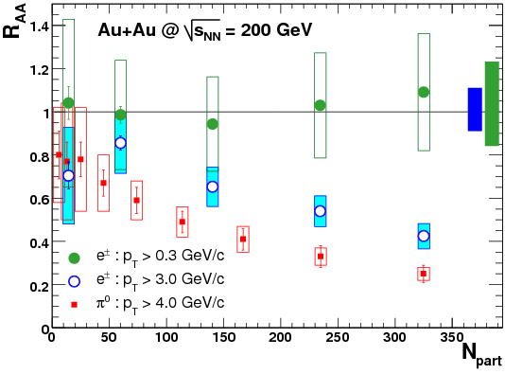

Non-photonic e production in AuAu
PRL 98, 172301 (2007)
binary scaling of total e± yield from heavy flavor decay
=> hard process production
high p_{T} e± suppression increasing with centrality
=> heavy flavor energy loss
=> very high dense matter is formed in AuAu collisions
7

Slide 8
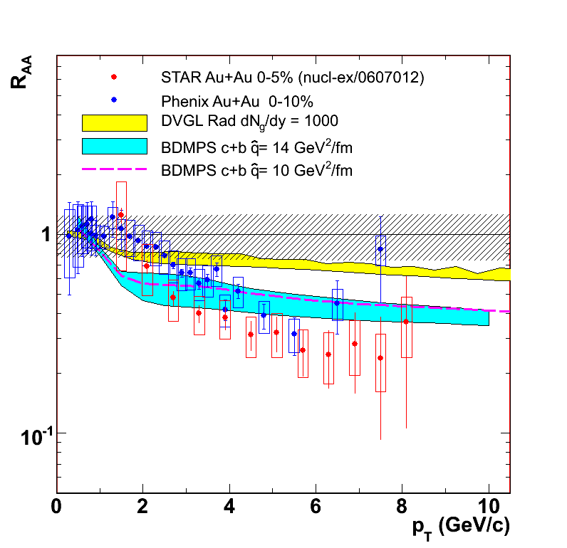
Models for energy loss
    radiative energy loss with typical gluon densities is not enough (Djordjevic et al., PLB 632(2006)81)
    models involving a very opaque medium agree better (Armesto et al., PLB 637(2006)362)
    collisional energy loss / resonant elastic scattering (Wicks et al., nucl-th/0512076, van Hees & Rapp, PRC 73(2006)034913)
A. Suaide QM06
Notes:
Currently several models are proposed to understand heavy flavor energy loss in the dense matter

Slide 9
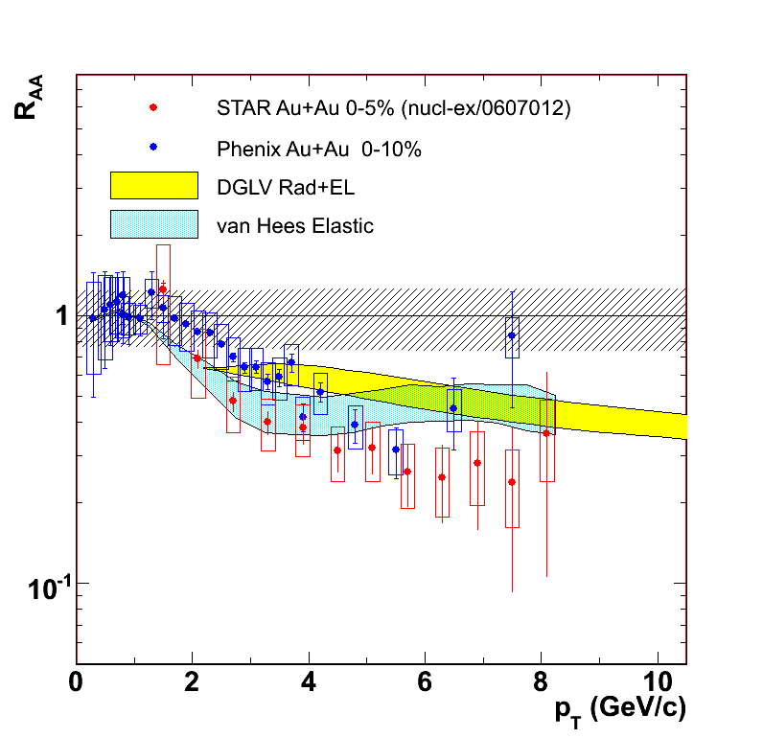
Models for energy loss
    radiative energy loss with typical gluon densities is not enough (Djordjevic et al., PLB 632(2006)81)
    models involving a very opaque medium agree better (Armesto et al., PLB 637(2006)362)
    collisional energy loss / resonant elastic scattering (Wicks et al., nucl-th/0512076, van Hees & Rapp, PRC 73(2006)034913)
A. Suaide QM06
Uncertainty from bottom quark contribution
not only theory but also experiment @ high pT

Slide 10
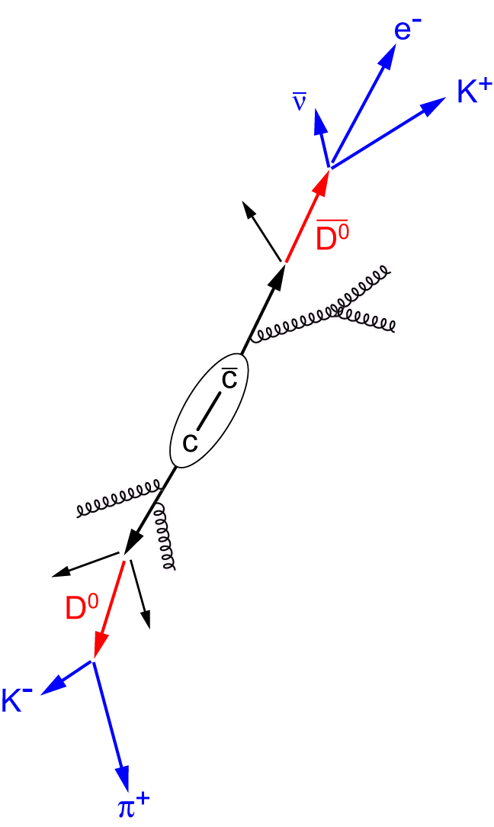
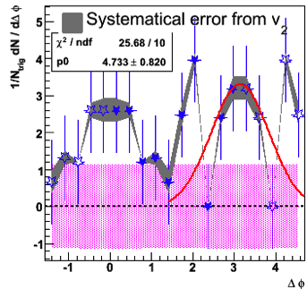
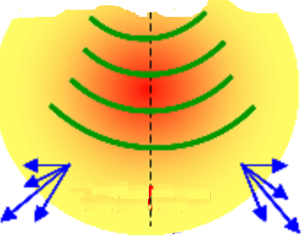
e^{HF}-h correlation in AuAu
trigger
0 – 20%: 3 < p_{T}^{trig} < 6 GeV/c & 0.15 < p_{T}^{asso} < 1 GeV/c
STAR preliminary
QM08
Gang Wang
Away side structure is similar to mach cone shape
The other evidence of heavy quark energy lose
Notes:
STAR measure non-photonic electron and hadron correlations in AuAu collisions

Slide 11
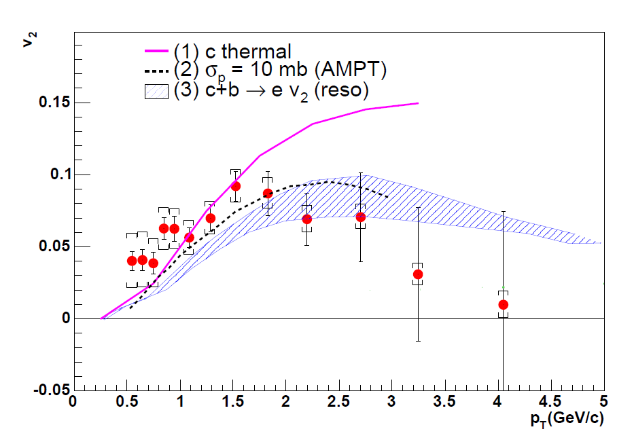
Non-photonic electron v₂
PRL 98 172301 (2007)
Strong elliptic flow for non-photonic electron
(1) Charm quark thermal + flow
(2) large cross section ; ~10 mb
(3) Elastic scattering in QGP
[Phys.Lett. B595 202-208 ]
[PRC72,024906]
[PRC73,034913]
charm quark flow -> partonic level thermalization
There is also uncertainty from bottom @ high pT

Slide 12
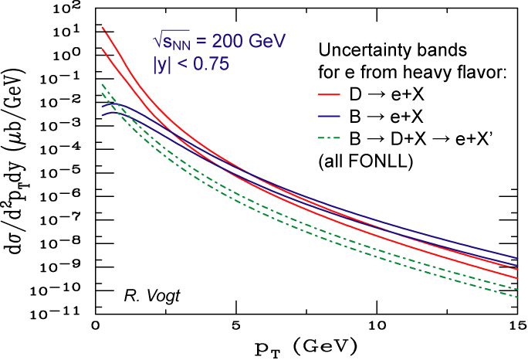
pQCD prediction for Bottom
Since charm and bottom
are heavy, their production
have been predicted by pQCD
FONLL predicts bottom quark
contribution significant (c/b = 1)
around 5 GeV/c in non-photonic
electron yield with
large uncertainty.
Separate charm/bottom
by using e-h correlations
*Uncertainty comes from mass,
PDF, etc in the calculation
*FONLL
=A Fixed-Order plus Next-
to-Leading-log
Notes:
Figure shows FONLL calculation for electron decay from charm and bottom decay
we try to separate charm and bottom by using e-h correlations

Slide 13
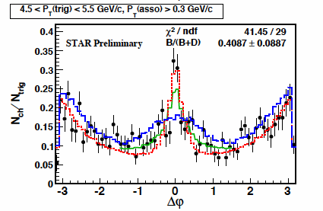
e^{HF} and hadron correlation
pp@200 GeV
e^{D} – h (MC)
e^{B} – h (MC)
fitting
Near side width for B decay is wider than
that of D decay due to decay kinematics
measuring e-h correlation in pp & fit by MC
with B/(B+D) as parameter

Slide 14
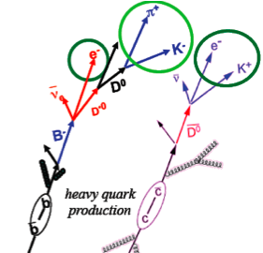
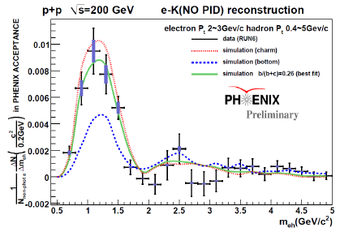
e and K correlation
Electron-Kaon charge correlation
  D meson decay
  => opposite sign eK pair
  B meson decay
  => same sign eK pair
QM08
Y. Morino
disentangle charm and remaining bottom contribution via (PYTHIA) simulation

Slide 15
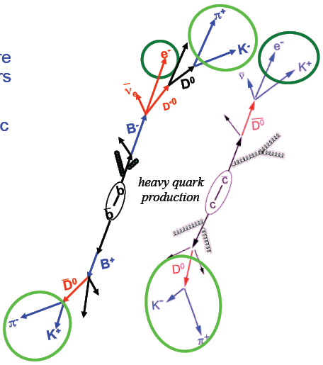
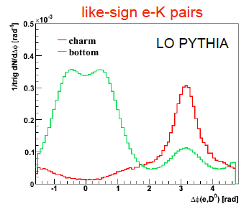
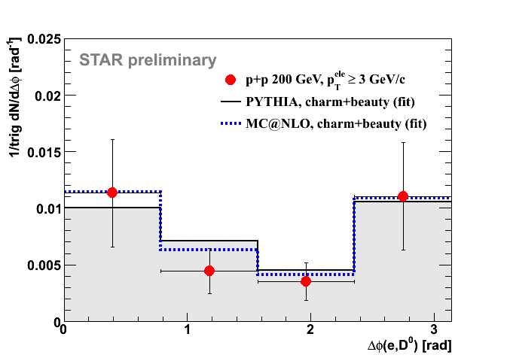
e and D0 correlaion
Request like-sign e-K pair
  near-side ; bottom dominant
  away-side ; charm dominant
compared with MC simulations to get B/D ratio
QM08
A.Mischke

Slide 16
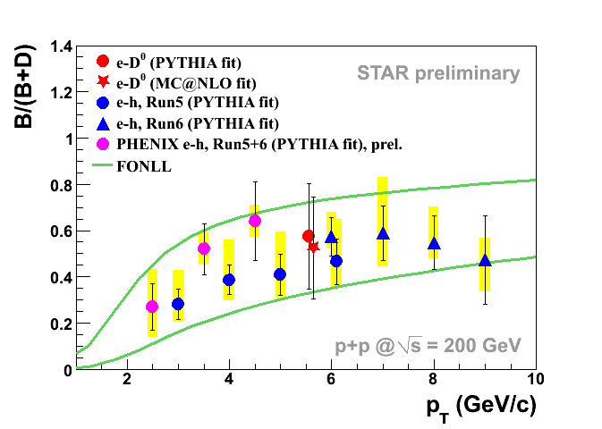
B decay contribution
B decay contribution to non-photonic electron
Three independent method (STAR & PHENIX) are consistent
B decay contribution increase with pT
> 50% e decay from B above 4-5 GeV/c
good agreement with pQCD (FONLL) prediction

Slide 17
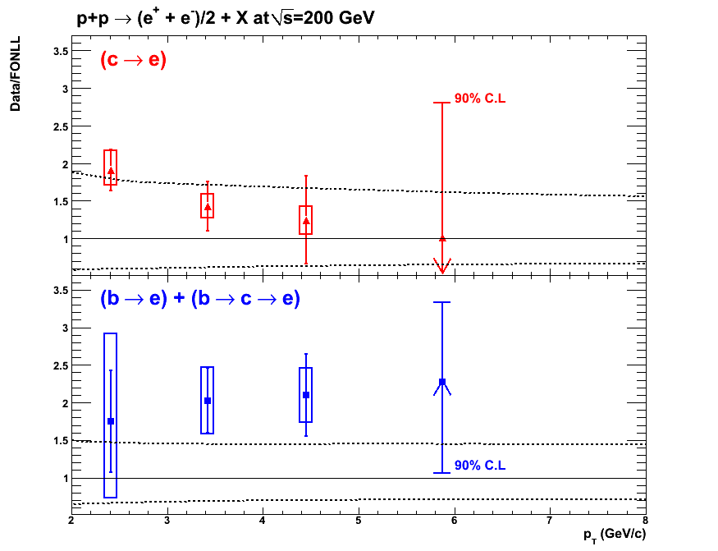
Bottom production @ pp
QM08
Y. Morino
Data/pQCD
Charm decay
Bottom decay
upper limit
of pQCD
data (c->e & b->e)/pQCD from PHENIX
ratio is almost flat -> pQCD well represent the p_{T} shape
σ_{data}/σ_{FONLL} ~2 reasonable value

Slide 18
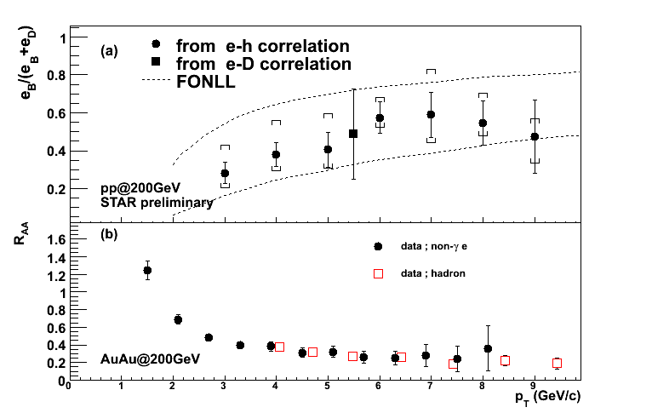
Large Bottom energy loss ?
Bottom quark contribution
is ~50% above 4-5 GeV/c @ pp
=> there would be significant
bottom contribution in
AuAu, too
R_{AA} for non-photonic electron
consistent with hadrons
Indicate large energy loss
not only charm but also
bottom in the dense matter
C:B ~ 1:1 @ pp

Slide 19
R_{AA}^{c} & R_{AA}^{b} correlation (1)
Relation between R_{AA} for charm and bottom decay
R_{AA}^{C} and R_{AA}^{B} are connected B decay contribution @ pp
With the measurements of r @ pp and R_{AA},
we can derive a relationship between R_{AA}^{c} and R_{AA}^{b}.
Notes:
Further information can be gained by constraining charm and bottom Raa from experimental results
Non-photonic electron contain charm and bottom decay
RAA for Non-photonic electron is combination of Raa for charm and bottom
They are simply connected by bottom contribution in pp

Slide 20
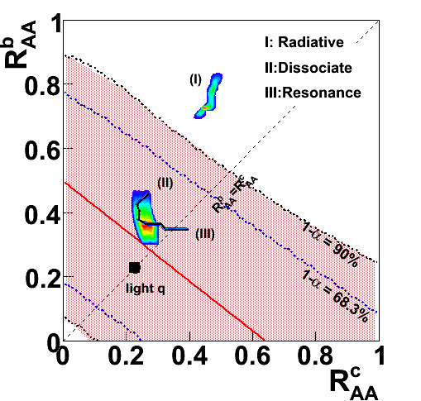
R_{AA}^{c} & R_{AA}^{b} correlation (2)
p_{T}>5 GeV/c
R_{AA}^{c} & R_{AA}^{b} correlation
from STAR
Dominant uncertainty is
normalization in R_{AA} analysis
R_{AA}^{b}< 1 ; B meson suppressed
prefer Dissociate and
resonance model
(large b energy loss)
STAR preliminary
I; Phys. Lett. B 632, 81 (2006) ; dN_{g}/dy = 1000
II; Phys. Lett. B 694, 139 (2007)
III; Phys.Rev.Lett.100(2008)192301

Slide 21
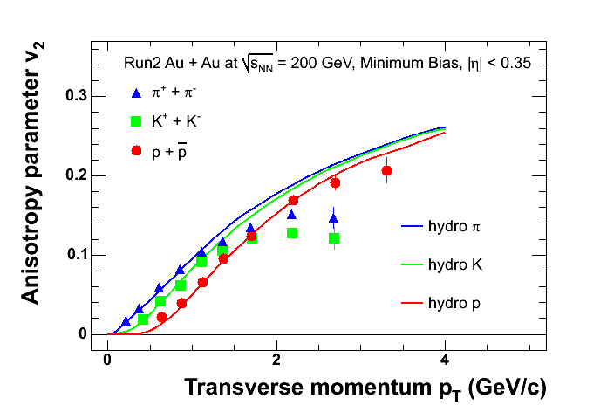
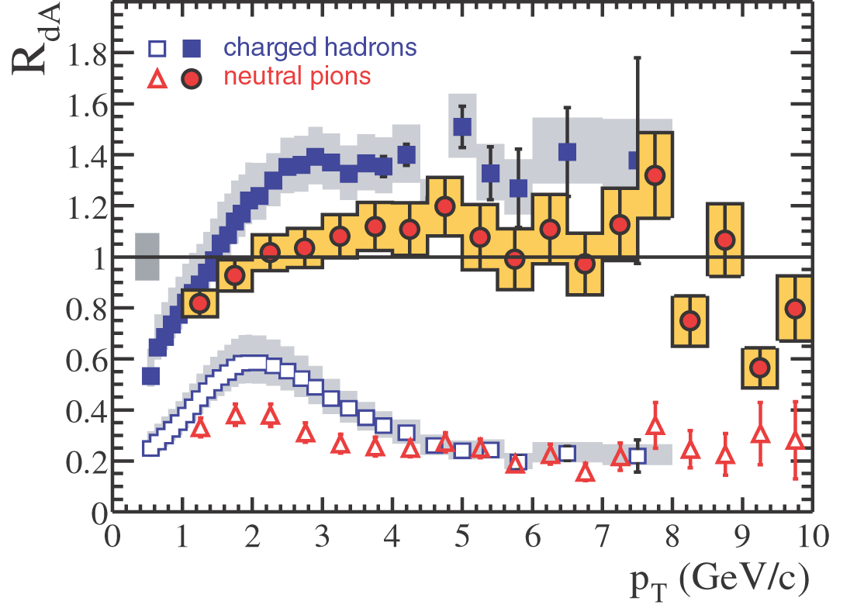
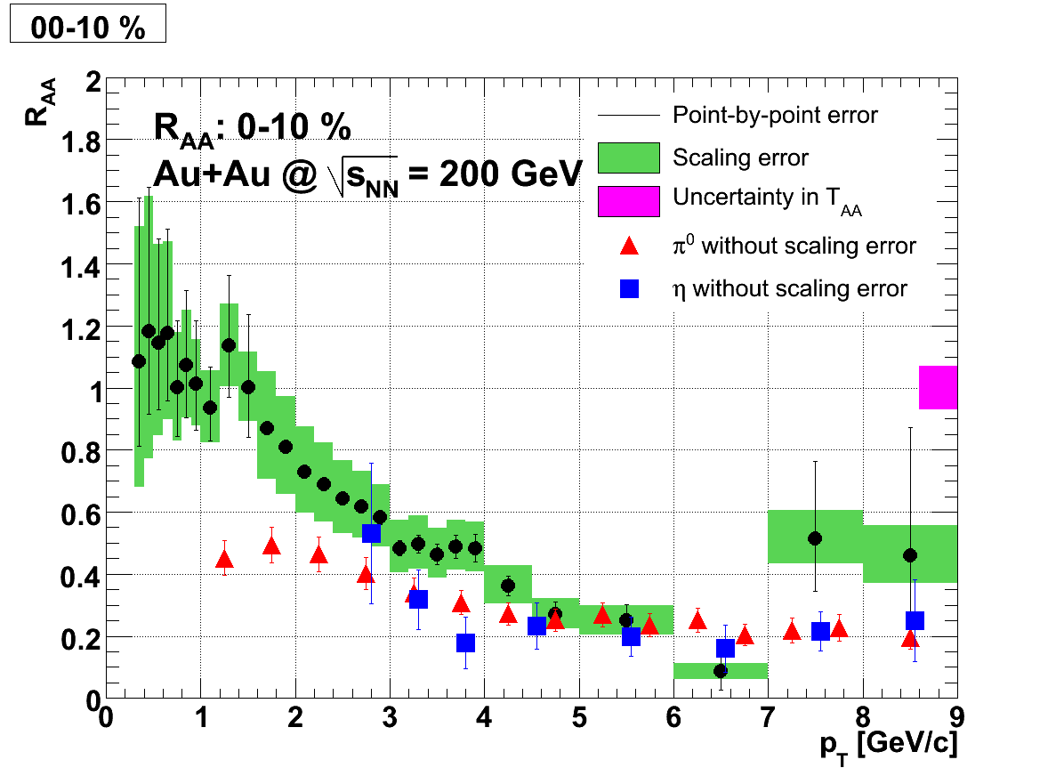
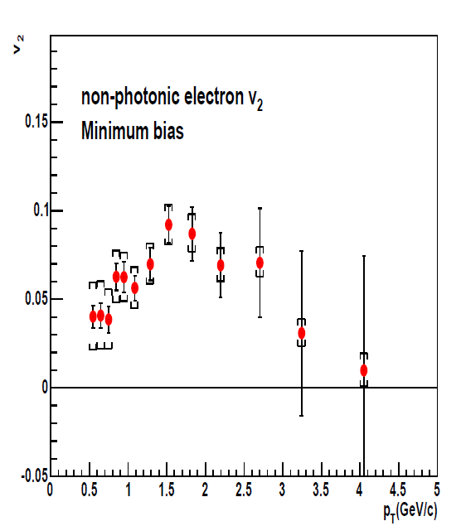
Summary
R_{AA}
Azmuthal correlation
v₂
d+Au
Au+Au
Same trends of heavy & light in the dense matter
Notes:
Heavy flavor behavior in the dense matter is same as light quarks
There is an uncertainty from bottom @ high pT, so we study B decay contribution

Slide 22
Summary
Heavy quark behavior is same as light quark
in the hot & dense matter @ RHIC
=> energy loss & flow
STAR & PHENIX extract B decay contribution
in non-photonic electron by using electron-hadron
correlations in pp.
B decay contribution is more than 50% above
5 GeV/c in pp collisions
PHENIX study bottom production @ pp
and it is consistent with pQCD prediction.
STAR study bottom energy loss and the result show
B meson suppression with 90% C.L.

