Slide 1
Jet and Flow analysis at RHIC and LHC
ShinIchi Esumi
Inst. of Physics, Univ. of Tsukuba
Source size/shape measurement with HBT
Energy loss and jet quenching
Small but high multiplicity system
Interplay between soft and hard
relation to collective event anisotropy

Slide 2
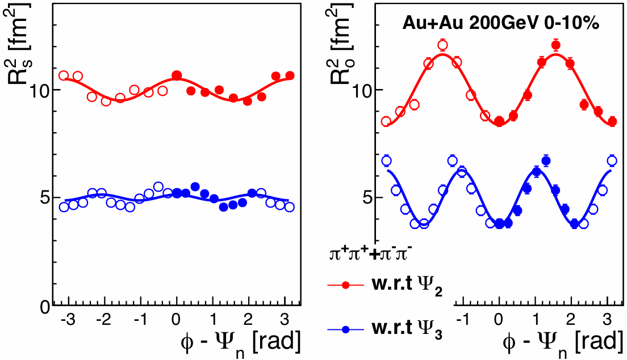
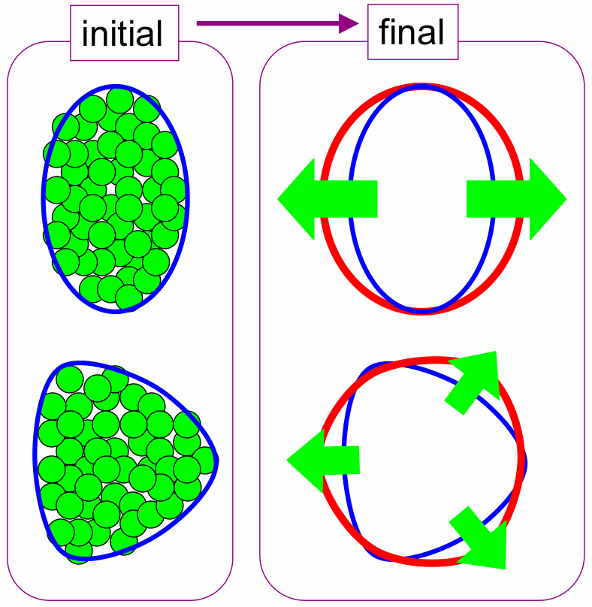
筑波大、新井田貴文
Source geometry (size, shape and time duration) at the end of freeze-out via two particle quantum interferometry (HBT measurement)
R_{T-side}, R_{T-out} vs (φ−Φ₂), (φ−Φ₃) R_{T-side}^{oscill.} < R_{T-out}^{oscill.} for n=2,3 (central)
side view size
q_{T-side} : R_{T-side}
p_{T1}
p_{T2}
depth + time duration
q_{T-out} : R_{T-out}
PHENIX Preliminary, QM12
together with v_{n}(p_{T})^{PID}
fitting with Blast Wave

Slide 3
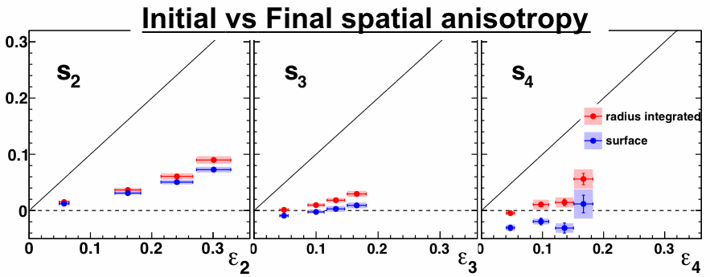
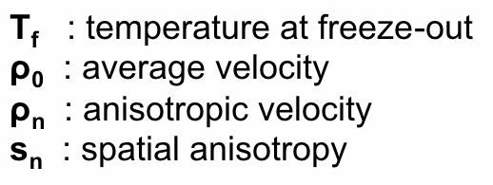
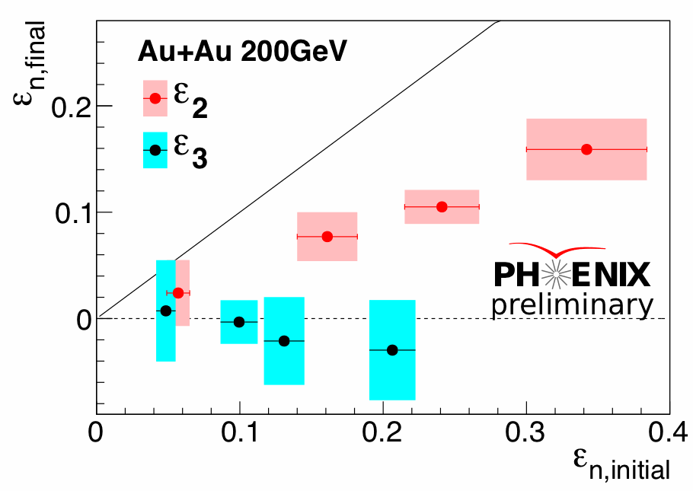
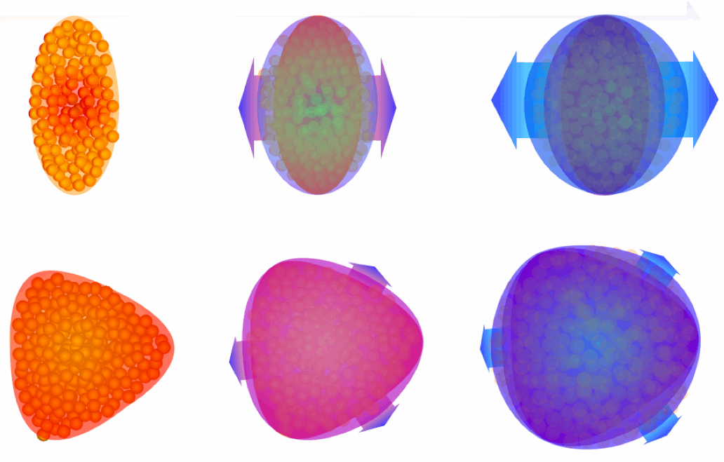
PHENIX, QM12
extracted by BW fitting with spectra + v_{2,3,4} of π,K,p
extracted from R_{Tside} by ππ HBT

Slide 4
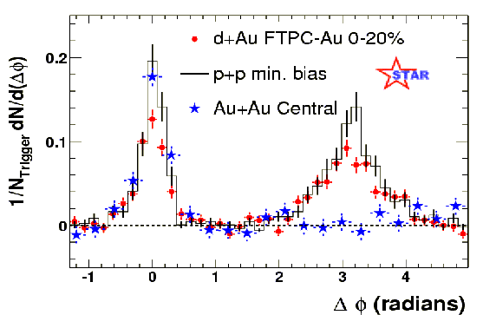
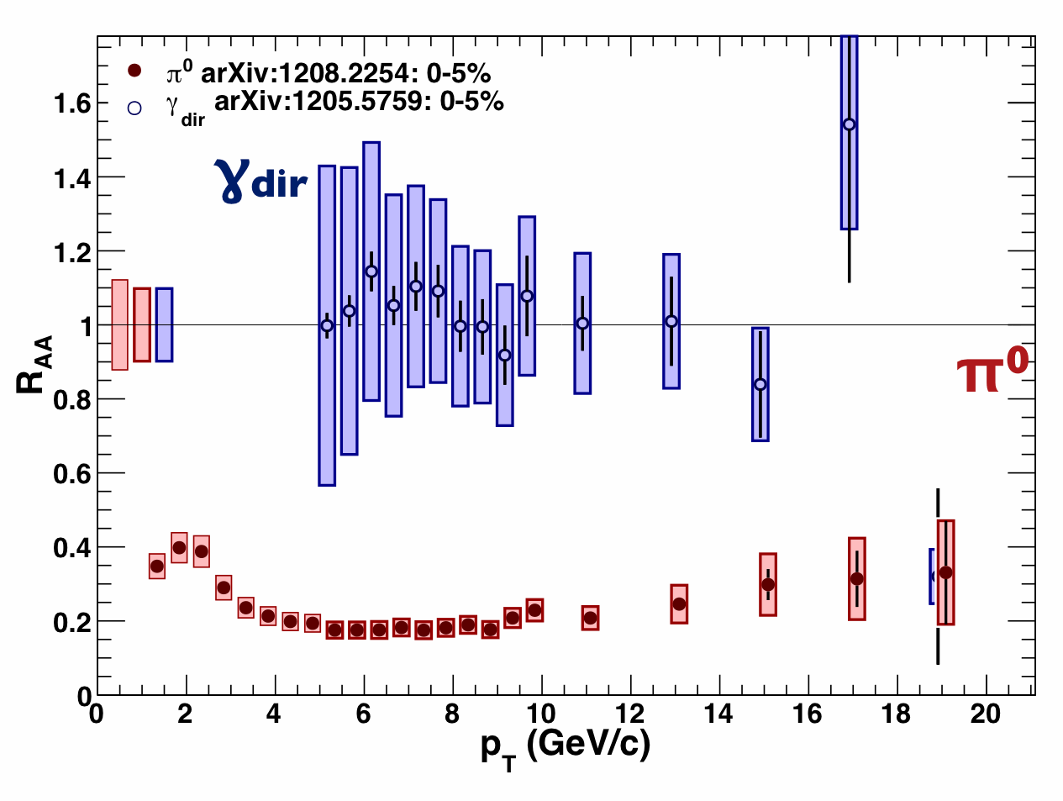
Energy loss (jet quenching)
in QGP
jet
p
p
γ
q
Au
Au
arXiv: 1208.2254
Phys. Rev. Lett. 91, 072304 (2003)
central Au+Au
PRL109, 152302 (2012)

Slide 5
peripheral
central
Di-jet asymmetry : A_{J}
LHC-ATLAS, arXiv : 1208.1967v2

Slide 6
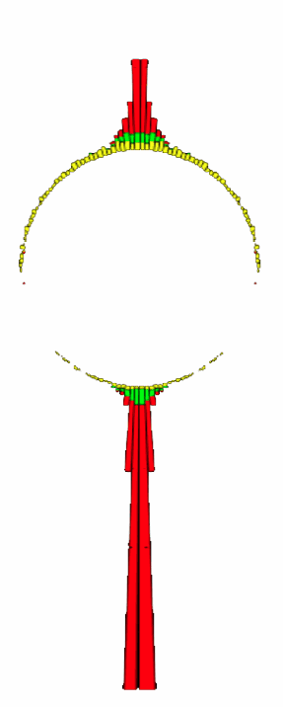
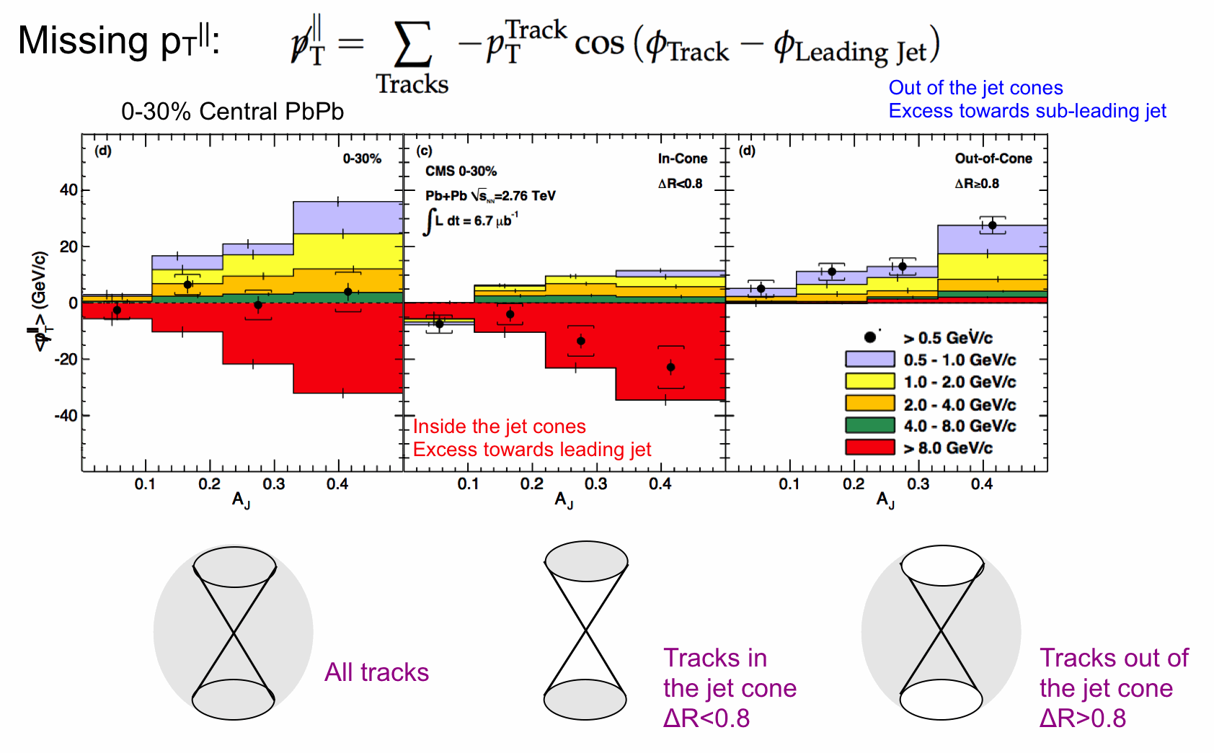
Re-distribution of the lost energy from the jet quenching
LHC-CMS, PRC84 (2011) 024906

Slide 7
Use photons, Jets, single hadrons
as trigger in order to look at
correlated association emission
Multi-particle correlation like 2+1 particle
correlation analysis (Trig1, Trig2, Asso) can be
used as largely modified jet and di-jet signal.
Trig1
Closer and closer to
the initial parton energy
Trig1
Asso
Gamma trigger
Asso
Jet (large R) trigger
Trig2
Trig2
Trig1
Jet (small R) trigger
Trig2
Asso
π⁰(hadron) trigger
Use “Trig2 relative to Trig1”
as jet trigger condition,
and look at distribution : “Associate relative to Trig1”
without jet-reconstruction bias
more and more surface bias
given by energy loss

Slide 8
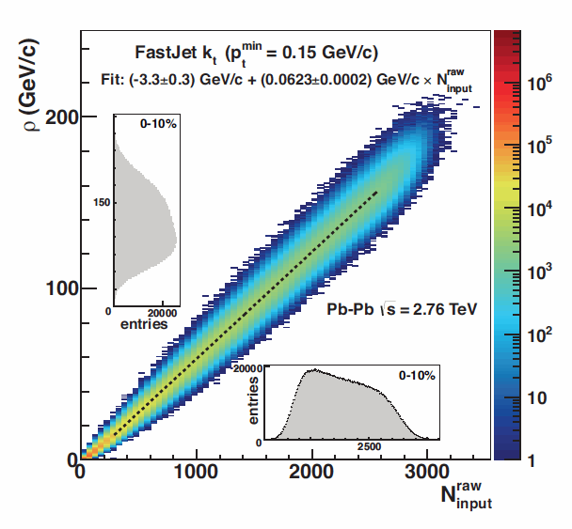
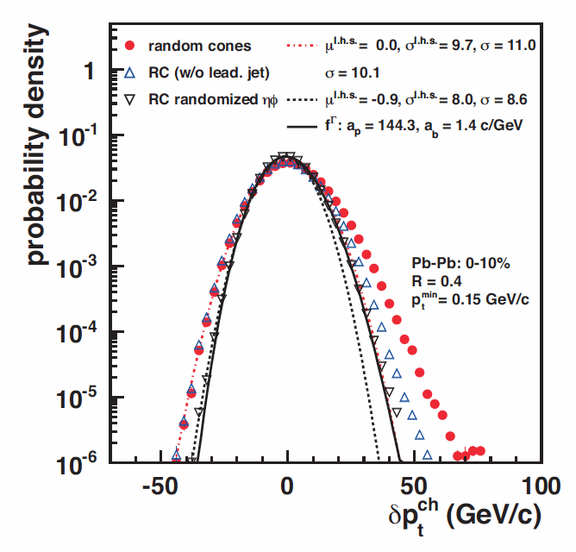
LHC-ALICE, JHEP03 (2012) 053
Background Fluctuation in Jet energy
p_{T}^{Jet} = p_{T}^{rec. Jet} – ρ Area^{rec. Jet}
δp_{T} = Σ_{ran.} p_{T} – ρ A
Area(πR²)~0.5 for R~0.4

Slide 9
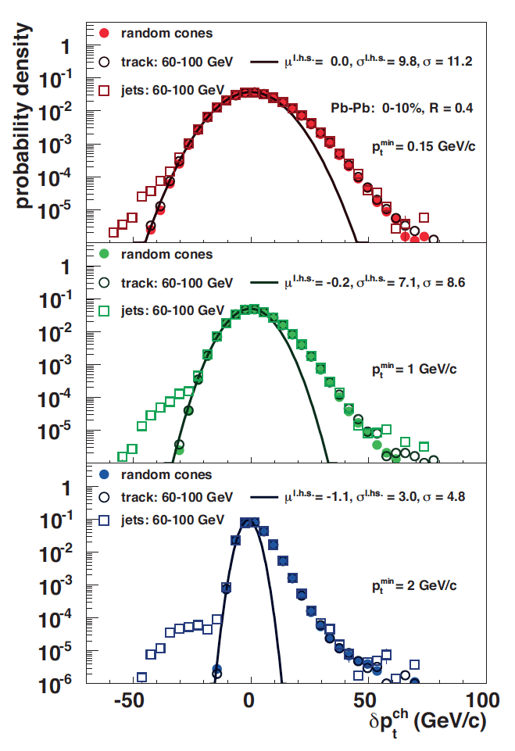
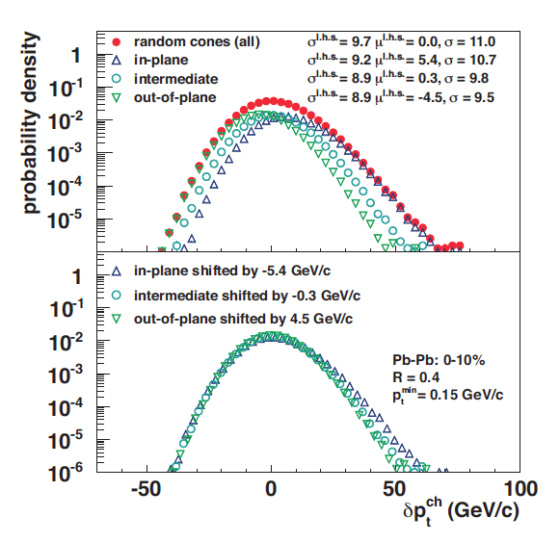
Event plane and pT threshold effects on
Jet energy determination
LHC-ALICE, JHEP03 (2012) 053

Slide 10
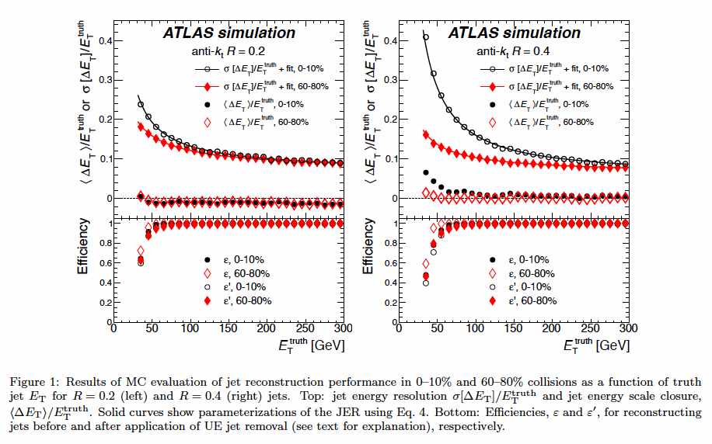
Energy resolution of Jet energy
LHC-ATLAS, arXiv : 1208.1967v2

Slide 11
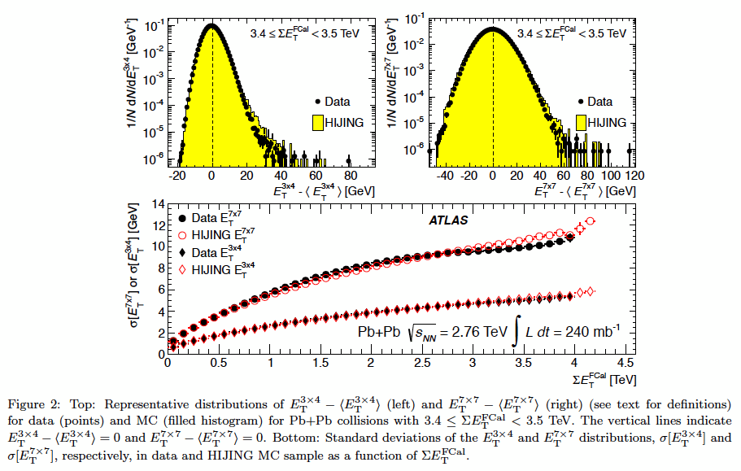
Jet cone radius dependence of fluctuation
LHC-ATLAS, arXiv : 1208.1967v2

Slide 12
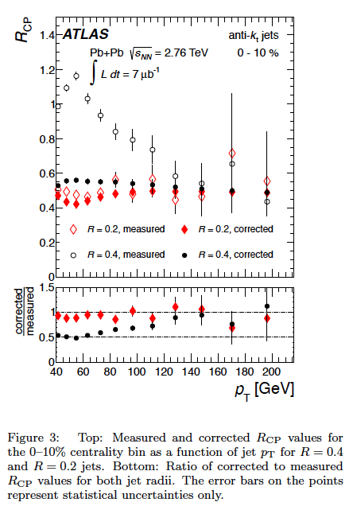
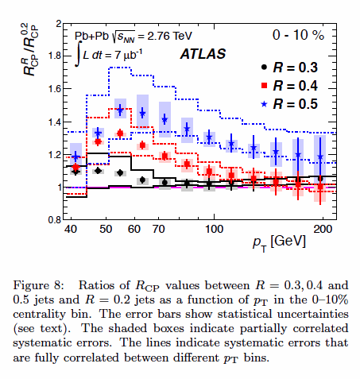
LHC-ATLAS, arXiv : 1208.1967v2

Slide 13
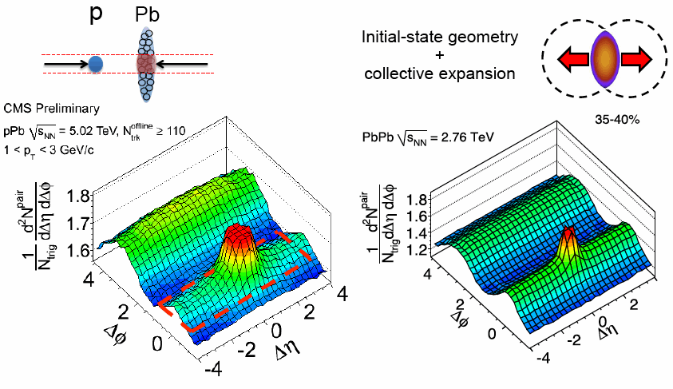
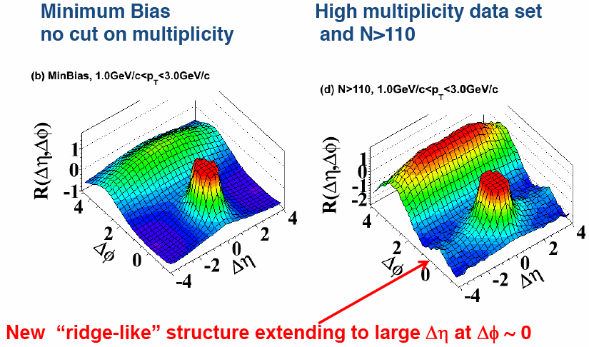
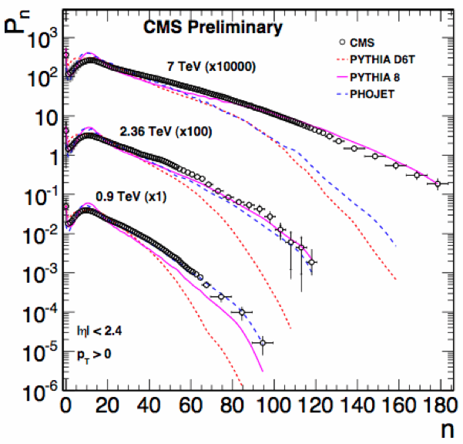
High mult. p+A
A+A
A small but high-temperature/density
system might be created in high multiplicity pp and pA collisions…
Are they collective/expanding?
Min. bias p+p
High mult. p+p

Slide 14
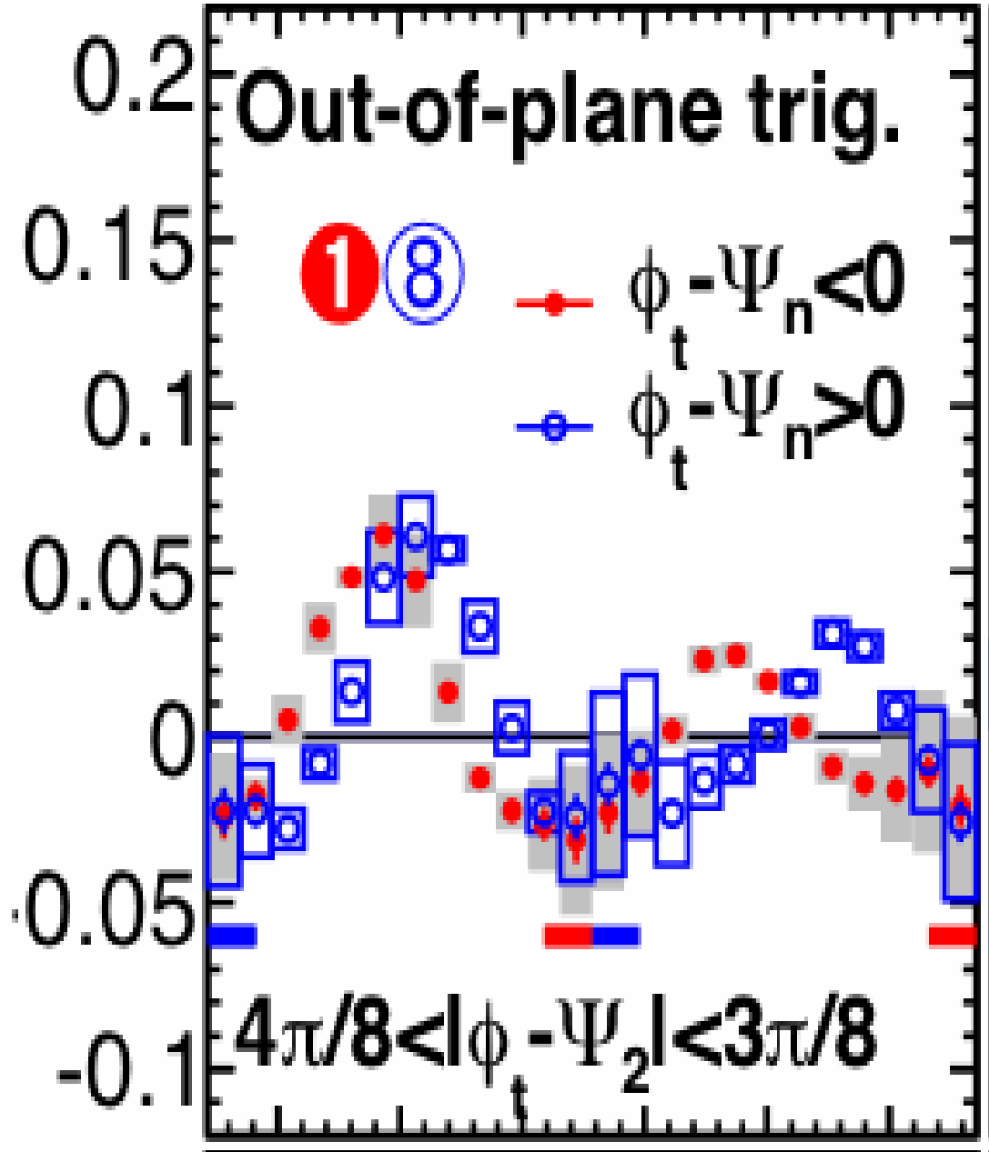
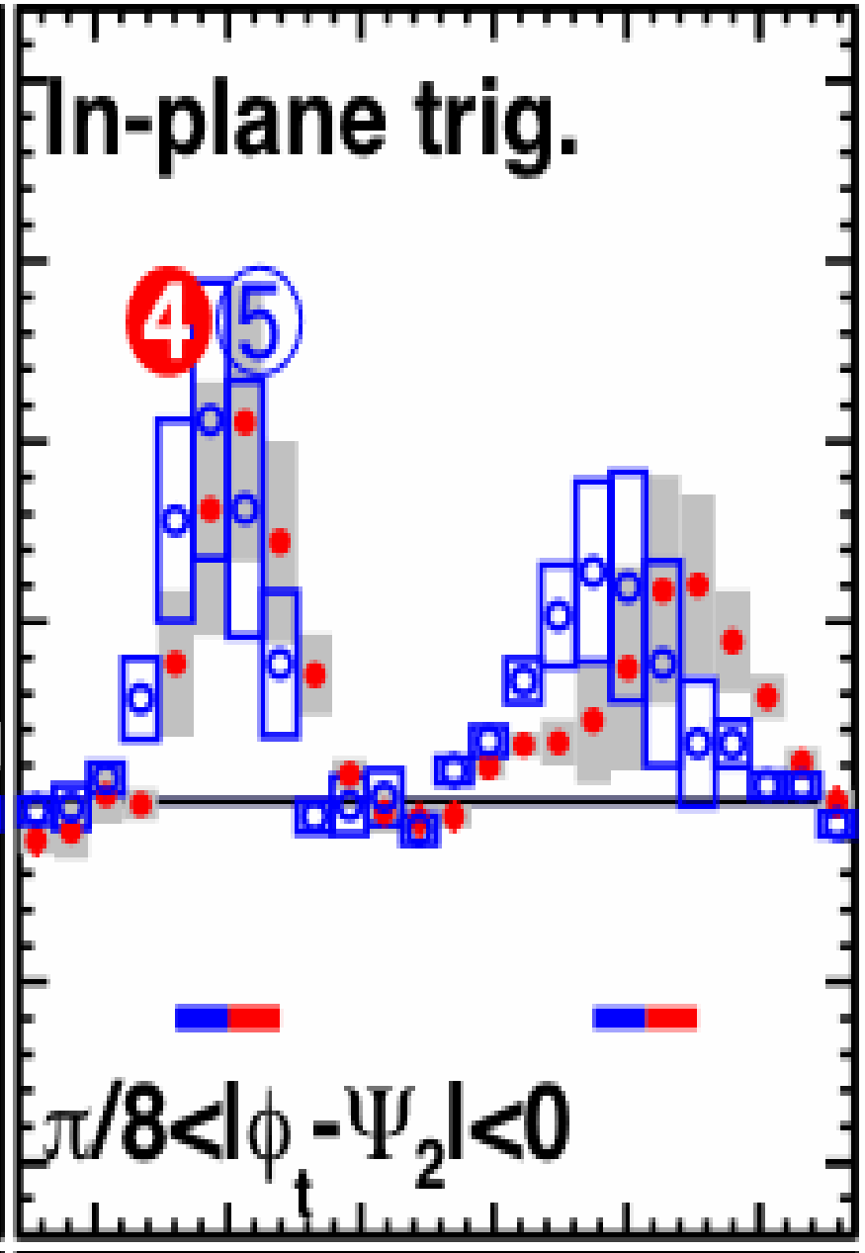
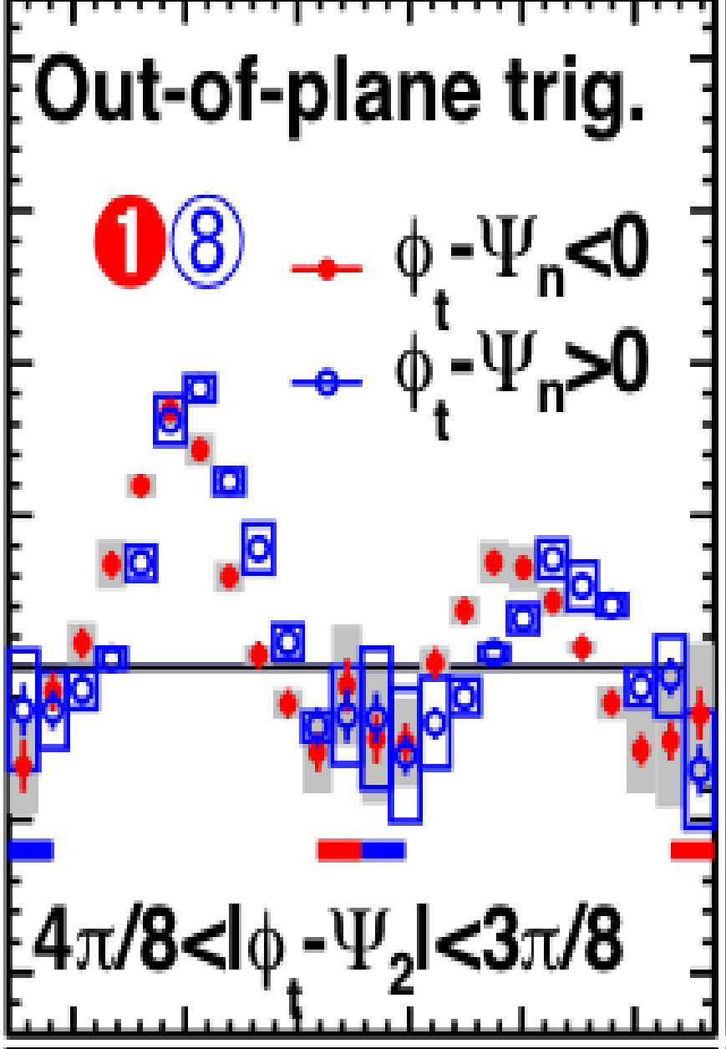
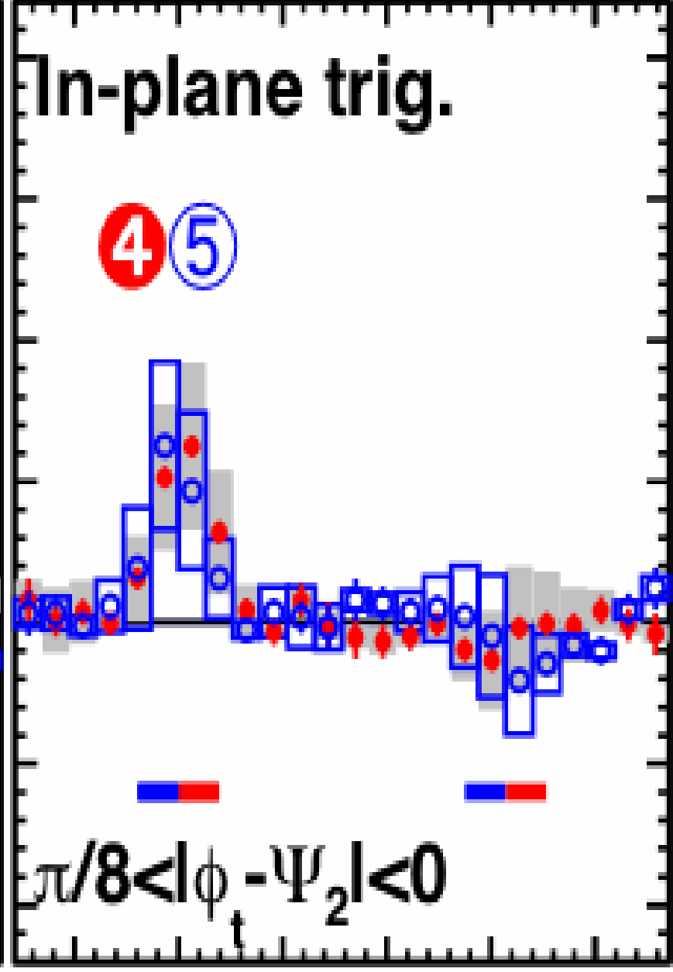
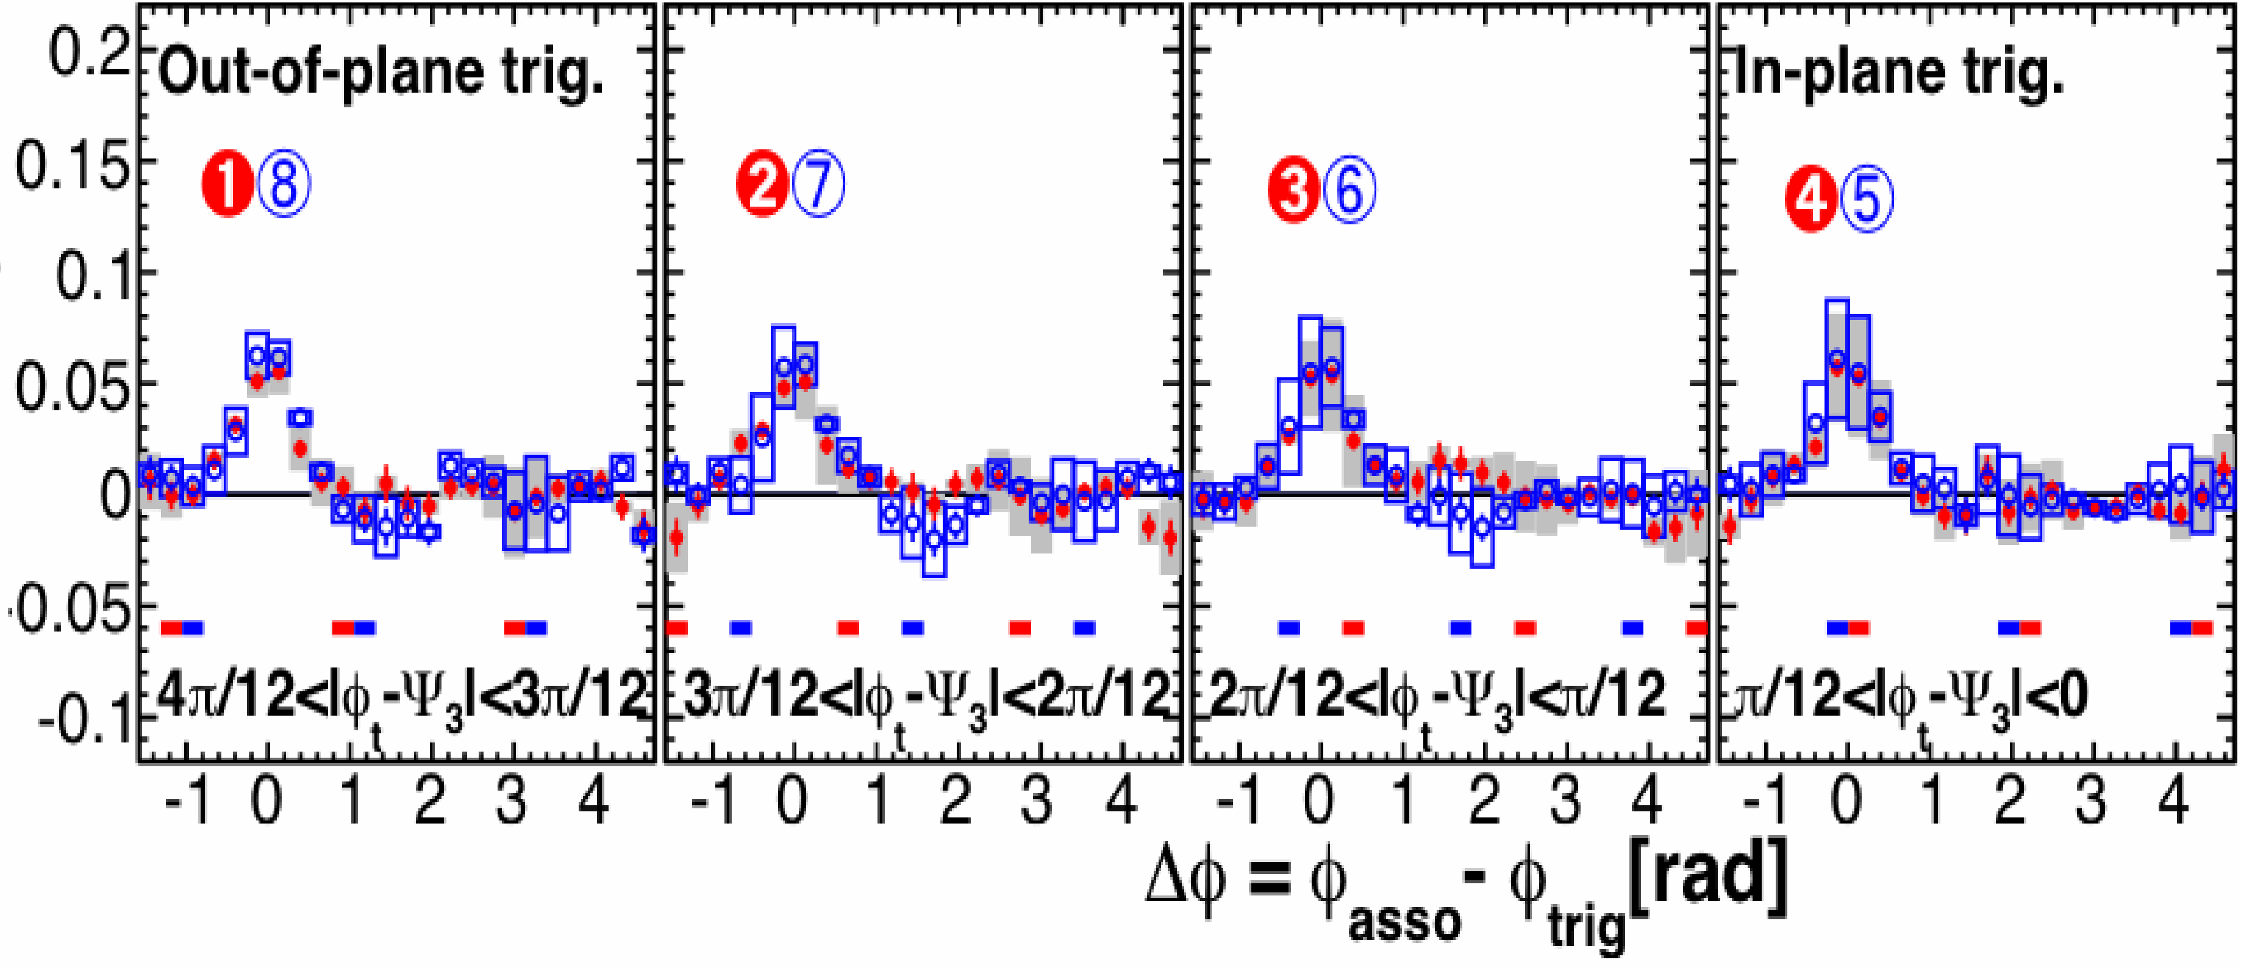
2 particle correlation w.r.t. collision geometry and expansion
筑波大、
轟木貴人
- strong Φ₂ dependence and left/right asymmetry (coupled with energy loss and flow) - broad out-of-plane correlation enhanced more in central (redistribution and expansion) - weak Φ₃ dependence
mid-central 40-50%
central 0-10%
Φ₂
Φ₃
central 0-10%
PHENIX Preliminary, QM12 Au+Au 200GeV, hadron-hadron p_{T} : (2~4)_{Trig} x (1~2)_{Asso} (GeV/c)

Slide 15
QM09: J. Konzer
Y(|∆η|>0.7) = Ridge + away-side two-Gaussian
STAR Preliminary
Au+Au 20-60%
Jet = Y(|∆η|<0.7) – Acceptance*Y(|∆η|>0.7)
3<p_{T}^{Trig}<4 GeV/c
1<p_{T}^{Assoc}<1.5 GeV/c
|∆η|>0.7
φ_{S}~0
φ_{S}~90
Ridge contributes v2 and is asymmetric in Δφ
Ridge
Jet
∆φ = φ_{assoc}-φ_{Trig}

Slide 16
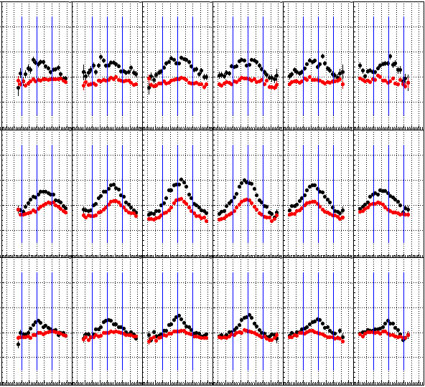
Associate yield per trigger
with AMPT simulation
-2
η^{Trig}
2
b_{imp} = 0 - 4 fm
η^{Trig}
|Δφ| < π/4 near side
|Δφ| > π/4 away side
beam
b_{imp} = 4 - 10 fm
Look at asymmetry
in Δη = η^{Asso} – η^{Trig}
associate η distribution
with respect to trigger η
b_{imp} = 10 - fm
-4 -2 0 2 4
Δη = η^{Asso} - η^{Trig}
-4 -2 0 2 4

Slide 17
Summary
Source size/shape measurement with HBT
Energy loss and jet quenching
Small but high multiplicity system
Interplay between soft and hard
relation to collective event anisotropy

Slide 18
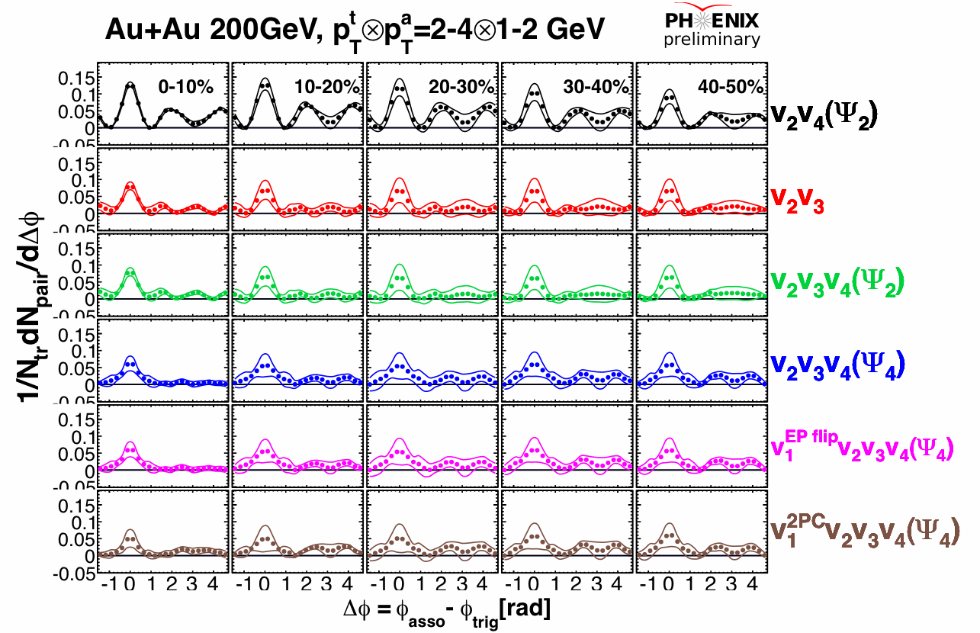

Slide 19
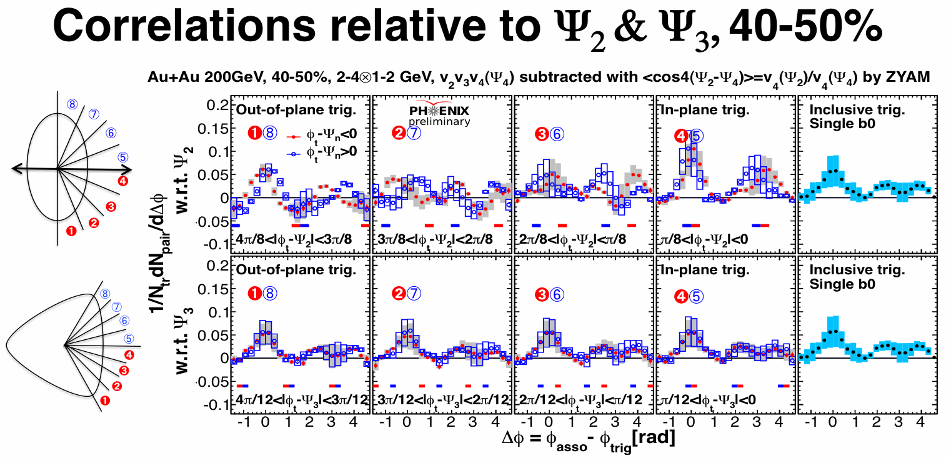
PHENIX, QM12
mid-central collisions
- strong Φ₂ dependence and left/right asymmetry coupling with geometry and/or expansion - almost no Φ₃ dependence (poor Φ₃ resolution)

Slide 20
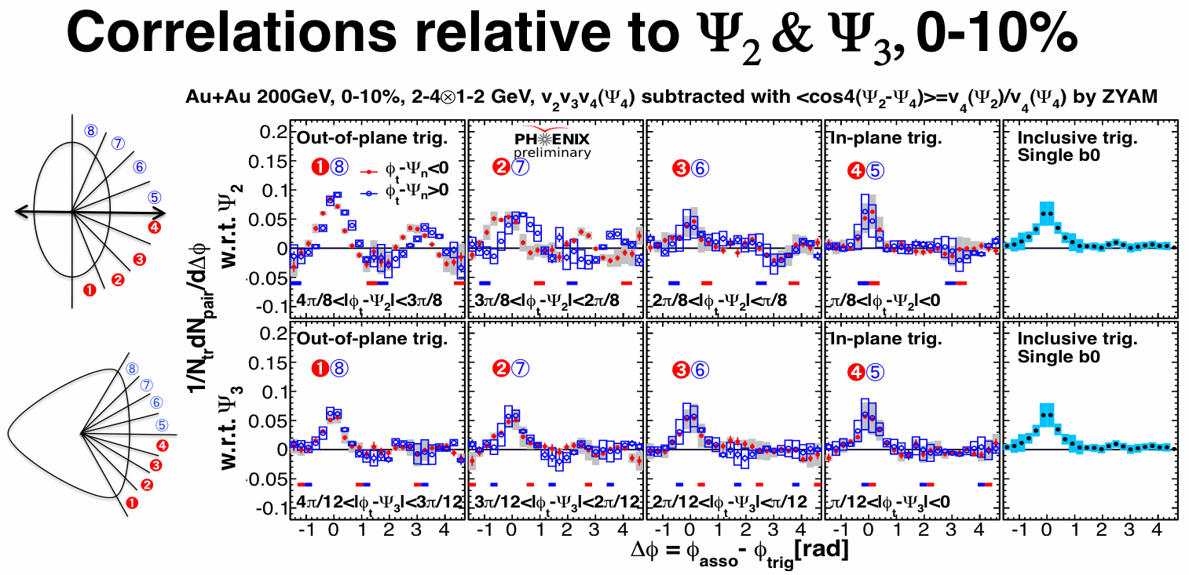
PHENIX, QM12
central collisions
- out-of-plane correlation enhanced
(strong jet quenching and collective expansion) - some weak Φ₃ dependence

Slide 21
Y(|∆η|>0.7) = back-to-back 2 ridges + away-side two-(left/right) Gaussian

