Slide 1
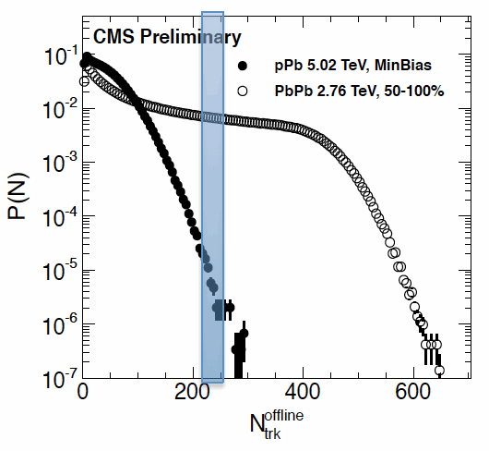
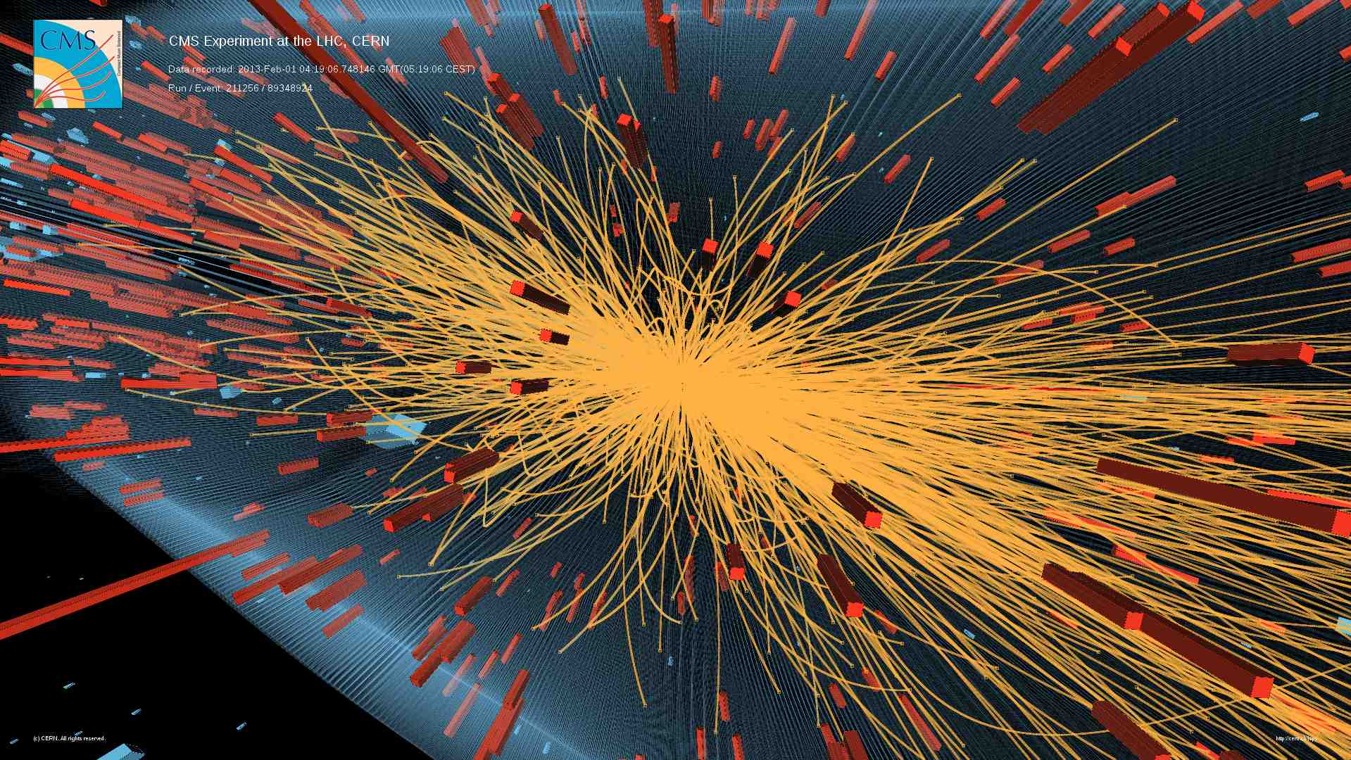
Jet, flow and correlation in pA and dA
ShinIchi Esumi, Univ. of Tsukuba
contents
Multiplicity, spetcra, R_{pA} and jets
Ridge-like correlation and flow

Slide 2
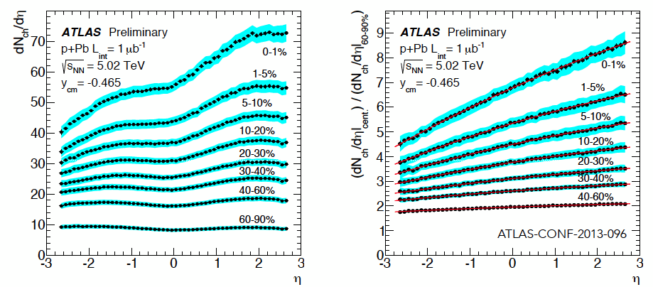
Multiplicity measurements from ATLAS
p
Pb
HP2013, S. Milov

Slide 3
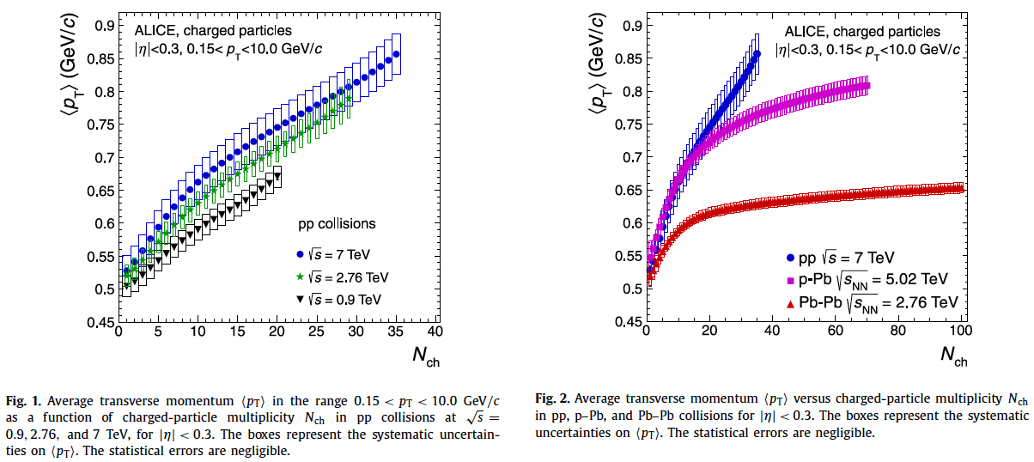
Mean p_{T} as a function of N_{ch}
PLB 727 (2013) 371-380

Slide 4
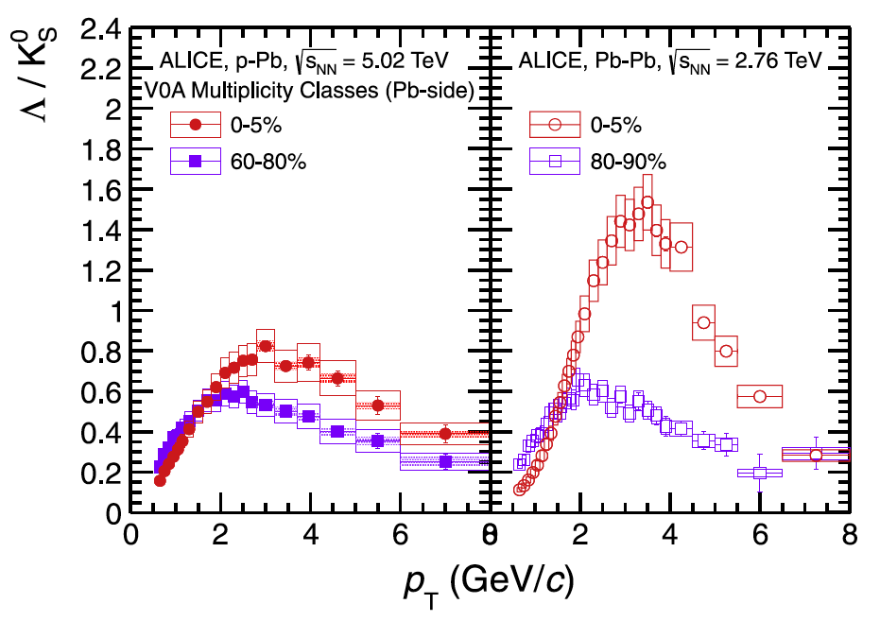
Baryon/Meson ratio
PLB 728 (2014) 25-38
flow, quark
coalescence

Slide 5
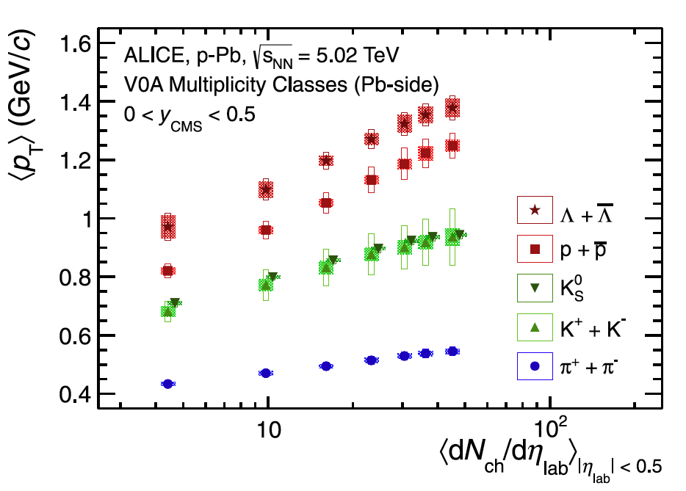
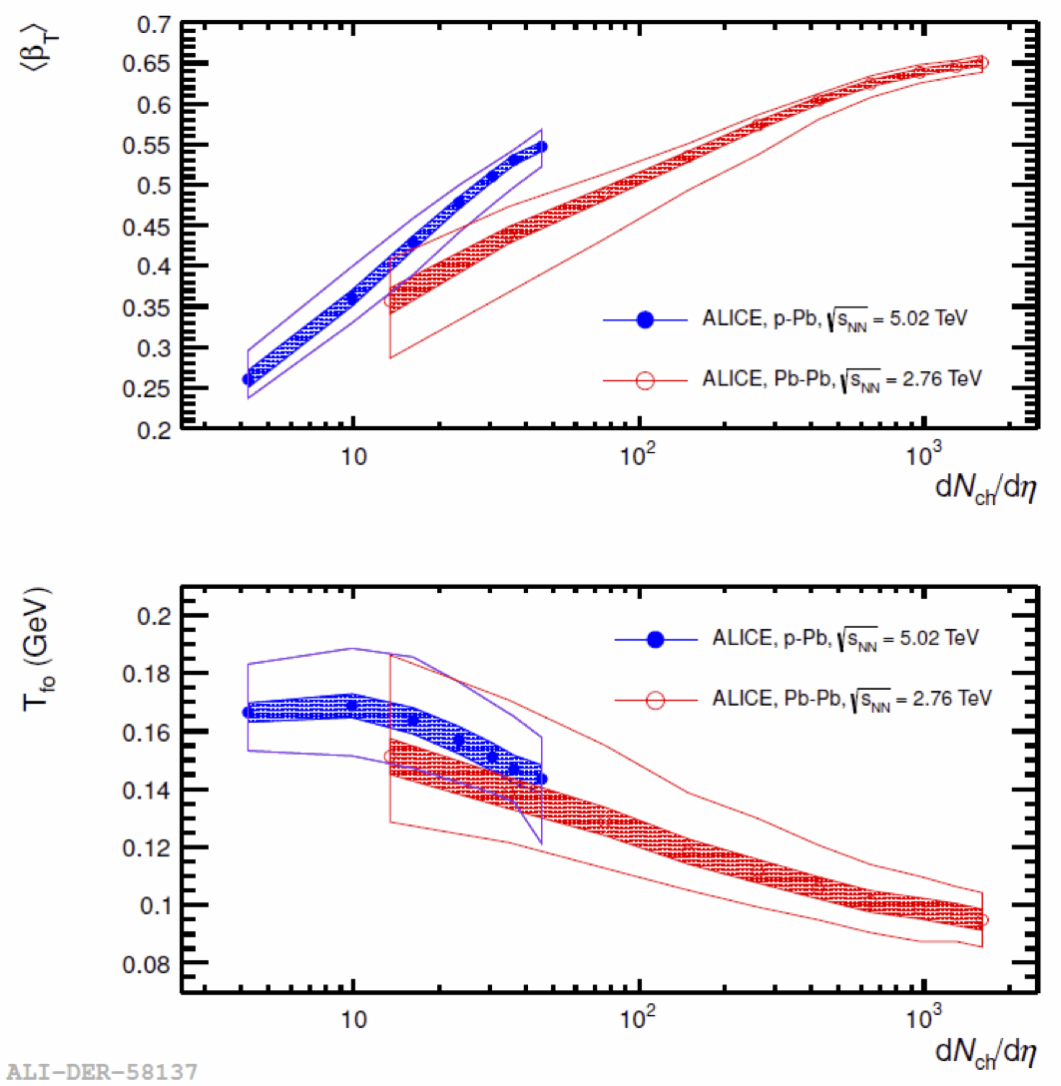
Hadron spectra
P+Pb
Pb+Pb
PLB 728 (2014) 25-38
Fitting on π, K, p, Λ spectra with
Blast-Wave (hydro inspired)
functional form to extract
freeze-out parameters ( T_{fo} , β_{T} )
NFQCD2013, J. Schukraft

Slide 6
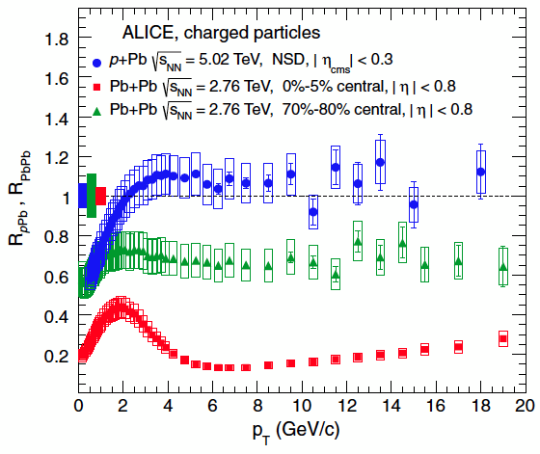
R_{pA} vs R_{AA}
PRL 110, 082302 (2013)
pA as a controlled experiment for comparison to AA
This provides that the suppression in AA is not an initial state effect

Slide 7
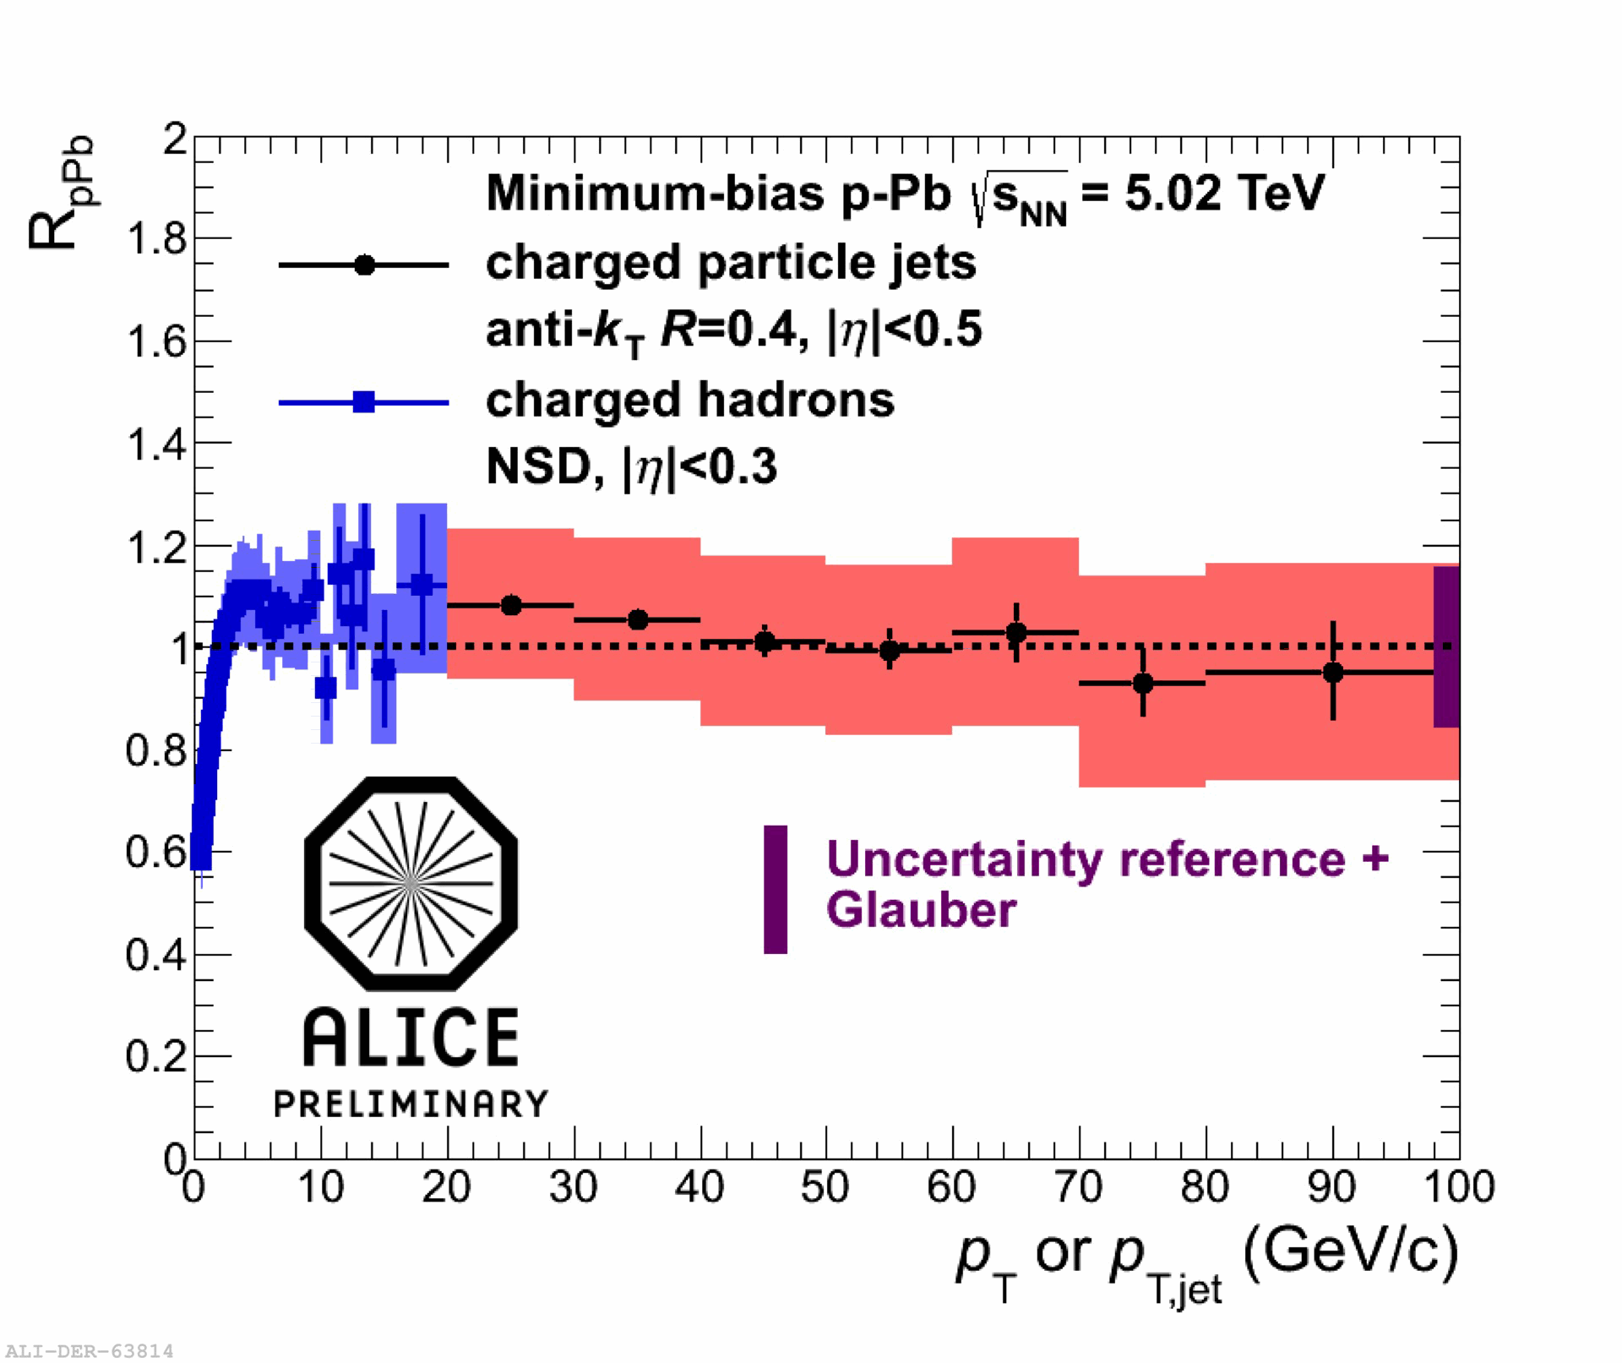
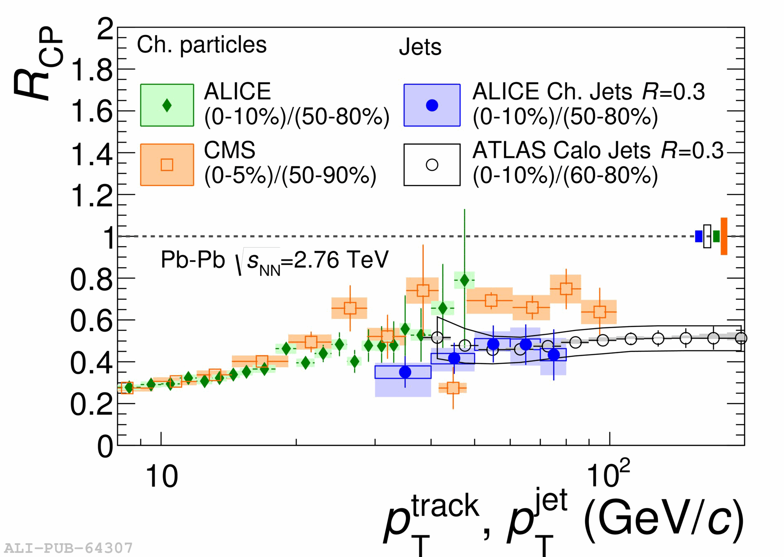
Jet R_{pPb} (p+Pb 5.02TeV) vs Jet R_{CP} (Pb+Pb 2.76TeV)
WWND2014, M. Verweij
No significant suppression of Jet observed for min. bias pPb at 5TeV

Slide 8

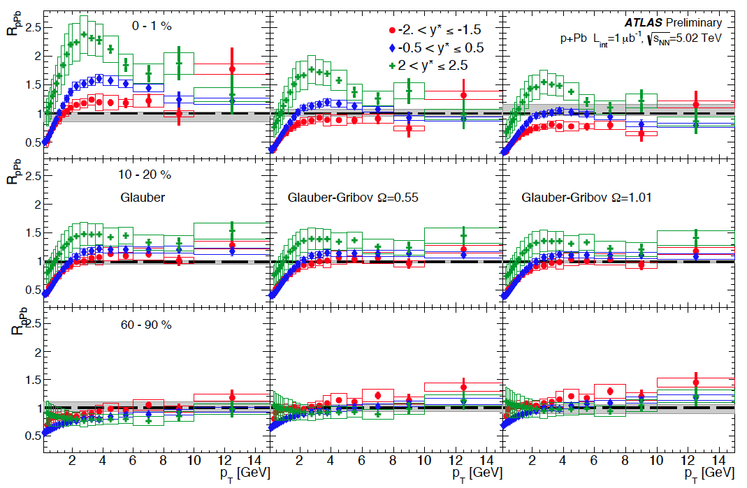
Centrality and η dependences
Glauber-Gribov
- color fluctuation (Ω)
p-side
Pb-side
HP2013, M. Spousta

Slide 9
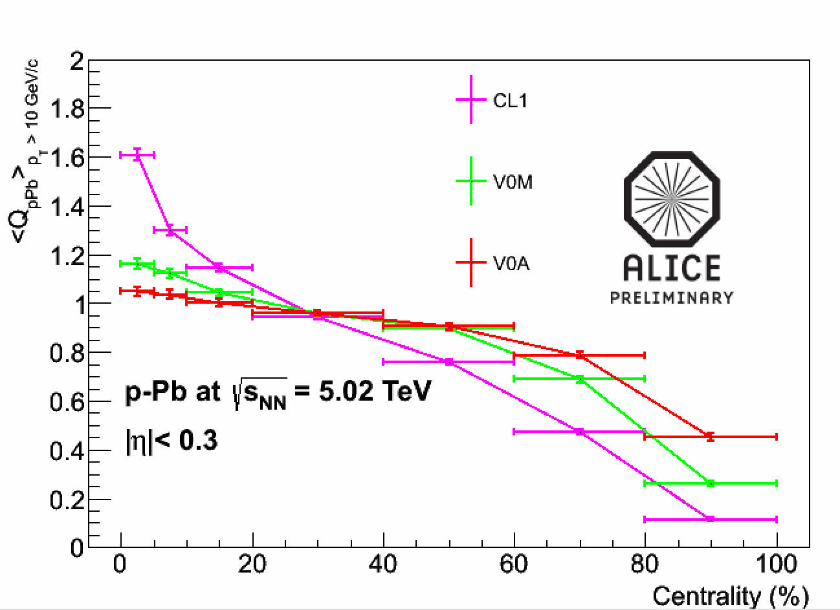
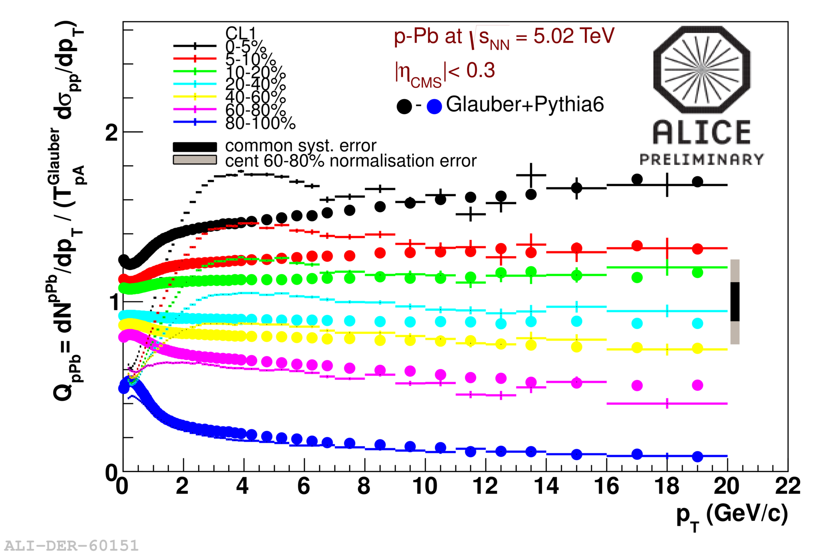
HP2013, C. Oppedisano
Centrality Bias Correction
(∝ 1/Q _{pPb})
pPb 5TeV Hijing arXiv:1310.4793

Slide 10
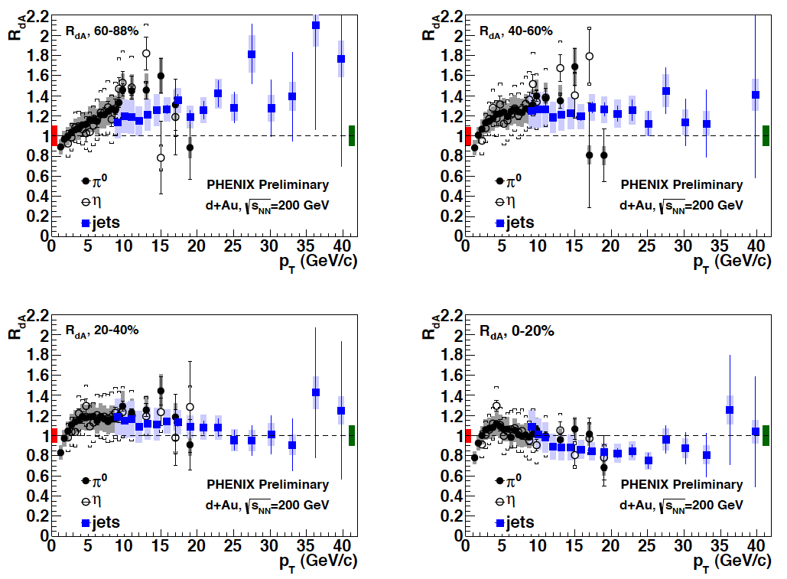
RHIC-PHENIX --- R_{dAu} of π⁰ and jet ---

Slide 11
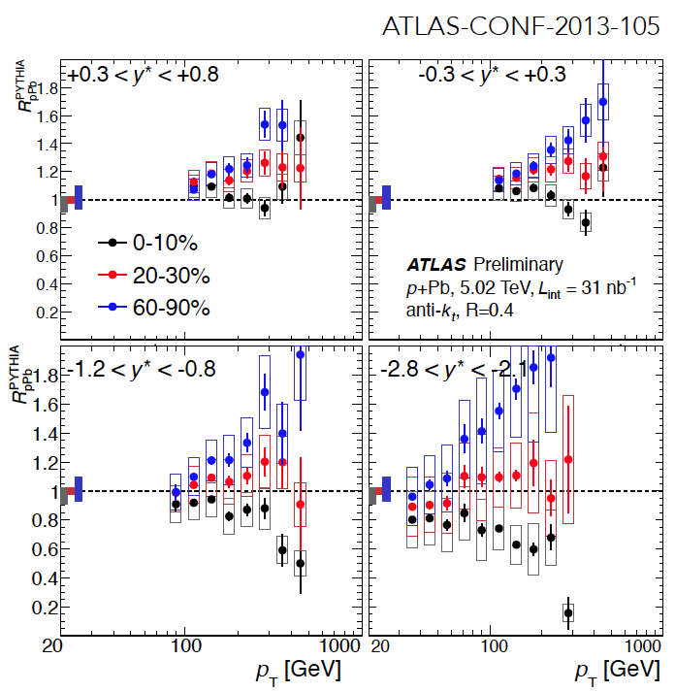
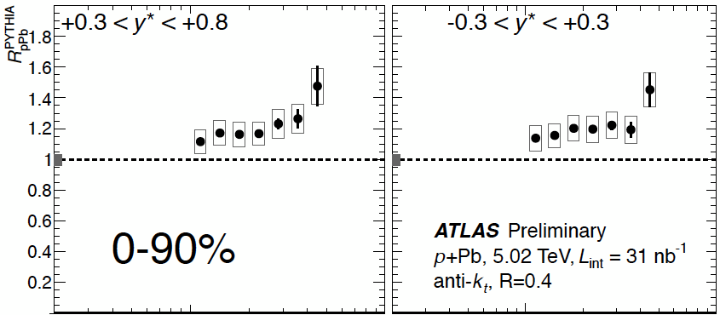
LHC-ATLAS --- R_{pPb} of jet w.r.t. pythia ---
HP2013, D.Perepelitsa

Slide 12
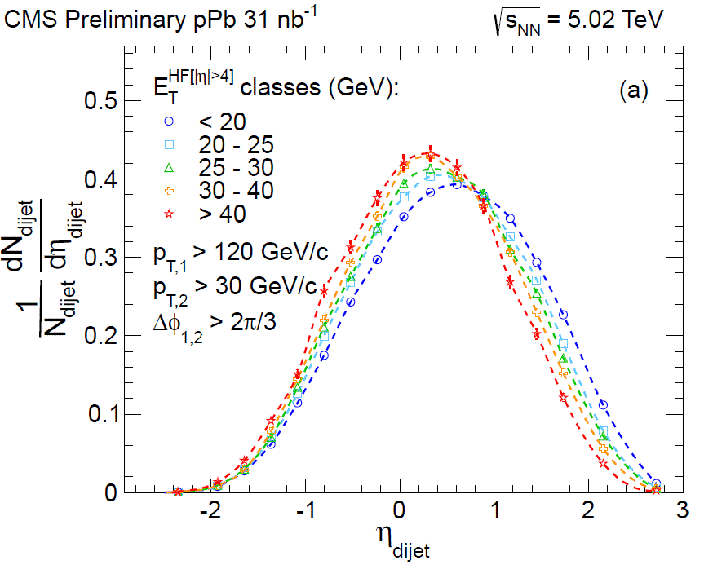
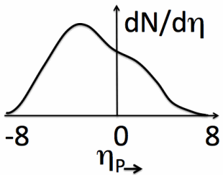
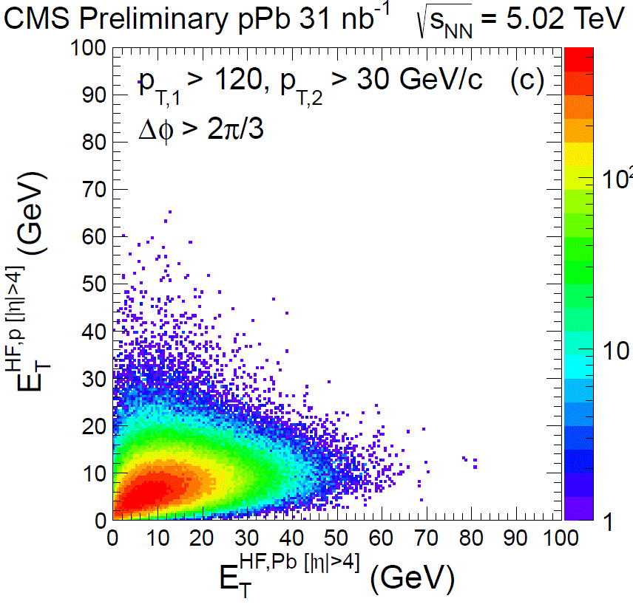
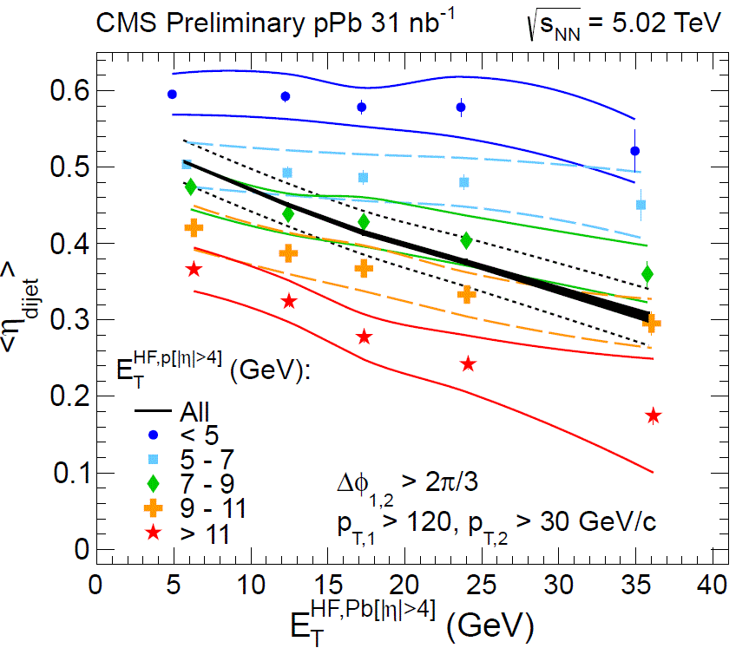
Di-jet η shift vs centrality
HP2013, D. Gulhan

Slide 13
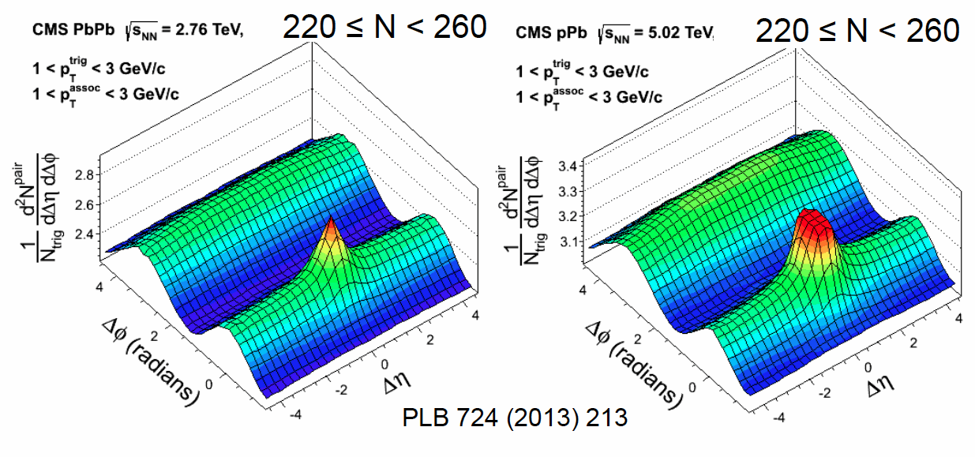
ridge/v_{n} between Pb+Pb and p+Pb
more jet-like

Slide 14
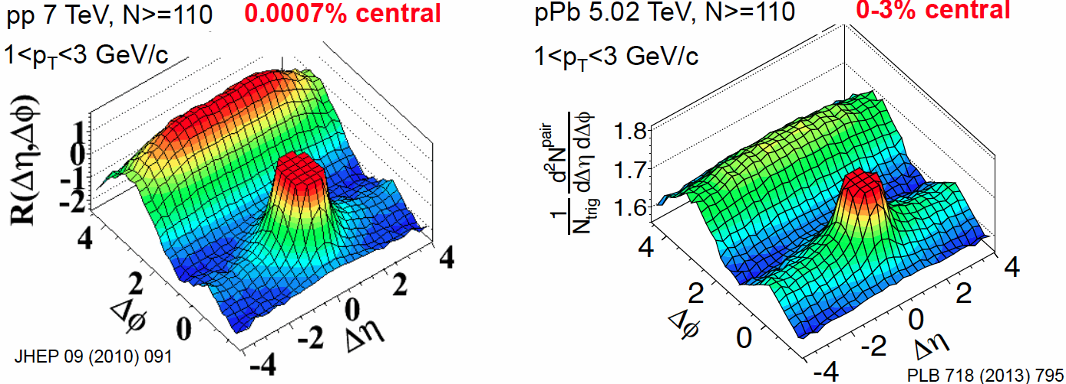
ridge/v_{n} between p+p and p+Pb
more jet-like

Slide 15
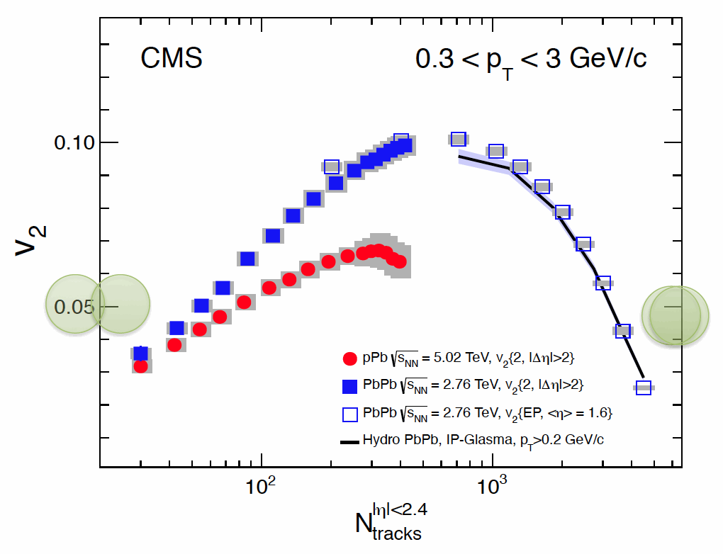
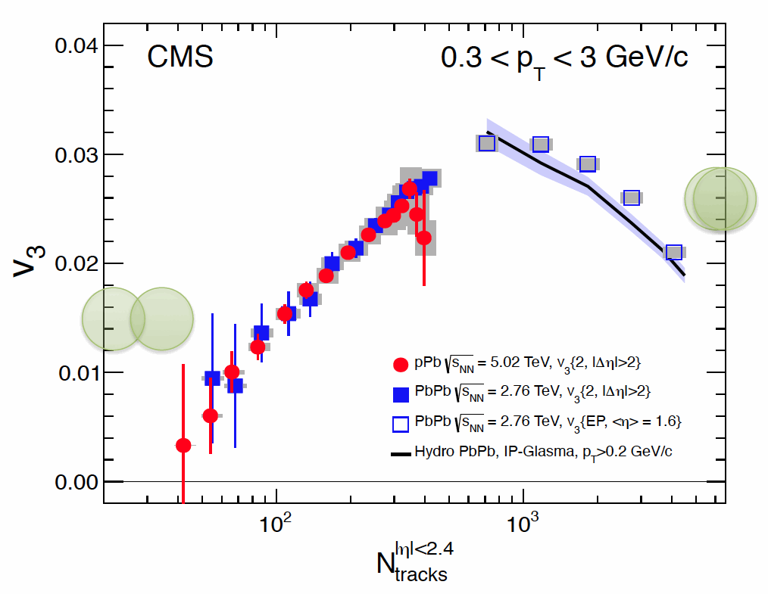
v₂ and v₃ between p+Pb and Pb+Pb --- CMS ---
HP2013, W. Li

Slide 16
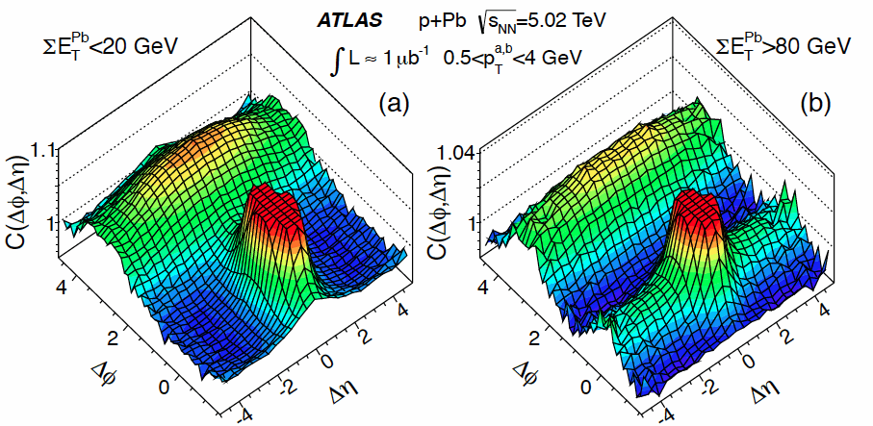
ridge/v_{n} between peripheral and central collisions
PRL110, 182302 (2013)

Slide 17
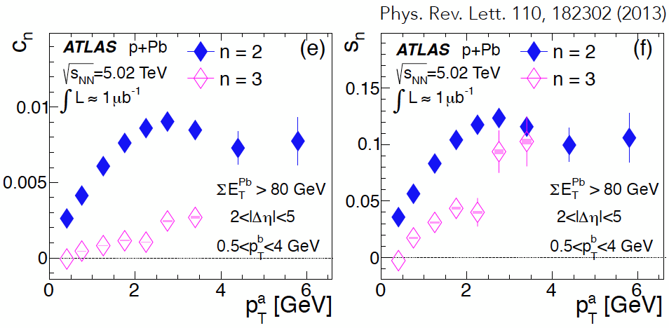
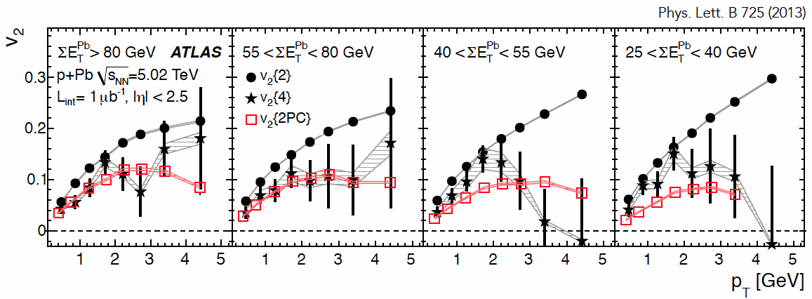
v₂ and v₃ in p+Pb
--- ATLAS ---
v₂ ∼ 10 %
v₃ ∼ 5 %
at p_{T} ∼ 2GeV/c
in central p+Pb collisions

Slide 18
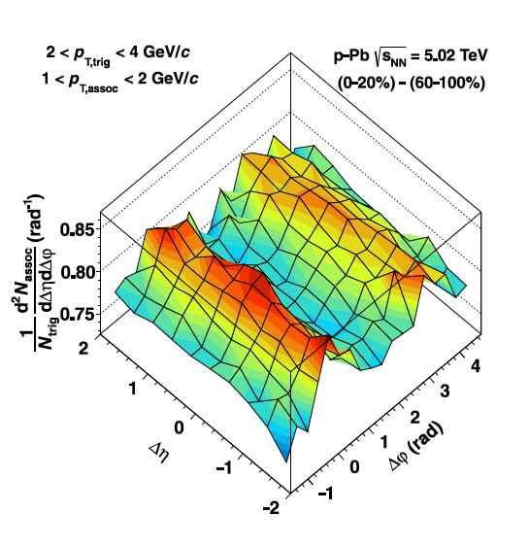
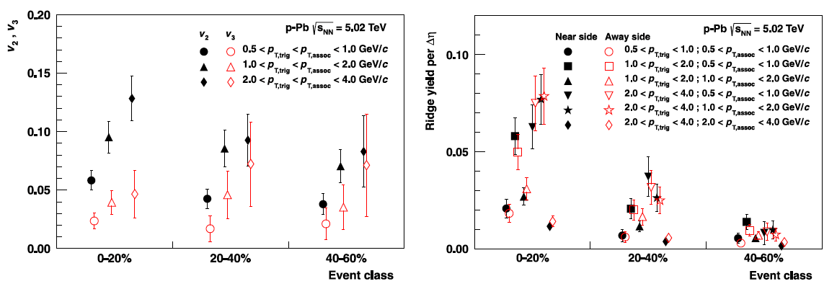
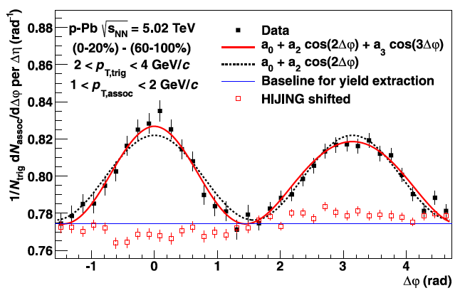
Double ridge in p+Pb
--- ALICE ---
Central – Peripheral subtraction of associate yield per trigger
Assumption : no change in jet shape
PLB 719 (2013) 29-41

Slide 19
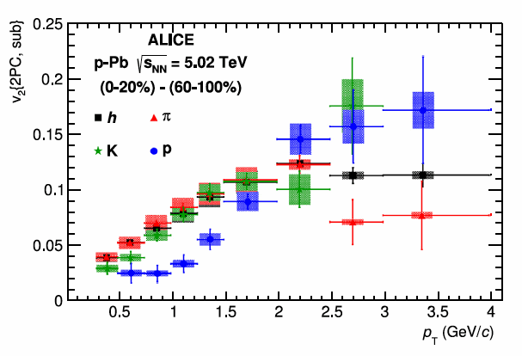
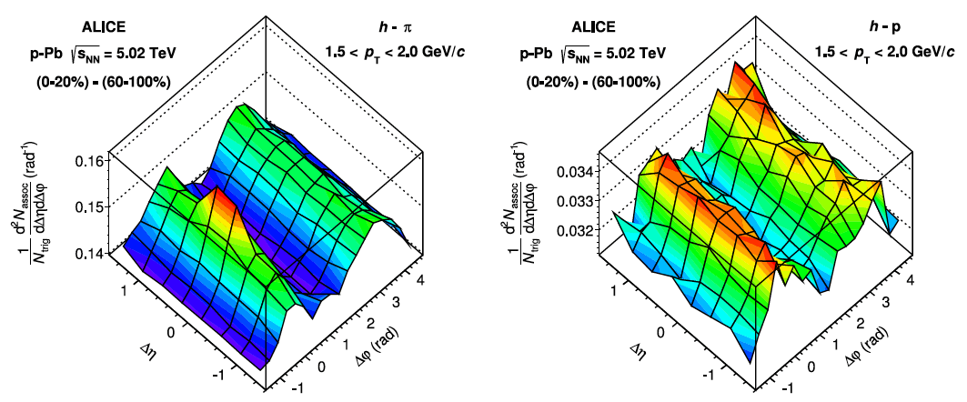
PLB 726 (2013) 164-177
Particle identified double ridge in pA
--- ALICE ---
similar to the “hydro-like” mass dependence of v₂(p_{T}) as seen in AA collision as well as the baryon-meson difference at middle p_{T} region

Slide 20
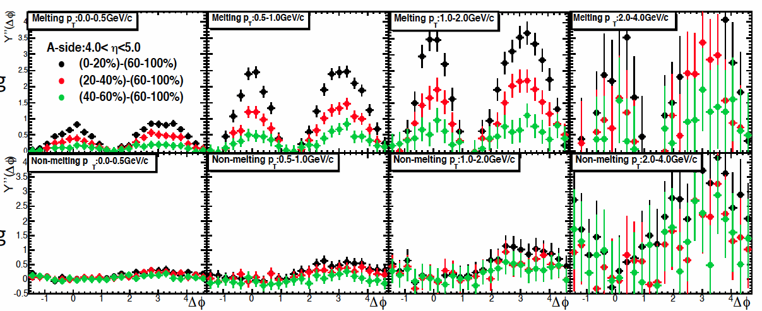
AMPT simulation p+Pb 5TeV (string-melting on/off)
for ALICE backward-central Δφ correlation (|Δη|=3∼6)
A-side : Pb-going side
C-side : p-going side
JPS 2014/Mar, Kazuki Oshima, Univ. of Tsukuba

Slide 21
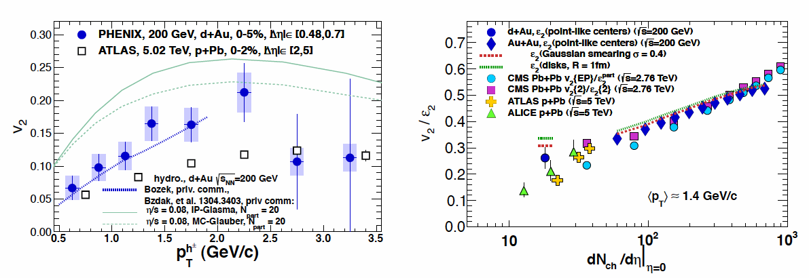
LHC-RHIC comparison (p+Pb 5TeV) – (d+Au 200GeV)
--- v₂(p_{T}) and v₂/ε₂(dN_{ch}/dη) ---
PRL 111, 212301 (2013)

Slide 22
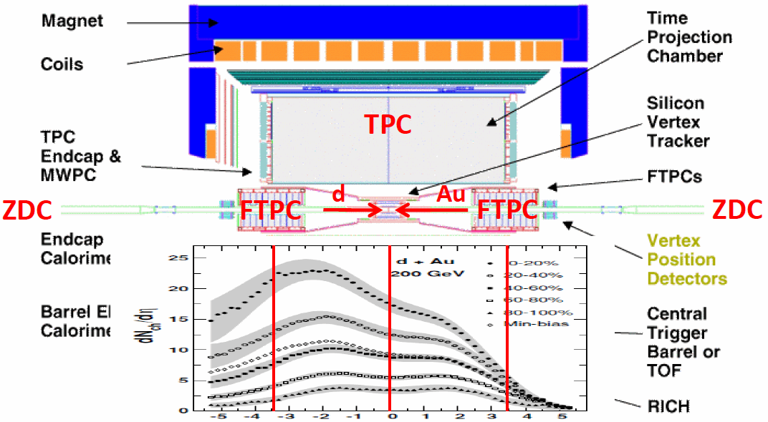
RHIC-STAR acceptance

Slide 23
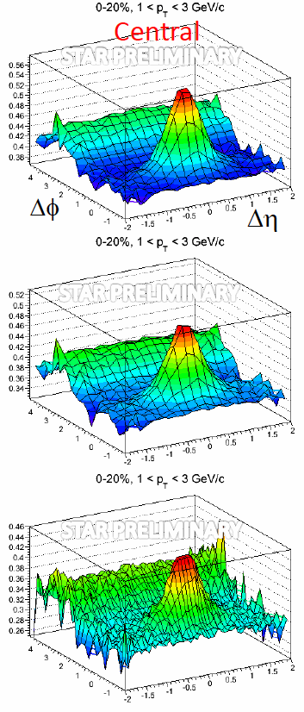
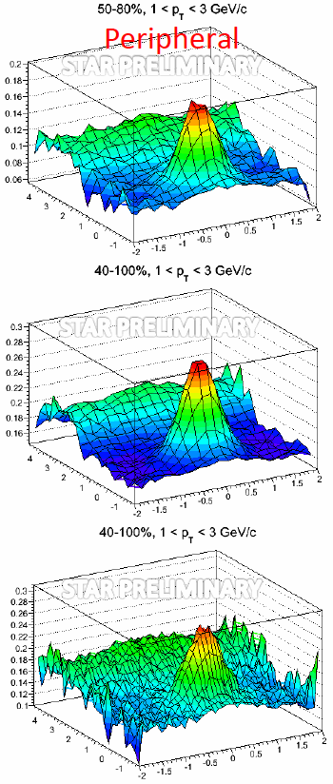
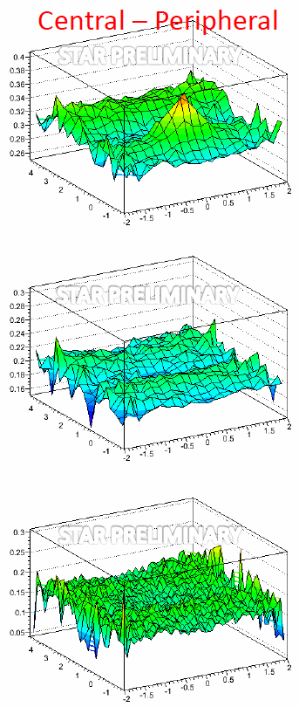
TPC-centrality |η|<1
FTPC-centrality -3.8<η<-2.8 (Au-side)
ZDC-centrality (Au-Side)

Slide 24
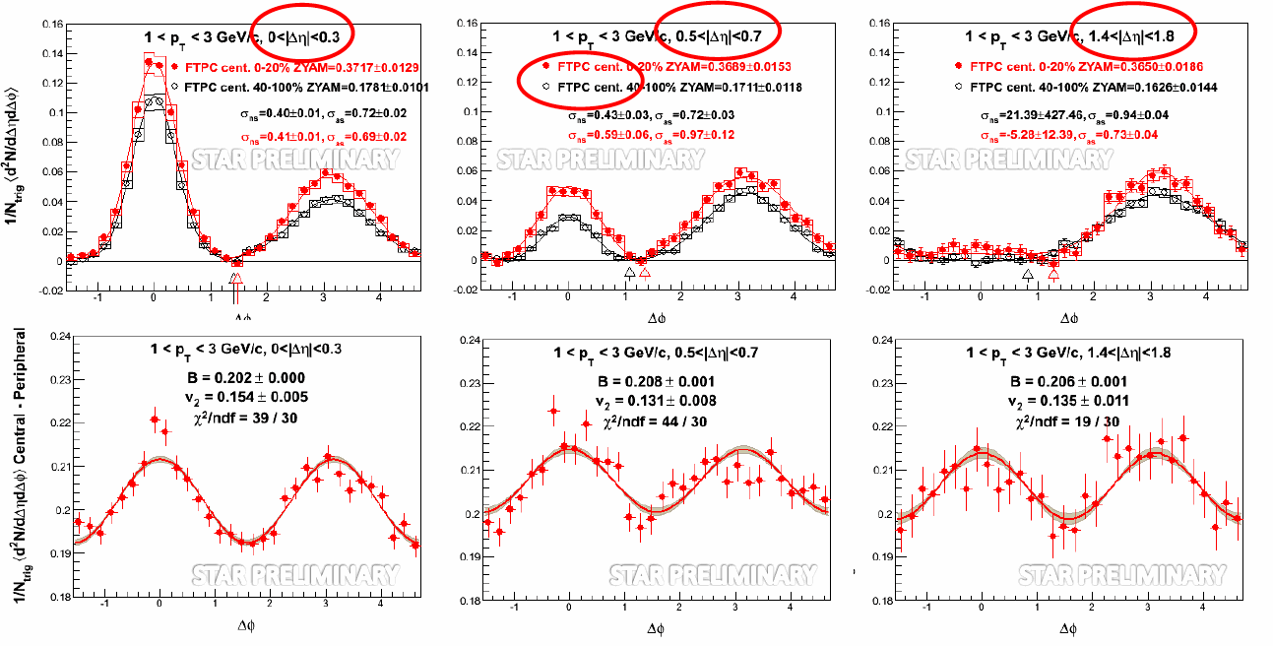
Δη dependence of Δφ correlation (central – peripheral)
--- RHIC-STAR ---
HP2013, F. Wang
|Δη| selection
central
peripheral
cent - peri

Slide 25
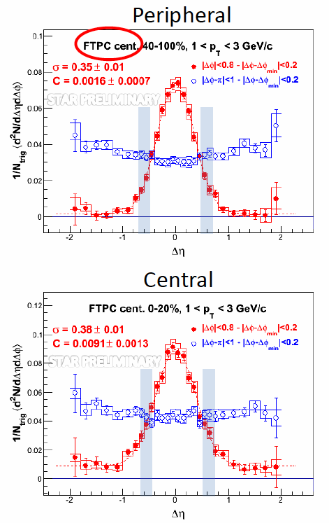
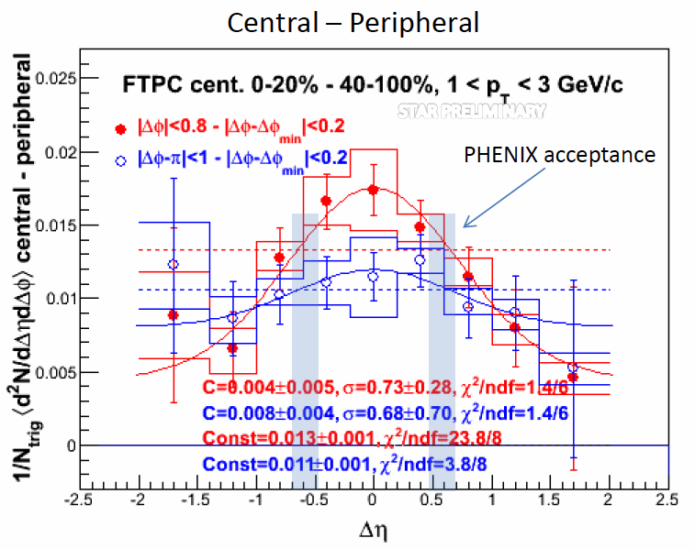
Δη correlation
(central – peripheral)
--- RHIC-STAR ---
HP2013, F. Wang

Slide 26
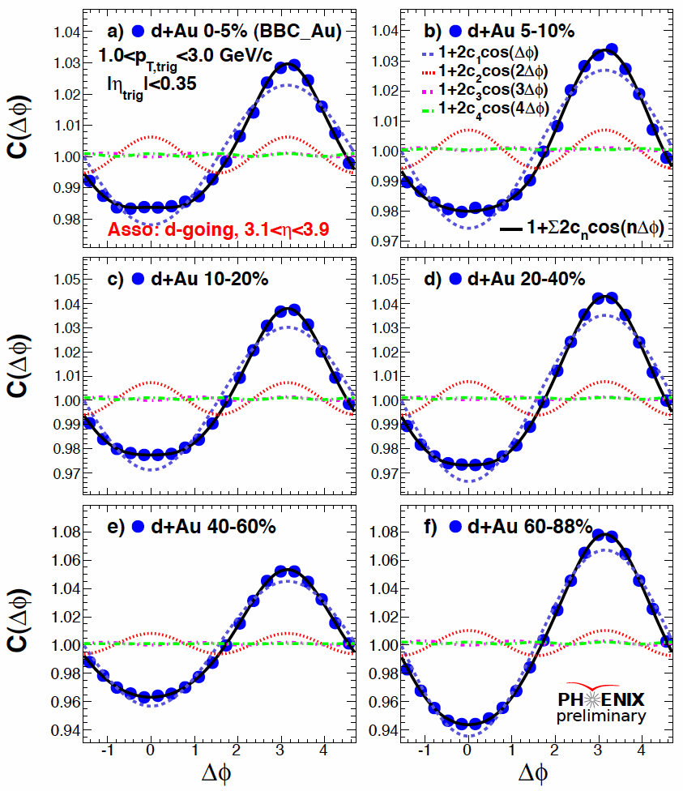
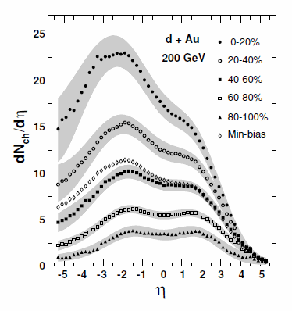
RHIC-PHENIX
Large Δη correlation
(1) central-forward
HP2013, S. Huang

Slide 27
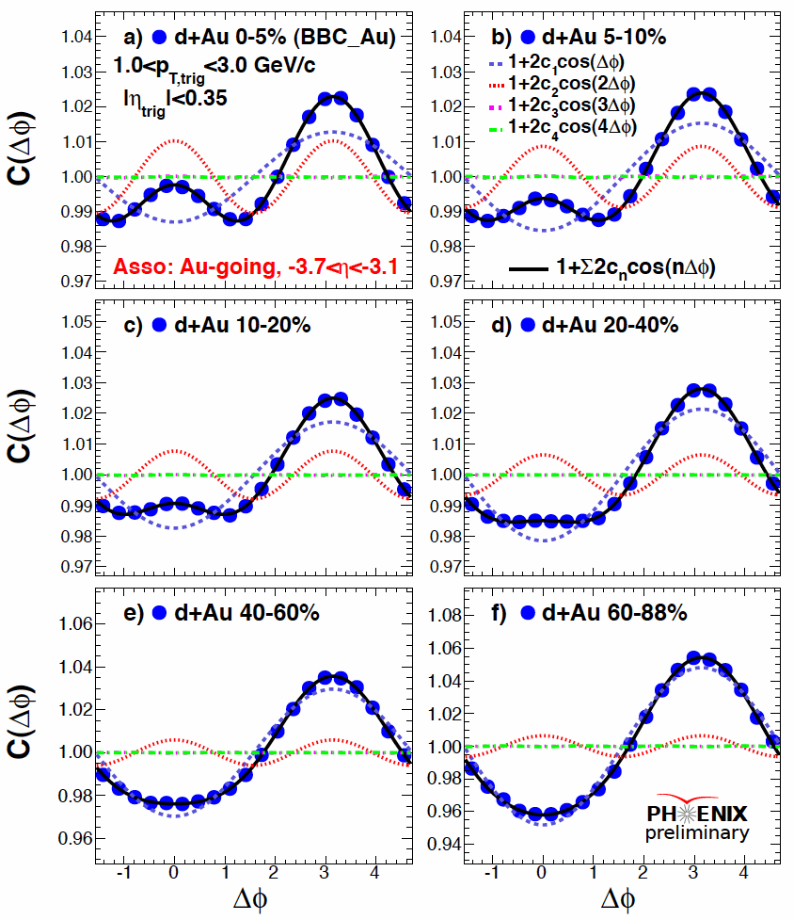
RHIC-PHENIX
Large Δη correlation
(2) central-backward
HP2013, S. Huang

Slide 28
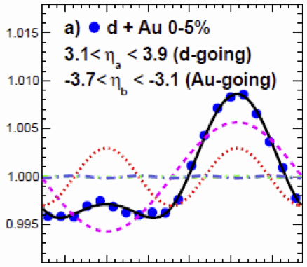
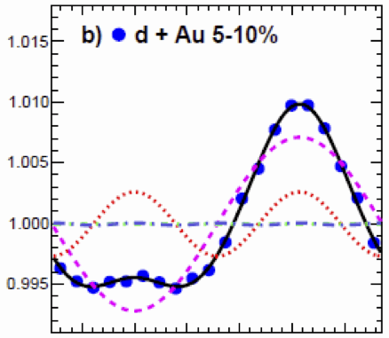
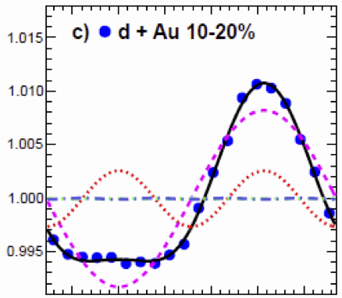
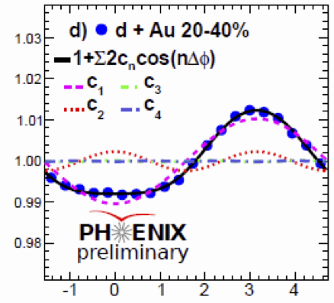
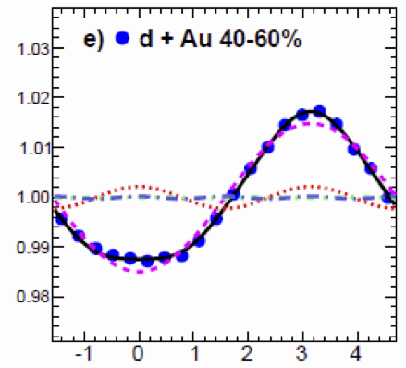
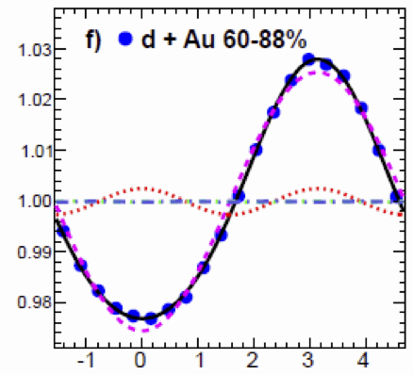
RHIC-PHENIX
Large Δη correlation
(3) forward-backward
C(Δφ)
C(Δφ)
C(Δφ)
HP2013, S. Huang
Δφ
Δφ

Slide 29

p_{T} dependence of central-backward correlation
in d+Au and p+p collisions at 200GeV
HP2013, S. Huang
p_{T} bin
d + Au 0–5%
p + p

Slide 30


v₂ measured w.r.t. forward Φ_{E.P.}in d+Au 200GeV
comparison to v₂{2PC}
comparison to LHC p+Pb
d+Au
|Δη|∼0.5
p+Pb
|Δη|∼3
HP2013, S. Huang

Slide 31


v₂ of identified particles in p+Pb and d+Au
PLB 726 (2013) 164-177
HP2013, S. Huang

Slide 32
Summary
Multiplicity, spetcra, R_{pA} and jets
Ridge-like correlation and flow

