Slide 1
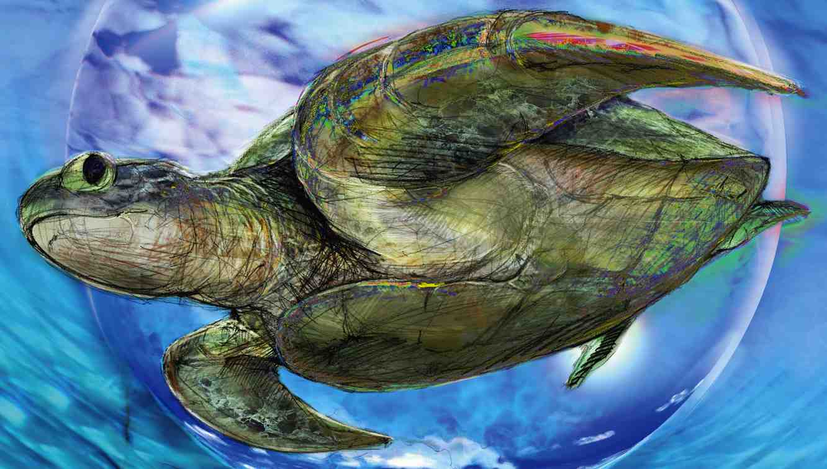
Study of Hot QCD matter at RHIC and LHC
ShinIchi Esumi, Inst. of Physics, Univ. of Tsukuba
Contents
Temperature
Energy loss
Collective flow
Critical point

Slide 2
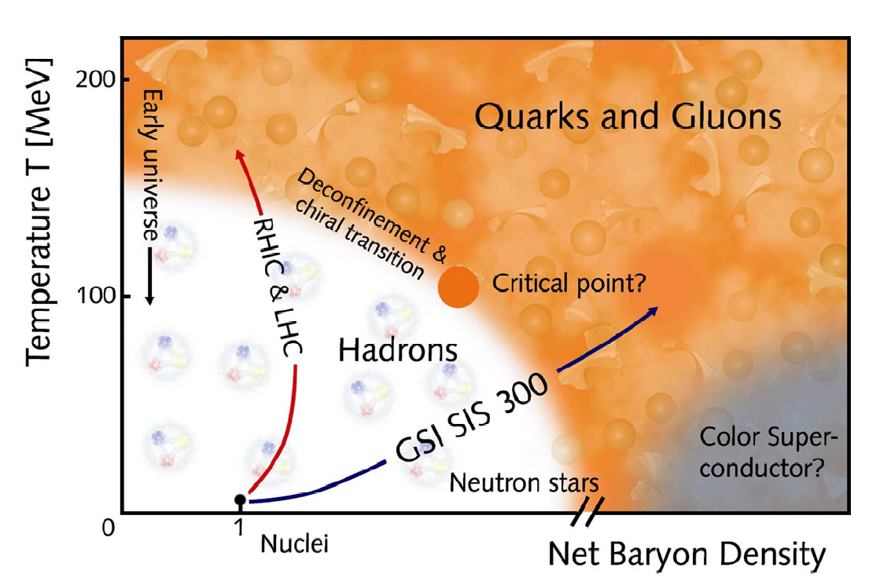
Hadronic Phase -> Partonic Phase
LHC
Partonic Phase
RHIC
FAIR J-PARC
Phase Transition
Hadronic Phase

Slide 3
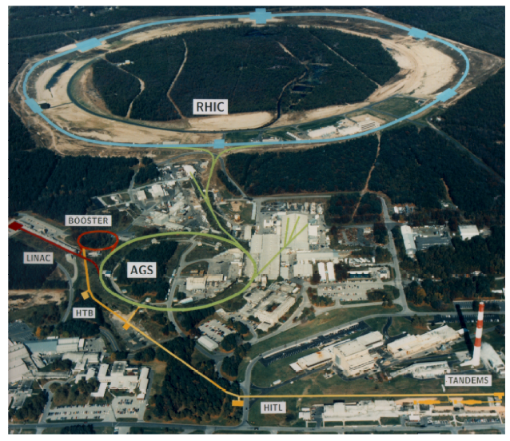
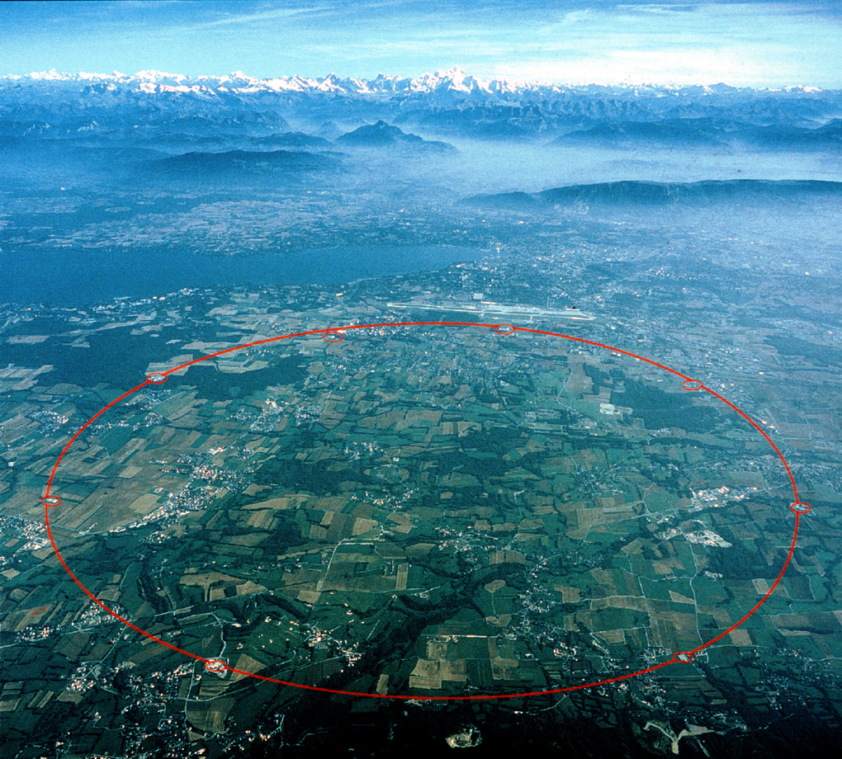
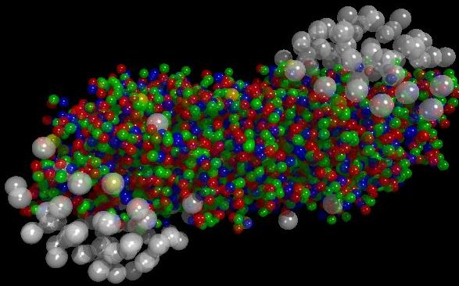
RHIC at BNL, sqrt(s_{NN}) = 10 - 200 GeV/c (New York, USA)
LHC at CERN, sqrt(s_{NN}) = 0.5 - 5.5 TeV/c
(Geneva, Switzerland)
Colliding Nucleus
Colliding Nucleus

Slide 4
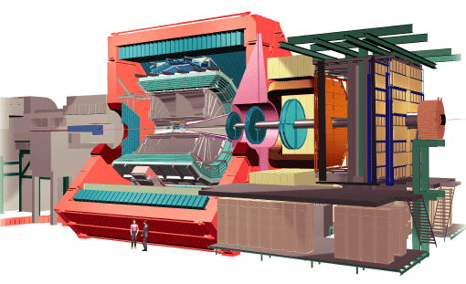
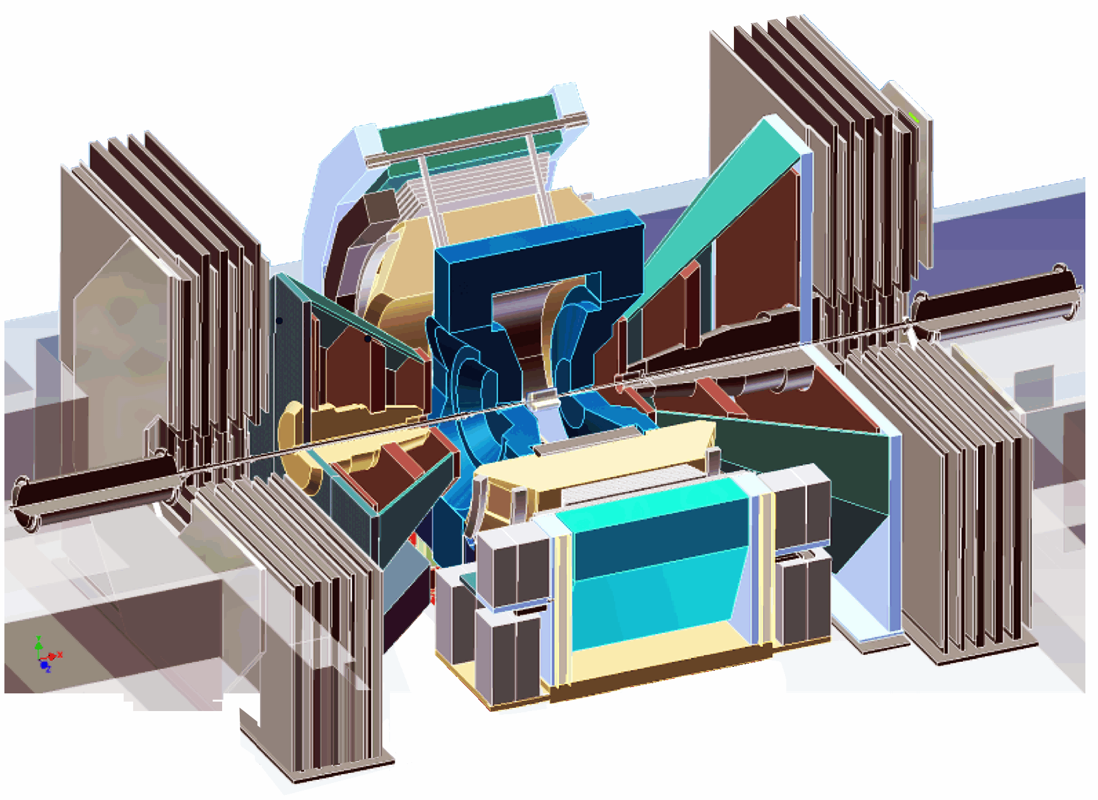
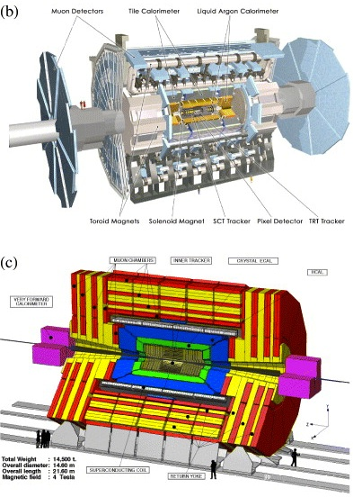
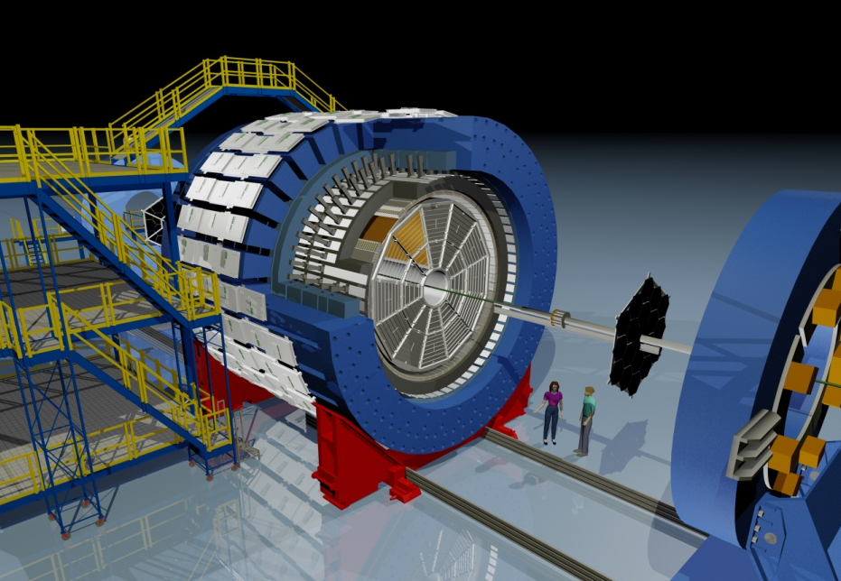
Experiments at RHIC and LHC
ALICE
PHENIX
ATLAS
STAR
CMS

Slide 5
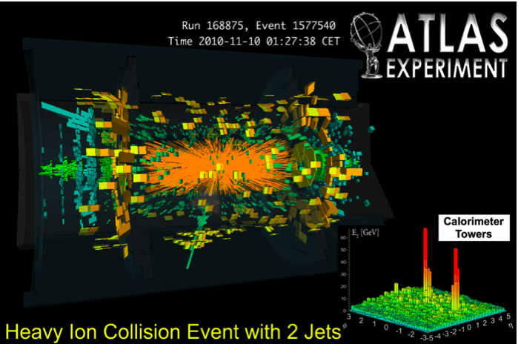
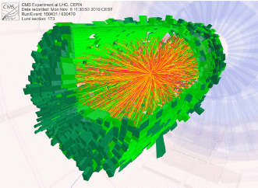
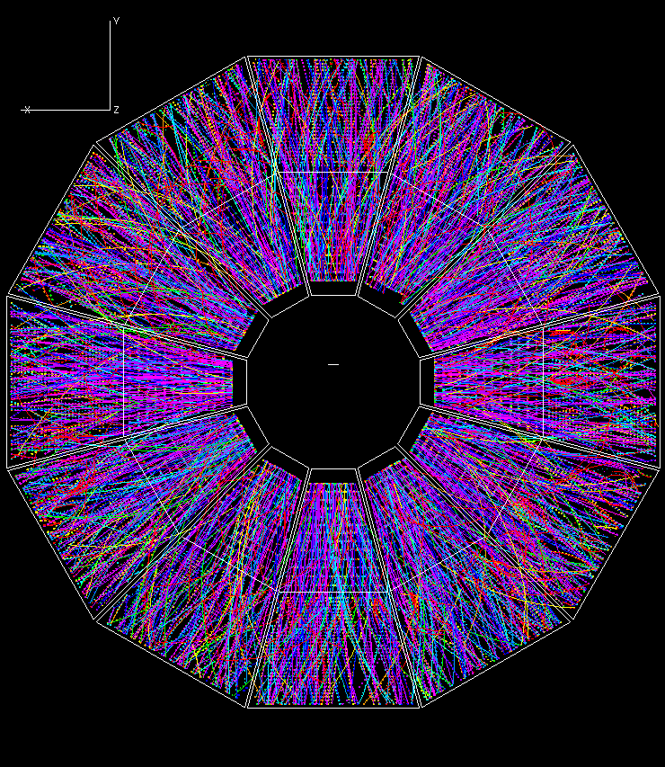
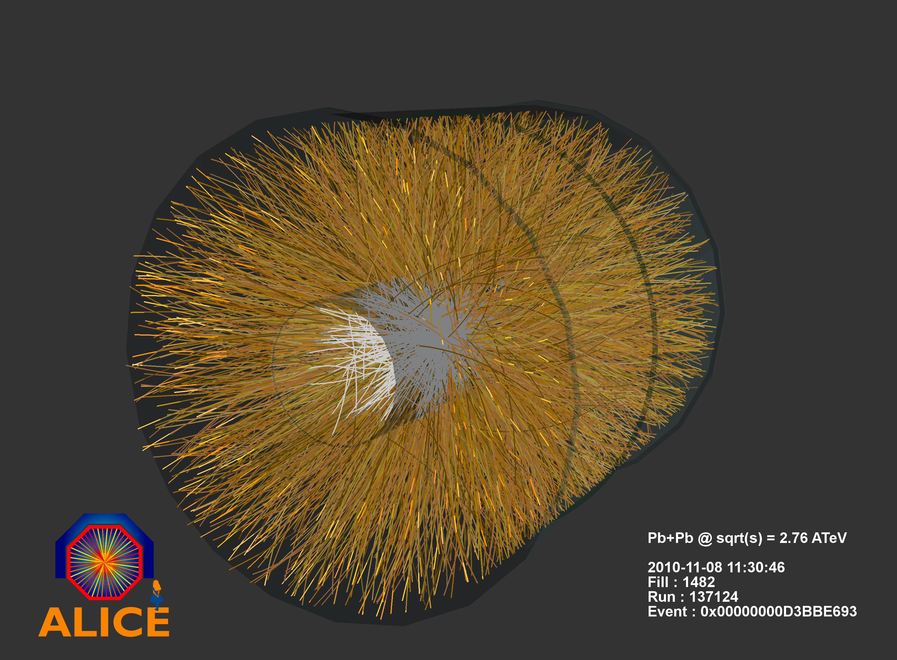
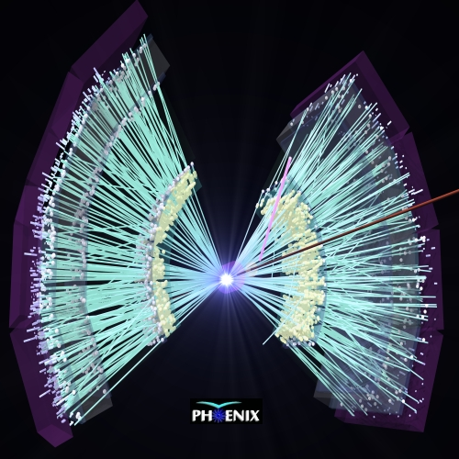
STAR
CMS
Experimental data
a few k to 10k particles per collision
PHENIX

Slide 6
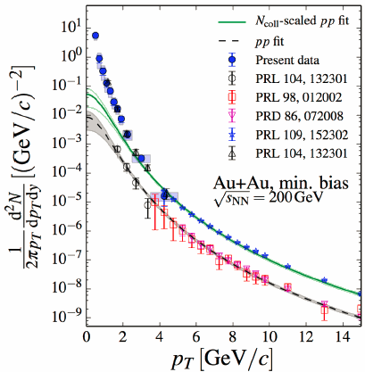
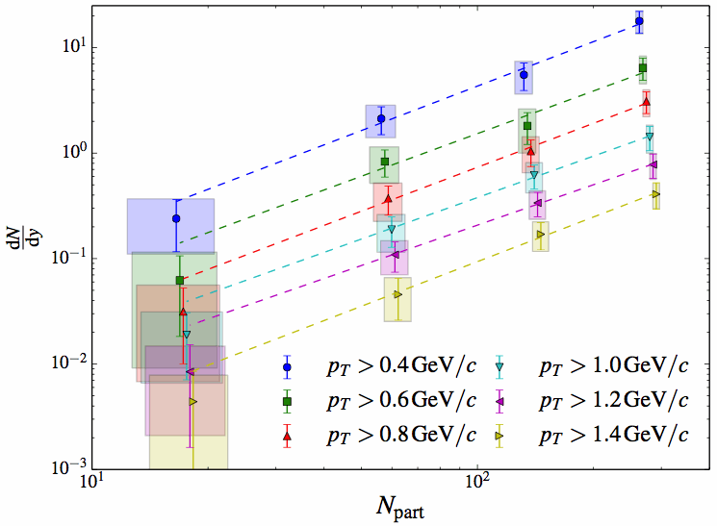
Enhanced thermal photon production at low p_{T}
Virtual and real photon measurements via internal and external conversion methods with electron pair measurements
Real photon measurements with EMcal
Initial temperature of 300∼600MeV
AuAu
arXiv:1405.3940
independent slope w.r.t. centrality
yield ~ N_{part}^{1.5}
pp
dN / dy
N_{part}

Slide 7
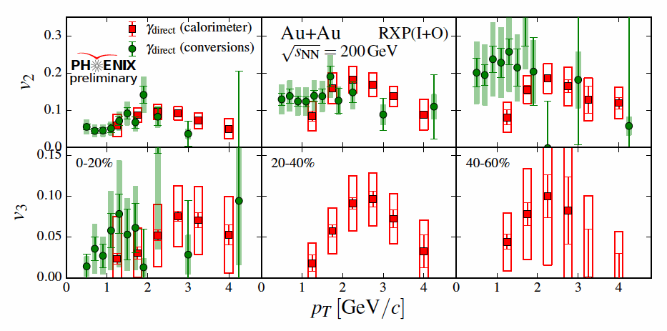
v₂
v₃
Direct (thermal) photon v₂ and v₃
v_{n} = < cos n(φ ^{particle} - Φ_{n}^{plane}) >
(n=2 : elliptic flow), (n=3 : triangular flow)
v₂
v₃
PHENIX, QM14
comparable to hadron for both v₂ and v₃ at 2∼3GeV/c
significant contribution from photons from later stages (inconsistent with early photons from hotter period)
flatter p_{T} dependence of v₂ at low p_{T}

Slide 8
History of temperature before/after the phase transition
Initial temperature :
Direct thermal photon measurement
initial temperature
Chemical Freeze-out temperature :
Particle species, ratios are fixed
at the end of inelastic interactions
critical point
Thermal Freeze-out temperature :
Particle spectra are fixed
at the end of elastic interactions
Critical Point :
1st order phase transition
non-monotonic behavior
expected fluctuation to diverge

Slide 9
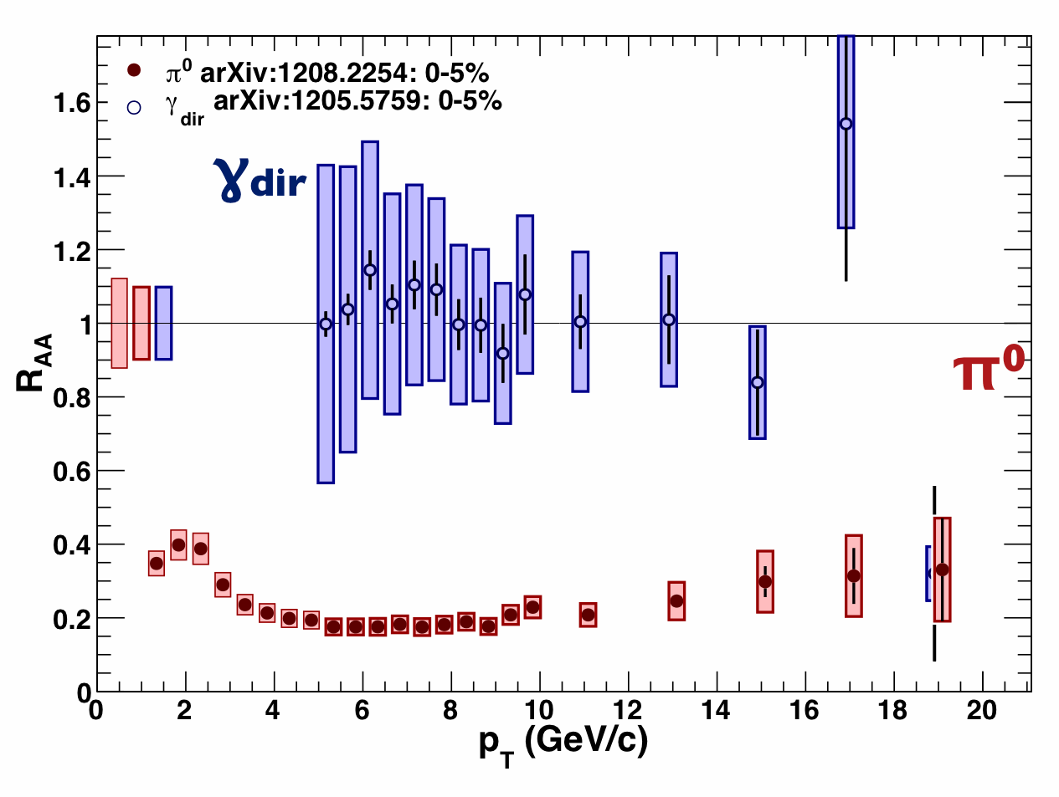
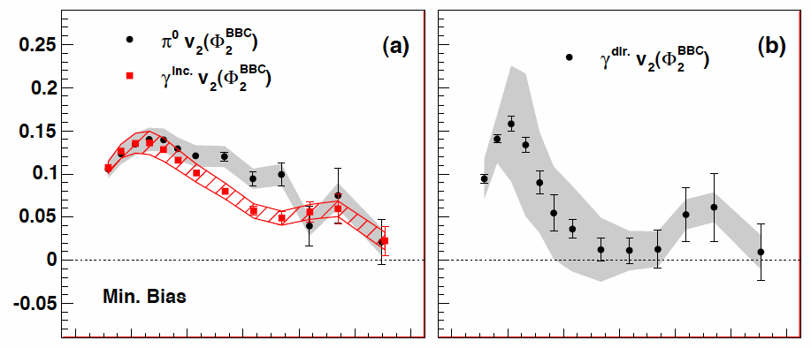
High p_{T} direct photon
as penetrating probe
PRL 109 (2012) 152302
γ
R_{AA}
p_{T} > 5 GeV/c | hadron | γ^{dir}
R_{AA} | < 1 | ∼ 1
v₂ | > 0 | ∼ 0
π⁰
^{(surface)}
v₂
PRL 109 (2012) 122302
R_{AA} =
N (A+A)
N_{coll} N(p+p)
π⁰
γ^{dir}
relative yield with respect to a simple independent superposition of pp data
γ^{inc}
2.76TeV Pb+Pb

Slide 10
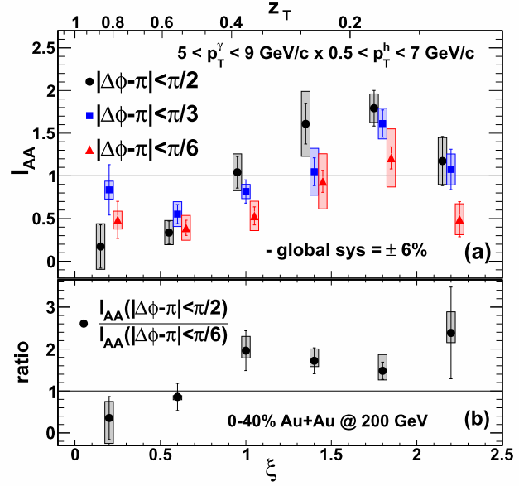
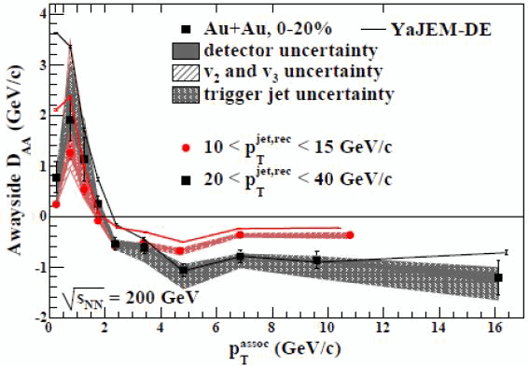
Energy loss at high p_{T} and re-distribution of the lost-energy at low p_{T} at RHIC
jet
γ
prompt photon - hadron correlation
N_{PTY} = associate hadron yield per trigger γ
I_{AA} = N_{PTY}(AA) / N_{PTY}(pp)
h
h
Low p_{T} enhancement
PRL 111 (2013) 032301
jet - hadron correlation
S_{PT} = associate hadron p_{T} sum per jet
D_{AA} = S_{PT}(AA) - S_{PT}(pp)
PRL 112 (2014) 122301
High p_{T}
Low p_{T}
High p_{T} suppression

Slide 11
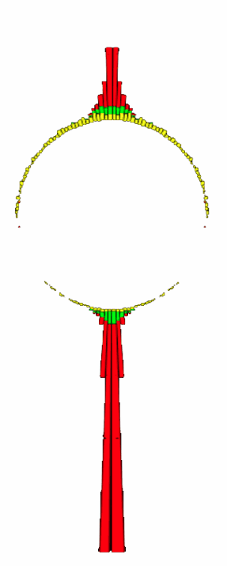
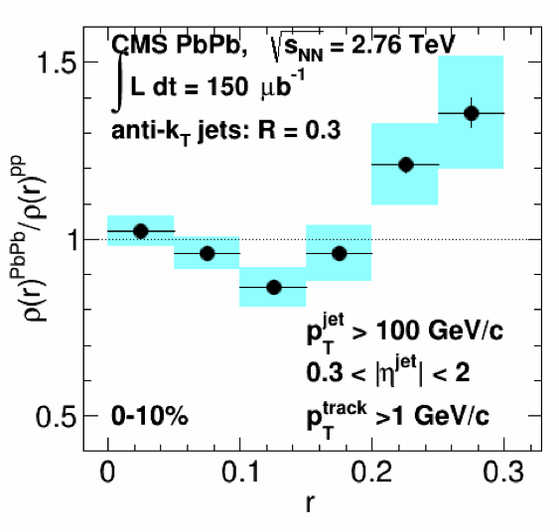
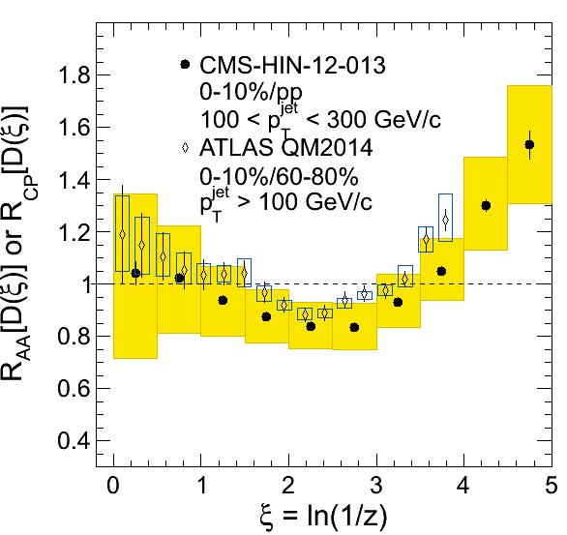
Modification of jet F.F. at LHC
re-distribution to lower p_{T} and to larger angle
CMS QM2014
Phys. Rev. C 90 (2014) 02490

Slide 12
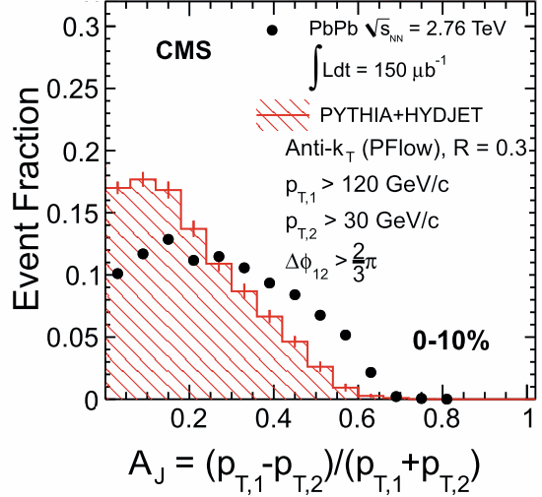
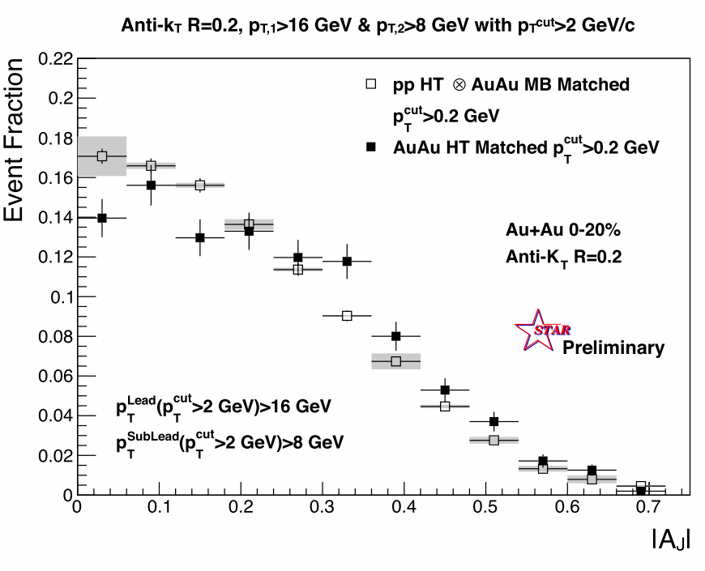
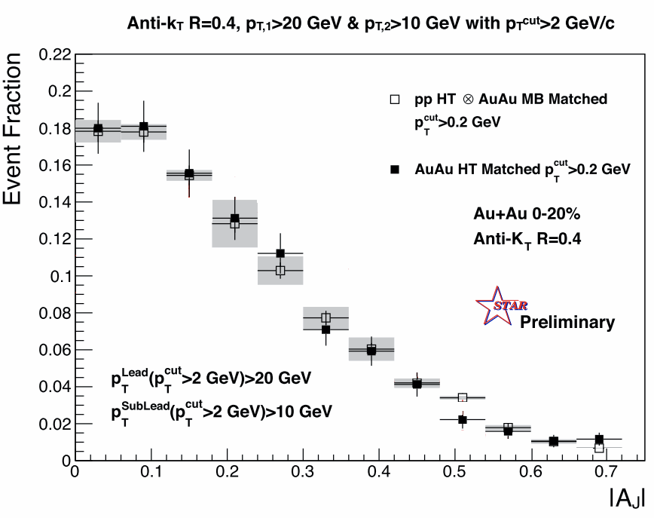
Jet quenching at RHIC vs LHC
(A_{J} : di-jet energy asymmetry)
Jet₁
(p_{T,1})
R∼0.2
R∼0.4
in (φ,η)
visible effect with smaller jet cone R∼0.2 at RHIC
lower jet energy than LHC, smaller effect than LHC
mostly recovered jet energy within larger jet cone R∼0.4
Somewhat contradicting with large angle emission of low p_{T} particles (jet selection bias…)
P_{T,1} − P_{T,2}
P_{T,1} + P_{T,2}
A_{J} =
Jet₂
(p_{T,2})
The difference is mostly gone.
STAR, QM14

Slide 13
jet-suppression by partonic energy loss
and/or modification of fragmentation function
(These two can not be clearly separated experimentally!)
Closer and closer to
the initial parton energy
Gamma
Jet (large R)
Jet reconstruction is to recover the lost energy to get the original parton depending on parameters.
Jet as a control tool to define path length
quark/gluon contribution should also be considered
Jet (+hadron)
Jet (small R)
π⁰ (hadron)
QGP
more and more surface bias
given by energy loss
center
surface

Slide 14
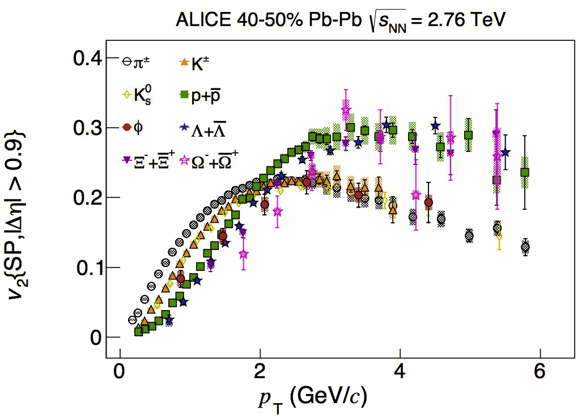
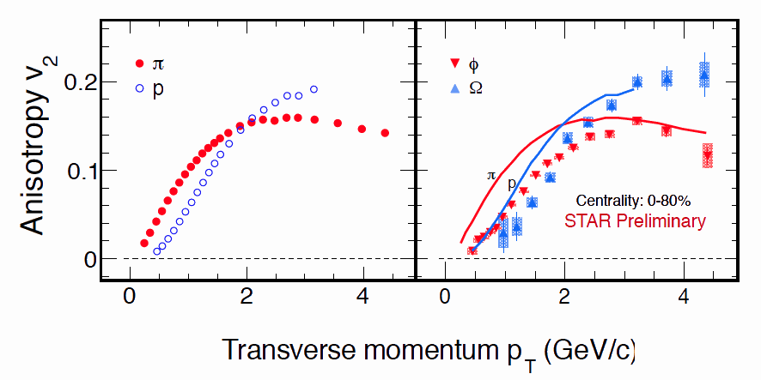
Elliptic flow with PID at RHIC and LHC
arXiv:1405.4632
baryon
High statistics measurements allow a precise comparison of v₂(p) and v₂(φ).
Some small deviation from hydro-like mass dependence of v₂ at low p_{T}
φ puzzle between peripheral and central at LHC
meson
2.76TeV Pb+Pb
p_{T} (GeV/c)
qq
qqq
200GeV Au+Au
ss
sss
baryon
meson
Number of quark scaling as a signal of partonic phase
STAR, QM14

Slide 15
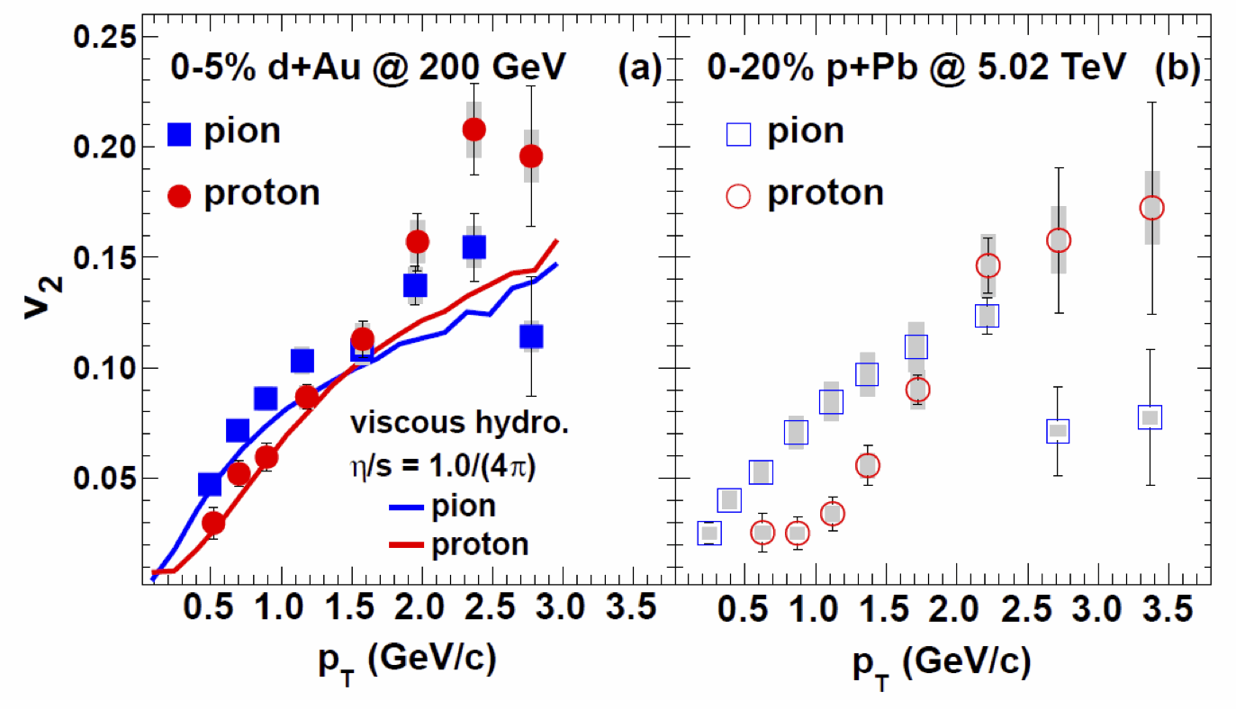
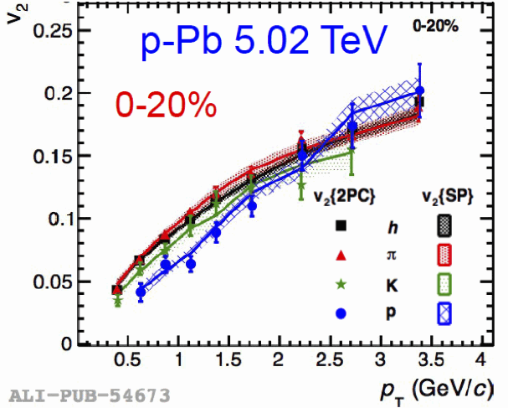
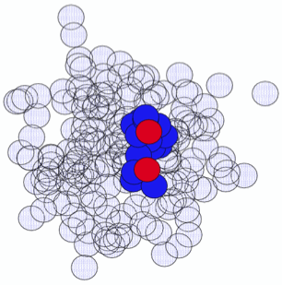
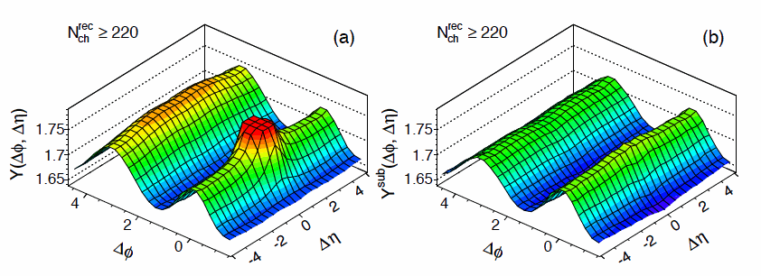
Elliptic flow in a small system?
d+Au in Glauber model
peripheral subtraction
peripheral subt.
arXiv:1404.7461 p_{T} (GeV/c)
PLB 726 (2013) 164-177
5.02TeV p+Pb : ATLAS
before and after jet-subtraction
arXiv: 1409.1792

Slide 16
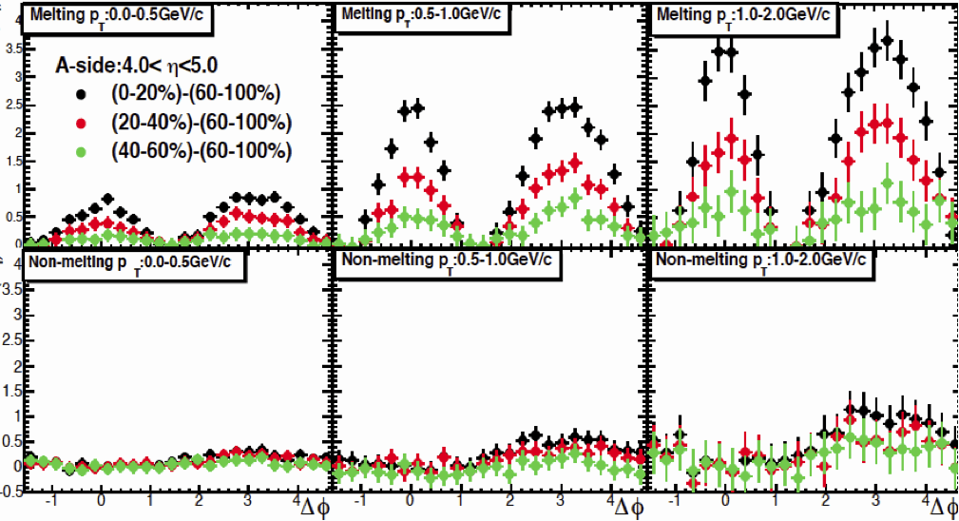
AMPT simulation p+Pb 5TeV (string-melting on/off)
for ALICE backward-central Δφ correlation (|Δη|=3∼6)
string-melting on
Associate yield / trigger
effectively partonic cascade : on/off
string-melting off : hijing + hadronic cascade
JPS 2014/Mar,
Kazuki Oshima,
Univ. of Tsukuba
TPC : |η|<1
V0A: 3<η<5 (Pb-going side)
V0C : -4<η<-2 (p-going side)
p_{T}/η cuts are chosen for ALICE TPC-V0A acceptance.

Slide 17
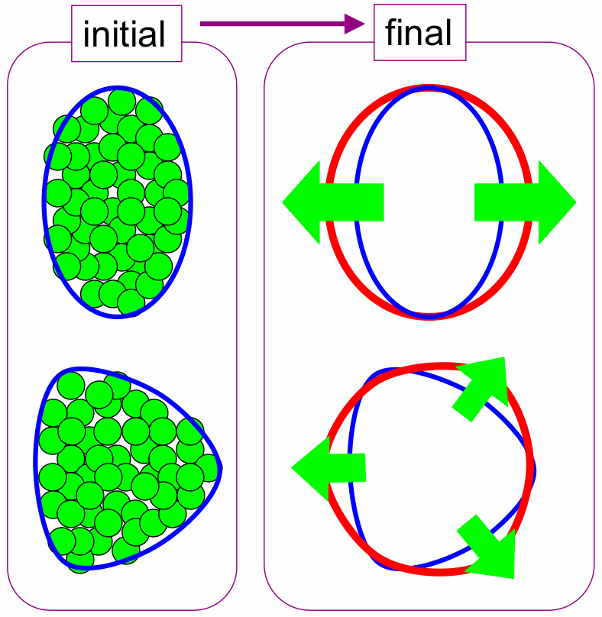
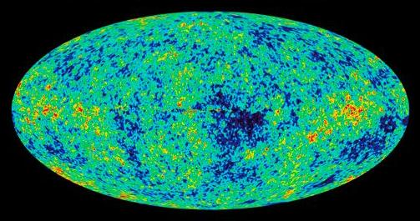
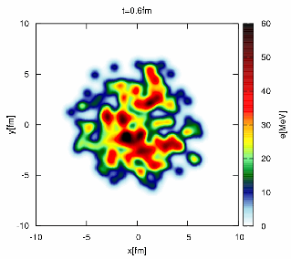
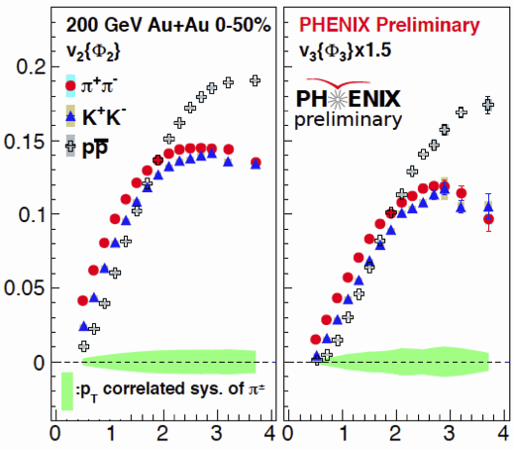
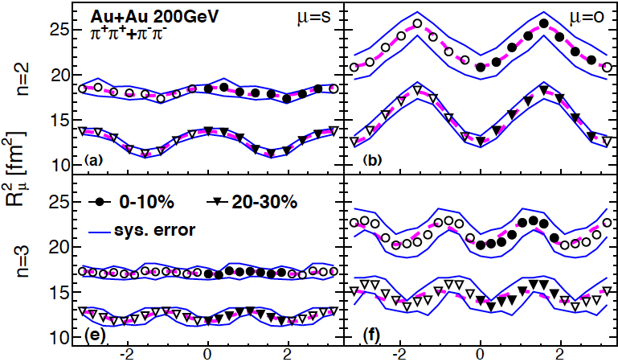
Triangular expansion and shape
Elliptic and Triangular expansion : v₂, v₃
Elliptic and Triangular shape : R^{HBT}_{Φ2}, R^{HBT}_{Φ3}
v_{n}
n=2
n=3
n=2
n=3
PHENIX, QM12
p_{T} [GeV/c]
PRL112 (2014) 222301

Slide 18
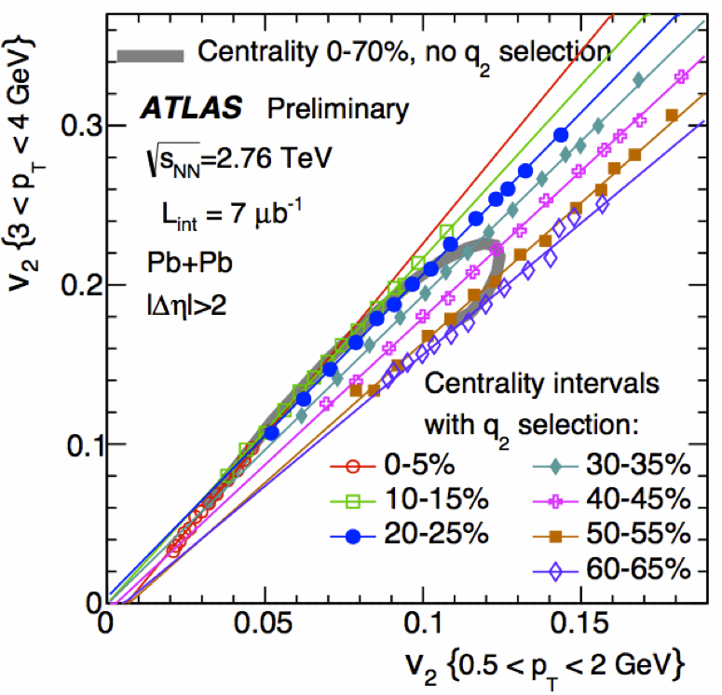
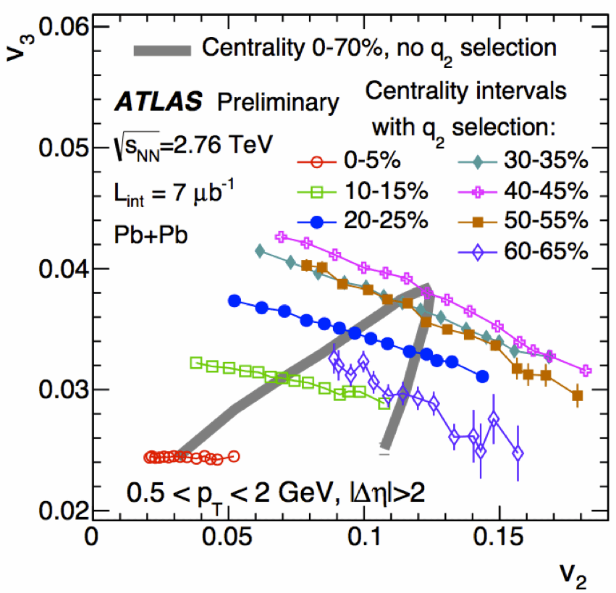
Cross harmonics correlation with Q₂ selection
v₂^{(Low pT)} vs v₂^{(high pT)}
v₂ vs v₃
ATLAS, QM14

Slide 19
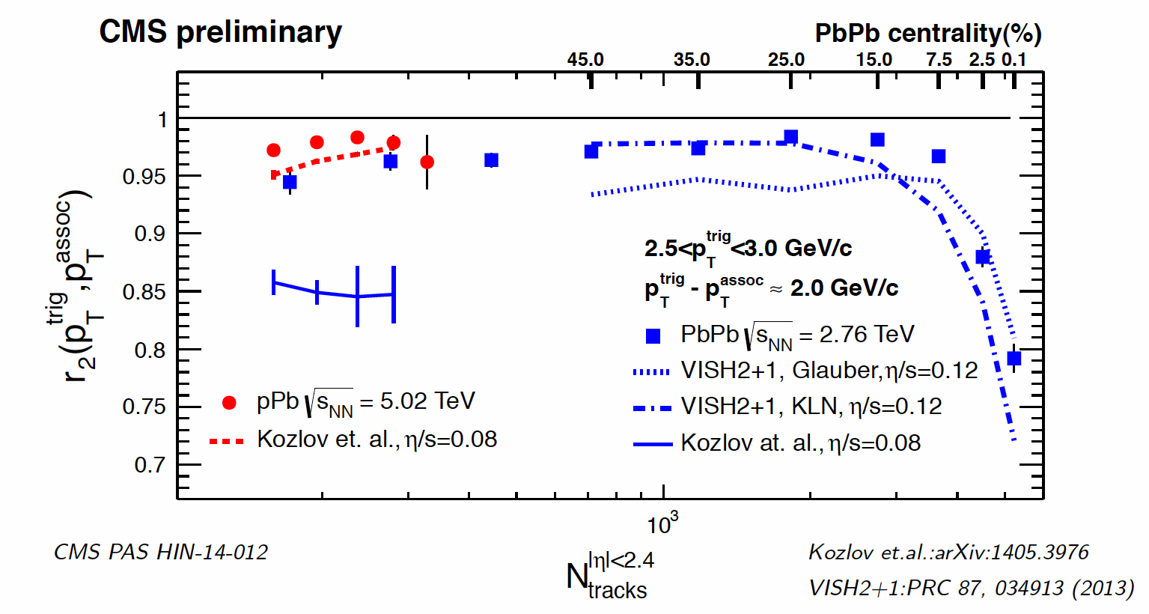
p_{T} dependent
flow fluctuation
measure of factorization
amazing similarity in hydro-models especially in central and at mid-p_{T}
despite of hydro-failure to explain v_{n} in central…
CMS, QM14
ALICE, QM14

Slide 20
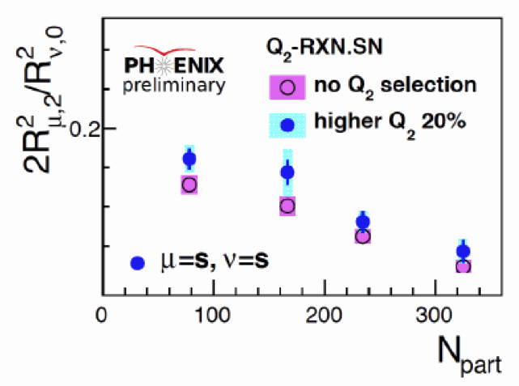
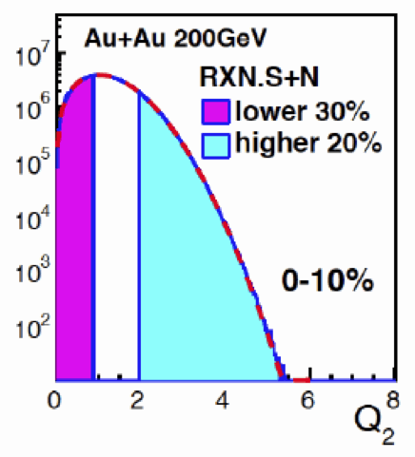
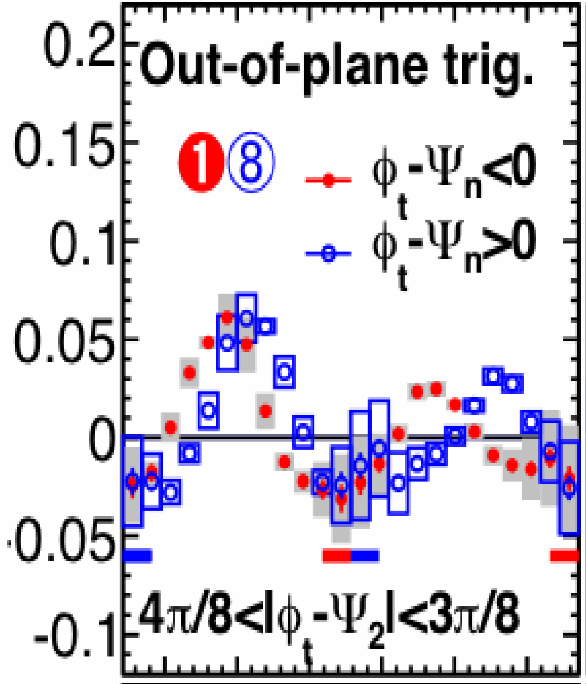
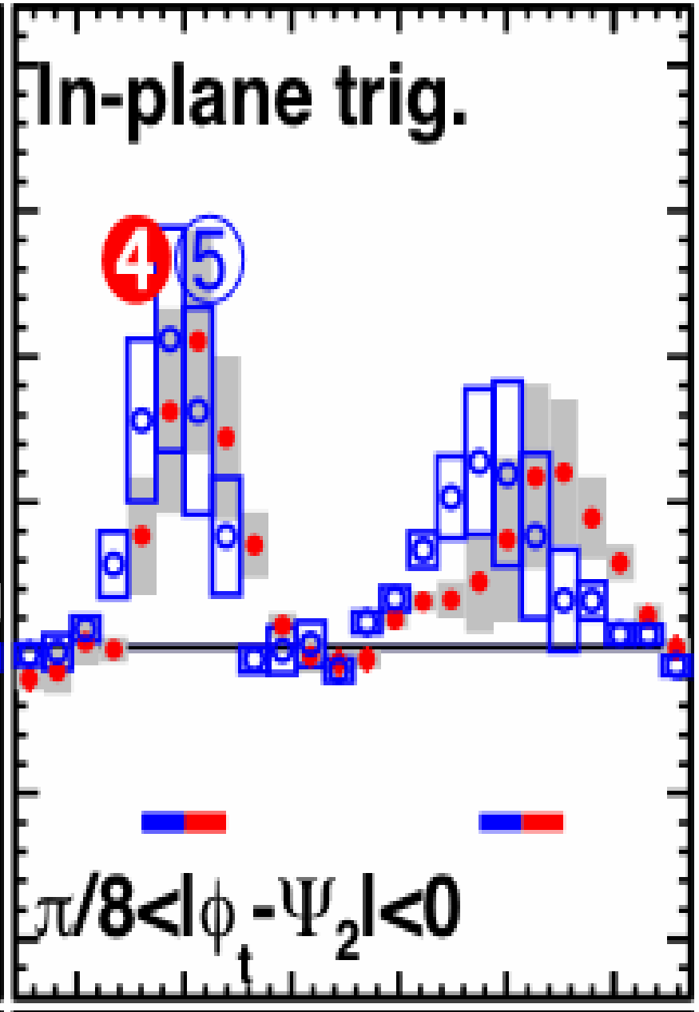
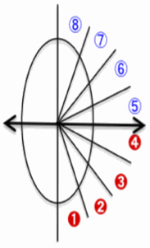
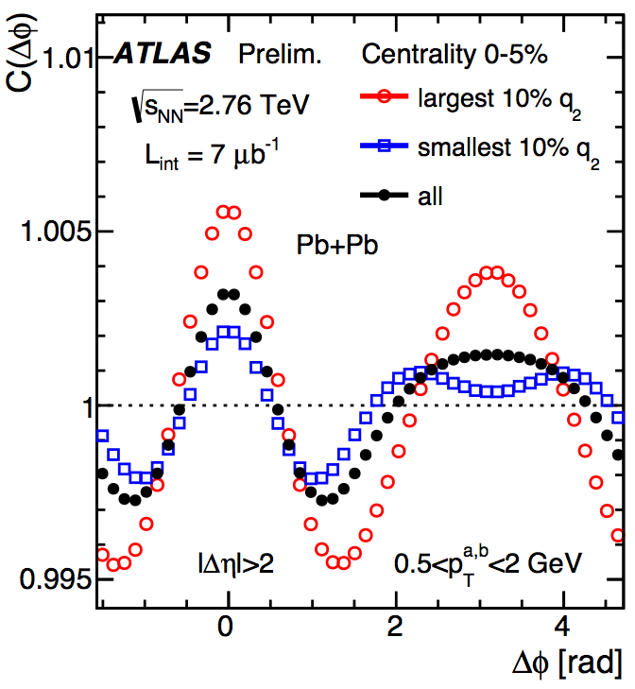
Event shape selection by Q₂ (∼v₂)
ε_{final} via HBT interferometry
relation of ε₂^{initial} – v₂ – ε₂^{final}
for a given centrality
ε₂^{final}
PHENIX, QM14
flow BG subtracted jet correlation
2-particle correlation
PHENIX
preliminary
1/N_{trig} dN_{Pair}/dΔφ
-1 0 1 2 3 4
-1 0 1 2 3 4
ATLAS, QM14
PHENIX, QM12
Δφ = φ_{Asso.} – φ_{Trig.}

Slide 21
More differential studies of hard-soft interplay, jet-medium interaction, jet-flow correlation
Φ₂ dep. analysis
Φ₃ dep. analysis
η_{Jet} dep. analysis
methods
Multi-particle correlation
Jet-hadron / γ-hadron correlation
Jet fragmentation function
Di-jet distribution
Yet another axis as a control parameter to define path length, geometry and expansion. Please join me, if you agree…

Slide 22
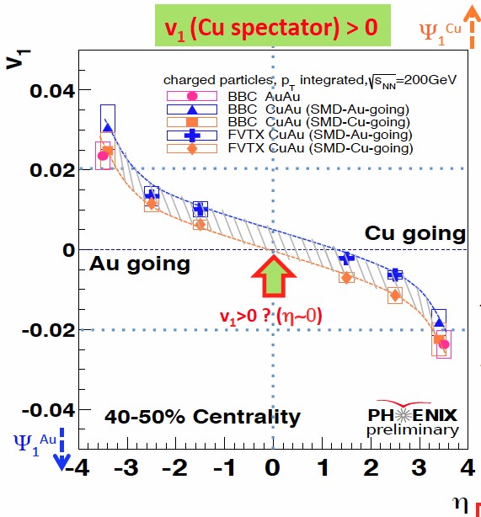
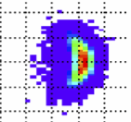
Various flow studies at RHIC
Cu spectators
beam
z
Φ₁^{Cu}
(x)
y
Cu+Au
collisions
( v₁ ∼ <p_{X}> )
reaction plane
x (x-z plane)
Φ₁^{Au}
(-x)
participants
200GeV Cu+Au
Au spectators
η
³He+Au collision data
on tape in RHIC-RUN14
PHENIX, QM14
arXiv: 1312.4565
hydro-
calculation

Slide 23
PRL112 (2014) 162301
PRL 112 (2014) 082302
Beam energy
dependence
of
v₁, v₂, HBT and charge asymmetry
PHENIX, QM14
∼v_{expansion}
arXiv:1404.1433
∼Δτ
10∼100 GeV

Slide 24
Fluctuation of conserved quantities such as
net-baryon, net-charge distribution
PRL 112 (2014) 032302
10∼100 GeV
There must be optimum acceptance.
arXiv:1402.1558
STAR, QM14

Slide 25
Future plan
Full energy Pb+Pb collisions at LHC
Luminosity upgrade at LHC
Beam energy scan II at RHIC
A state-of-art jet detector at RHIC
Future facilities
FAIR at GSI (Darmstadt, Germany)
J-PARC at JAEA/KEK for heavy-ion collisions (Tokai, Japan)

Slide 26
Summary
Initial temperature and collective flow via thermal photons
Partonic energy-loss using jets and prompt photons
Collective flow even in small system
Event shape selection as another control parameter
Beam energy scan to search for a critical point
Future facilities

