Slide 1






Star
Asian
Computing
Center
Pusan National University
In-Kwon YOO
On Behalf of SACC Team
J.Lauret, D.Yu, W. Bett, J. Packard
E. Dart, E. Hjort
S.D.Lee, D.K.Kim, H.W.Kim

Slide 2
Outline
Outline
Motivation
  STAR Computing Infrastructure
  KISTI & Supercomputing Center
SACC Project
  STAR Asian Hub
  SACC Working Group
  Computing Resources / Network Research
  To-Do List
Outlook : Heavy ion Asian Computing Center

Slide 3
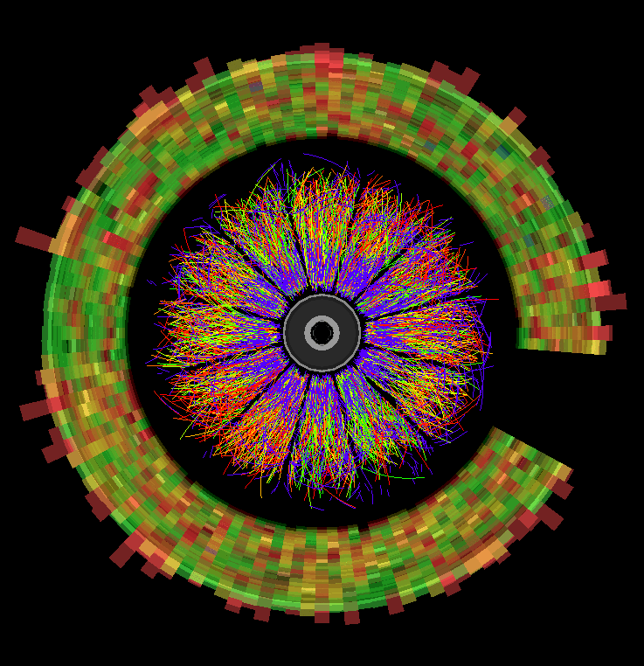
1. Motivation a. STAR Computing
STAR S&C Structure
JLauret
production
DAQ
DST/event
Analysis
MuDST
Raw Data
Our data processing path is
  DAQ to DST
  DST to MuDST : Size reduction is ~ 1 to 5
STAR Plan
  FY 08: 370 Mevts
  FY 09: 700 Mevts
  FY 10:1200 Mevts
  FY 11:1700 Mevts
  FY 12:1700 Mevts

Slide 4
1. Motivation a. STAR Computing
STAR Computing Sites
JLauret
Tier 0
BY DEFINITION: RHIC Computing Facility (RCF) at BNL
  Acquisition, recording and processing of Raw data ; main resource
Services
  Long term (permanent) archiving and serving of all data … but NOT sized for Monte Carlo generation
  Allow re-distribution of ANY data to minimally Tier1
Functionality
  Production reconstruction of most (all) Raw data, provide resource for data analysis
  Has full support structure for users, code, …
Tier 1
Services
  Provide some persistent storage, source from Tier0
  MUST Allow redistribution of data to Tier2
  Provide backup (additional copies) for Tier0
  May requires a support structure (user account, ticket, response, grid operations,…)
Functionality
  Provides a significant added value to processing capabilities of STAR
  Half of the analysis power AND/OR Provide support for running embedding, simulation, …
  Redistribution of data to Tier2
Tier2
Would host transient datasets – requires only several 100 GB
Mostly for local groups, provide analysis power for specific topics
MUST provide cycles (opportunistic) for at least simulation
  Low requirement of Grid operation support or common project
Data transfer should flow from Tier0 to Tier2

Slide 5
1. Motivation a. STAR Computing
STAR Computing Sites
JLauret
6 main dedicated sites (STAR software fully installed)
BNL Tier0
NERSC/PDSF Tier1
WSU (Wayne State University) Tier2
SPU (Sao Paulo U.) Tier2
BHAM (Birmingham, England) Tier2
UIC (University of Illinois, Chicago) Tier2
Incoming
Prague Tier2
KISTI Tier1

Slide 6








Wayne State University
University of Birmingham
Brookhaven National Lab
PDSF
Berkeley LAB
Fermi Lab
Universidade de São Paulo
STAR Grid
STAR Grid = 90% of Grid resources part of the OpenScience Grid

Slide 7




Amazon.com
NPI, Czech Republic
MIT X-grid
SunGrid
STAR is also outreaching other grid resources & projects
Interoperability / outreach
Virtualization
VDT extension
SRM / DPM / EGEE

Slide 8
STAR Resource Needs
1. Motivation a. STAR Computing
JLauret
 | FY05 | FY06 | FY07 | FY08 | FY09 | FY10 | FY11 | FY12
STAR Requirement
Real Data Volume (TB) | 600 | 570 | 560 | 870 | 1720 | 3000 | 4160 | 4160
Reco CPU (KSI2K) | 660 | 314 | 462 | 1532 | 3296 | 5891 | 6960 | 6960
Analys CPU (KSI2K) | 360 | 157 | 210 | 730 | 1648 | 2805 | 3480 | 3480
Dist. Disk (TB) | 150 | 71 | 105 | 365 | 749 | 1275 | 1740 | 1740
Cent. Disk (TB) | 30 | 14 | 21 | 73 | 150 | 255 | 348 | 348
Annual Tape Volume (TB) | 720 | 684 | 672 | 1044 | 2064 | 3600 | 4992 | 4992
Tape bandwidth (MB/sec) | 200 | 200 | 200 | 200 | 500 | 800 | 1000 | 1000
WAN bandwidth (Mb/sec) | 160 | 384 | 528 | 640 | 1760 | 2944 | 3800 | 3800
Simulation CPU (KSI2K) | 153 | 71 | 101 | 339 | 742 | 1304 | 1566 | 1566
Simulation Data Volume (TB) | 120 | 114 | 112 | 174 | 344 | 600 | 832 | 832
560
1720
4160
462
3296
6960

Slide 9
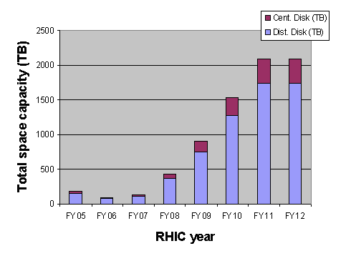
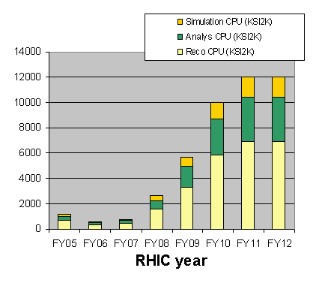
STAR Resource Needs
1. Motivation a. STAR Computing
JLauret

Slide 10
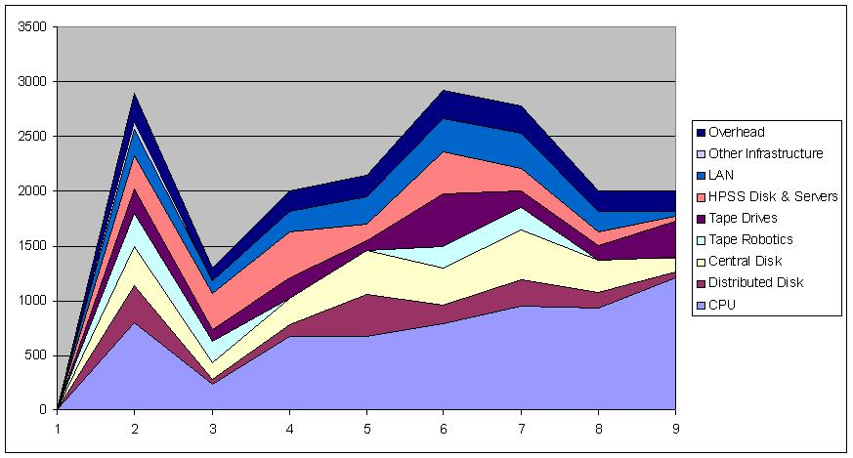
STAR S&C Cost Analysis
1. Motivation a. STAR Computing
JLauret
K$
5
6
7
8
9
10
11
12
Observation: Cost seem to go into CPU
BUT this folds distributed disks (1/2 cost)
Reduced used of centralized disk is nonetheless third in cost
Cost is clearly
Storage (~ ½)
CPU (1/3rd)
HPSS & LAN is second

Slide 11
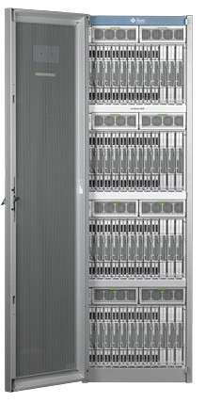
1. Motivation b. KISTI Resources
Cluster system
SDLee, HWKim
Item | Cluster system
 | Phase 1 | Phase 2
Manufacturer & Model | SUN C48 | SUN Fusion
Architecture | Cluster
Processor | AMD Opteron 2GHz (Barcelona) | Intel Xeon 3.3GHz+ (Gainestown)
Operating System | Cent OS | Cent OS
Nodes | 188 | 2,688
CPU cores | 3,008 (16/node) | 21,504 (8/node)
Rpeak | 24TFlops | 286TFlops
Memory | 6TB | 64.5TB
Disk storage | 207TB | 1PB
Tape storage | 422TB | 2PB
Interconnection network | Infiniband 4X DDR | Infiniband 4X DDR
Cooling | Chilled water cooling | Chilled water cooling
Delivery date | Jan, 2008 | 2Q, 2009

Slide 12
1. Motivation b. KISTI Resources
SMP system
SDLee, HWKim
Item | SMP system
 | Phase 1 | Phase 2
Manufacturer & Model | IBM p595 | IBM p6H
Architecture | SMP
Processor | POWER5+ 2.3GHz | POWER6 5GHz+
Operating system | AIX 5.3 | AIX 5.3+
Nodes | 10 | 24
CPU cores | 640 (64/node) | 1,536 (64/node)
Rpeak | 5.9TFlops | 30.7TFlops
Memory | 2.6TB | 9.2TB
Disk storage | 63TB | 273TB
Tape storage | -
Interconnection network | HPS | Infiniband 4X DDR
Cooling | Air-cooling | Air-cooling
Delivery date | Sept, 2007 | 1Q, 2009

Slide 13
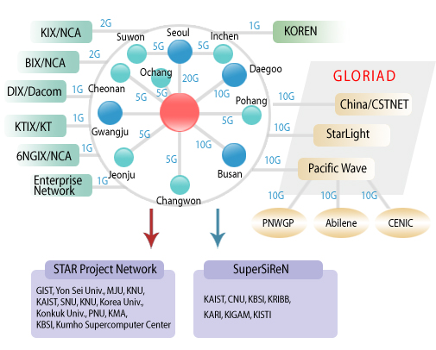
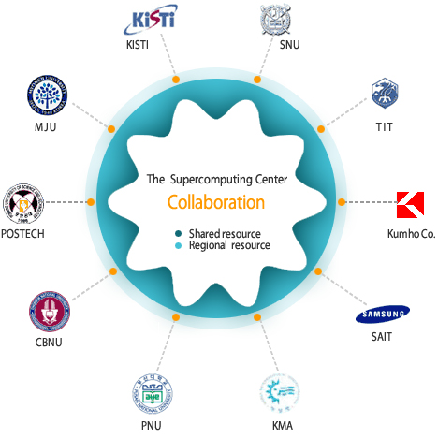
Research Networks
1. Motivation b. KISTI Resources
SDLee, HWKim
KREONET

Slide 14
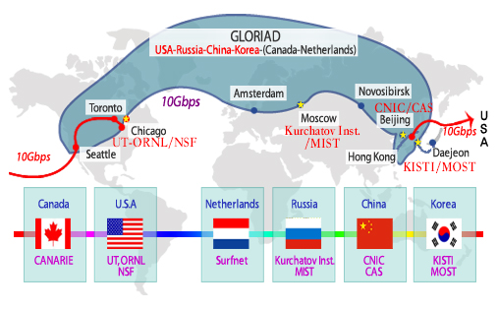
GLORIAD
1. Motivation b. KISTI Resources
SDLee, HWKim

Slide 15








STAR Asian Hub
2. Project a. STAR Asian HUB

Slide 16
Star Asian Computing Center
2. Project a. STAR Asian HUB
Computing Infrastructure with massive data from STAR
  Frontier Research
  Maximum Use of IT resources in Korea
    Data Transfer
    Cluster Computing with Supercomputer
    Mass Storage
Korean Institute for Science and Technology Informations (KISTI @ Daejoen)
  Korean HUB for GLORIAD + KREONET
  Super Computing Resources
  Mass Storage Management
Asian Supercomputing HUB :
  - BNL – NERSC – KISTI – SSC etc.

Slide 17

2. Project b. Working Group
SACC Working Group
PNU
  IKYoo et al.
KISTI
  SDLee, DKKim, HWKim
BNL (STAR)
  JLauret, DYu, Wbett, Edart, JPackard
SSC + Tsinghua Univ. ?
  ZXiao et al. ?

Slide 18
KISTI STAR Computing
2. Project c. KISTI STAR Computing
SDLee, HWKim
Configuration of a testbed(16 cores) under way
Eventually SUN cluster 1st shipment (~3,000 cores) will be dedicated to STAR early next year!
Initial Network status : below 1 Mbps (over 10Gbps line)
Network Optimization between KISTI and BNL : since 2008-07
Target Throughput : over 2 Gbps (over LP)
KISTI’s effort
  Installed 10Gbps NIC equipped server in Seattle
  Local optimization

Slide 19
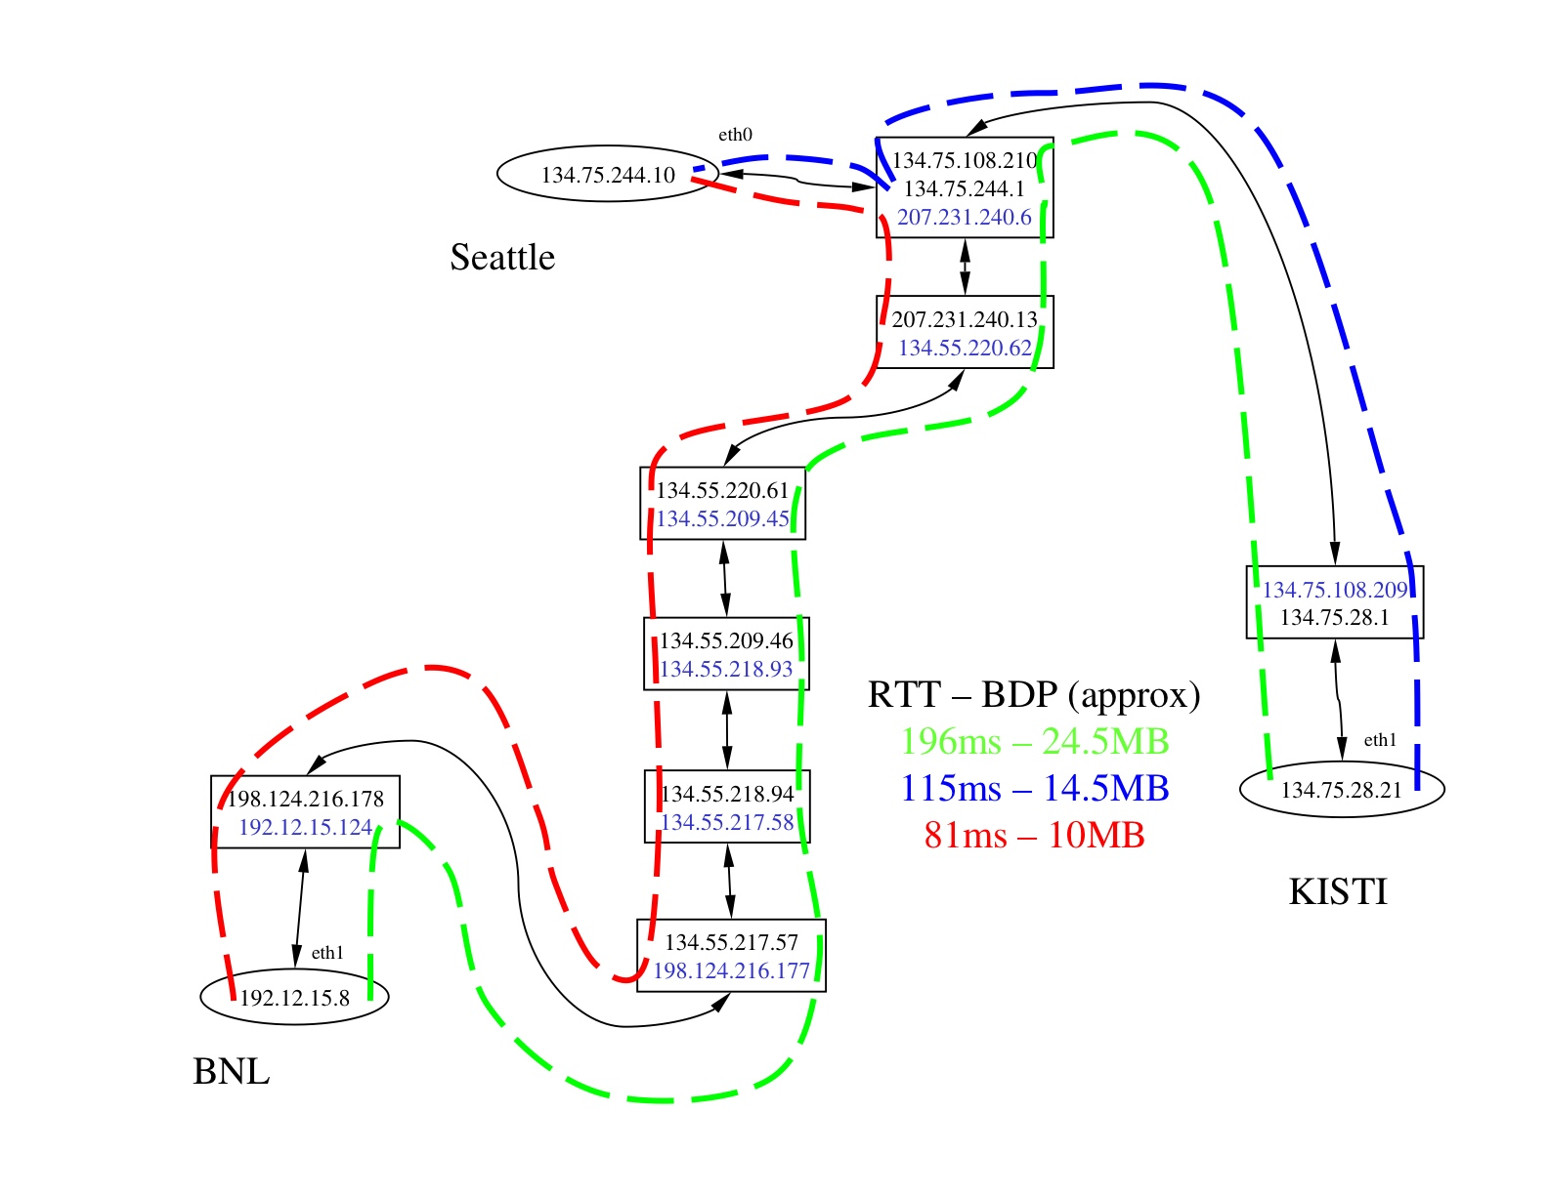
2. Project c. KISTI-BNL Networking
Dantong YU

Slide 20
BNL to KISTI Data Transfer
2. Project c. KISTI-BNL Networking
Dantong YU
Network Tuning improved transfer from BNL to KISTI
  Identified bottleneck with Kreonet2 peering point with Esnet. 1Gpbs => 10Gbps
  Network and TCP stack was tuned at KISTI hosts.
After Tuning
Before Tuning

Slide 21
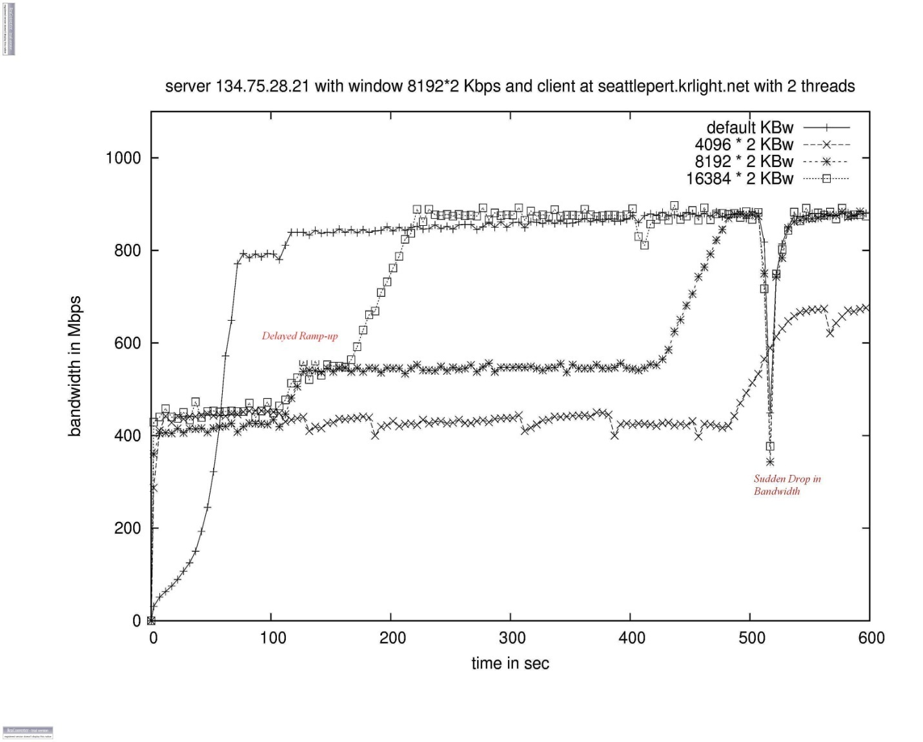
Network Research
2. Project c. KISTI-BNL Networking
Dantong YU
There are two kinds of network events that require some further examination.
Delayed ramp up.
Sudden Drop in Bandwidth.
Notes:
21

Slide 22
STAR Data Transfer Status
2. Project c. KISTI-BNL Networking
Dantong YU
Performance between BNL and KISTI :
not symmetrical.
A bottleneck from KISTI back to BNL.
  Packet drops at BNL receiving host. (will be replaced).
  Old Data Transfer Nodes at BNL: being replaced
  Findings being corrected:
    High performance TCP parameters
  Findings are still under investigation
    TCP slow ramp up, and performance sudden drop.
test/tune GridFtp tools : in next 4 weeks

Slide 23
STAR Data Transfer Plan
2. Project c. KISTI-BNL Networking
Dantong YU
Replace the old data transfer nodes
  1 Gbps per node, with expansion slots for 10Gbps.
  Large local disk for intermediate cache.
Deploy OSG BestMan for these nodes.
RACF firewall will be rearchitectured.
Data transfer performance should be only limited by the local disk buffer at both ends.
Notes:
23

Slide 24
To do list
2. Project d. To-Do List
KISTI needs to finish the testbed preparation
STAR Software should be installed and tested
KISTI net people need to set up lightpath between KISTI and BNL eventually
BNL net people need to set up a host for the end-to-end test and measure the throughput
We need to complete “a real mass data-transfer” from BNL to KISTI sooner or later!
Start Production test at KISTI

Slide 25
Outlook towards HACC
3. Outlook HACC
STAR Asian Computing Center (SACC) (2008 – 2011)
  Experimental Data from International Facility
    Computational Infrastructure for LHC / Galaxity
  Asian Hub for International Coworking
  Frontier Research
Heavy ion Analysis Computing Center (HACC) (2011-)
  Extend to Other project (HIM) ?
  Extend to ATHIC ?
  Dedicated Resources for Heavy ion Analysis Computing

Slide 26
BNL PHENIX WAN Data Transfer
Appendix PHENIX
Dantong YU

Slide 27
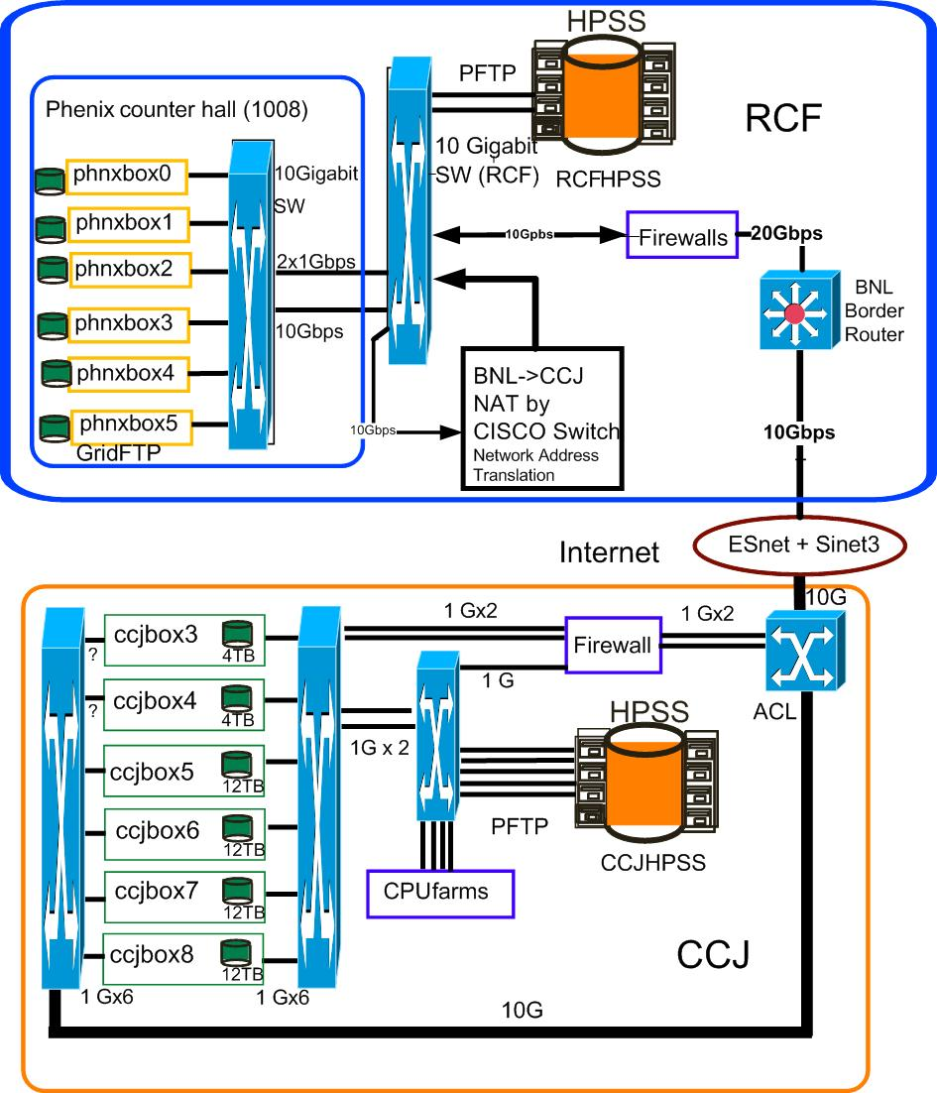
PHENIX Data Transfer Infrastructure
Appendix PHENIX
Dantong YU

Slide 28
Computer Platforms on Both Ends
Appendix PHENIX
Dantong YU
BNL: Multiple 3.0Ghz dual CPU nodes with Intel copper gigabit network. Local drives connected by Raid Controller. There are PHENIX on-line hosts.
CCJ Site: 8 dual-core AMD Opteron based hosts, each with multiple Tera bytes SATA drives connected with a RAID controller. Each one has one gigabit broadcom network card.
The LAN on both ends are 10Gbps.
The data transfer tool is GridFtp.

Slide 29
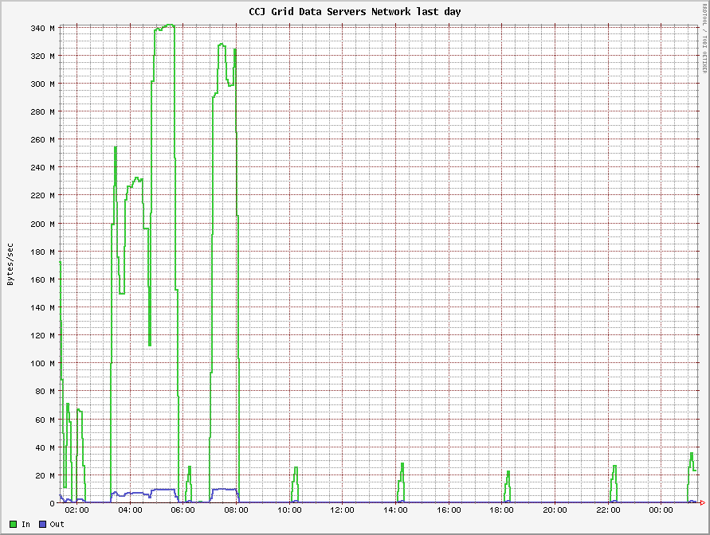
PHENIX to CCJ Data Transfer Test at the beginning of 2008 (Mega Byte/second)
Appendix PHENIX
Dantong YU
We can transfer up to 340Mbyte/second from BNL to CCJ, it hits the BNL firewall limitation.

Slide 30
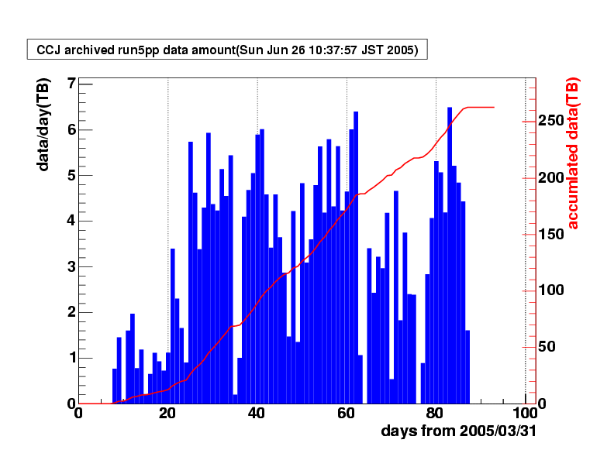
Data Transfer to CCJ, 2005
Appendix PHENIX
Dantong YU
2005 RHIC run ended on June 24, Above shows the last day of RHIC Run.
Total data transfer to CCJ (Computer Center in Japan) is 260 TB (polarized p+p raw data)
100% data transferred via WAN, Tool used here: GridFtp. No 747 involved.
Average Data Rate: 60~90MB/second, Peak Performance: 100 Mbytes/second recorded in Ganglia Plot! About 5TB/day!
Courtesy of Y. Watanabe

Slide 31
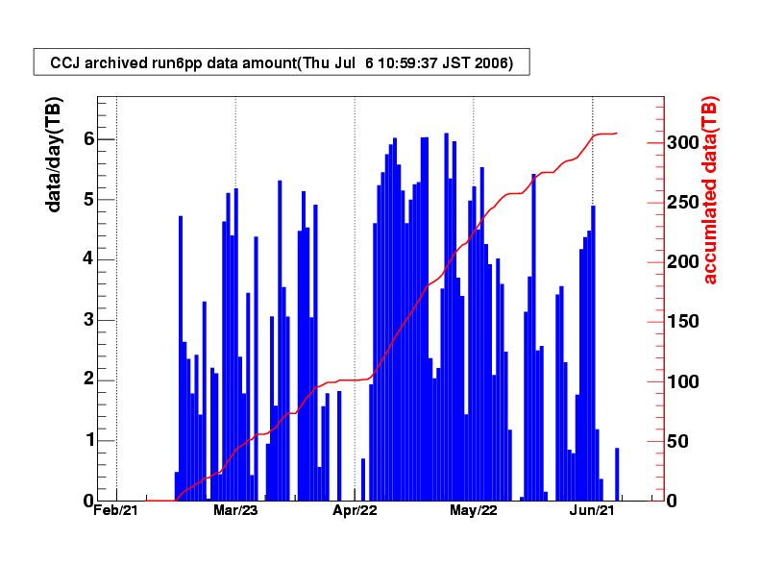
Data Transfer to CCJ, 2006
Appendix PHENIX
Dantong YU

