Slide 1
Photon Analysis & J-Cal
JSPS Research Fellow / University of Tsukuba
T. Horaguchi
Nov .05 2009 for the workshop for ALICE upgrades by Asian Countries

Slide 2
Outline
Introduction
Large Hadron Collider
ALICE Experiment
Jet-Calorimeter
Jet Finding Algorithm
Physics in pp Collisions
  Inclusive Jet Production
  Dijet production
  Prompt Photon Production
  Photon-Jet Production
  Underlying Event
Summary

Slide 3
Introduction
Large Hadron Collider
  Powerful QCD Machine !
ALICE Experiment
  Focus Heavy Ion Physics
  pp physics is also important topic
Jet-Calorimeter @ ALICE
  Enhance physics message from ALICE
  Increase physics topics @ ALICE
This talk is entitled “Photon Analysis and J-Cal”; however,
jet as a QCD physics in pp collisions are also discussed.
And this talk focuses about pp physics @ ALICE LHC.

Slide 4

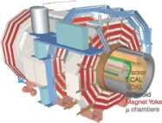

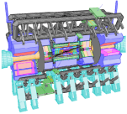
Large Hadron Collider @ CERN
LHC can accelerate up to
  14 TeV pp collisions
  5.5 TeV PbPb collisions
2009
  Commissioning @ 450GeV
  Collisions @ 450GeV
2010
  3months : 7TeV pp
  5months : 8~10TeV pp
  1month : Heavy Ion Run
LHC will run from this November !
CMS
LHC-b
ALICE
ATLAS

Slide 5
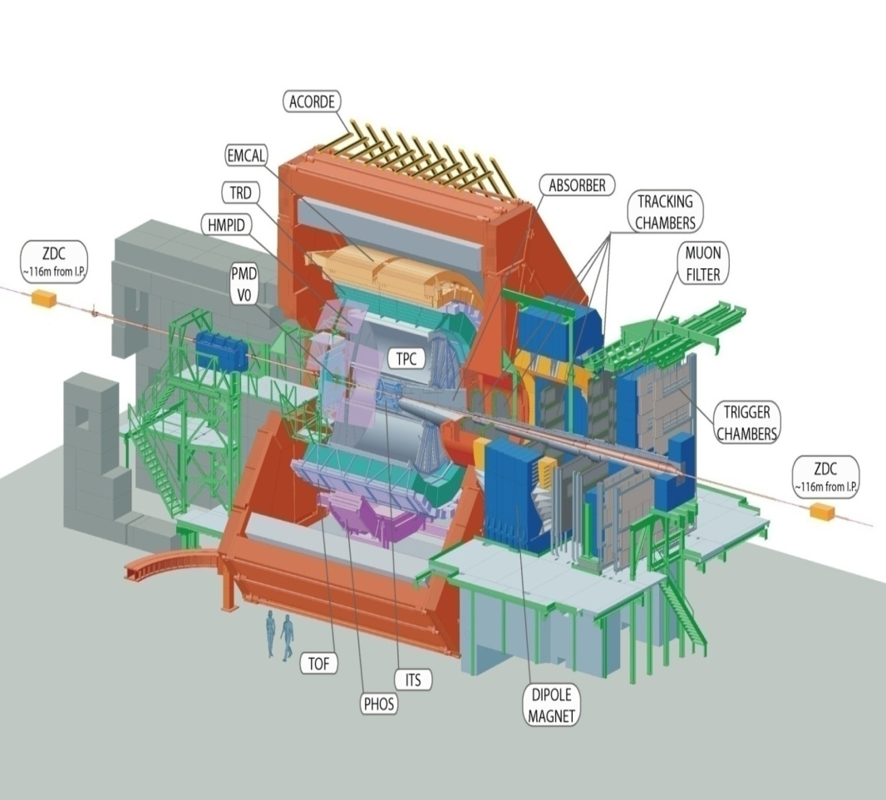
ALICE Detector
TPC (Time Projection Chamber)
  Main tracking device
    |η| < 0.9, full azimuth
  Largest ever
    88 m³, 10 m long, 5.6 m diameter, 570 k channels
    3 % X₀, Ne (86)/CO₂ (9.5)/ N₂ (4.5), O₂ ~ 1 ppm
    max. 80 MB/event (after compression)
ITS(Inner Tracking System)
  Tracking (|η|< 1) + multiplicity (|η|< 2)
  Si pixel/drift/strip; 2 layers each rφ resolution: 12, 38
TRD(Transition Radiation Detector)
  Tracking and particle identification
  |η| < 0.9, full azimuth
  400 – 600 μm resolution in rφ, 23 mm in z
  e/π separation > 100 at p_{T} > 3 GeV/c
Track finding efficiency ~ 90 % @ p_{T} > 1GeV/c
Momentum resolution of electrons ~ 2% @ p_{T} > 4GeV/c
PHOS (Photon Spectrometer)
EMCAL (ElectroMagnetic Calorimeter)
  Photon & electron measurement
  |η| < 0.7, 120 degree azimuth
J-Cal (Jet Calorimeter)
  Same as EMCAL, but located at opposite
  See nest page

Slide 6
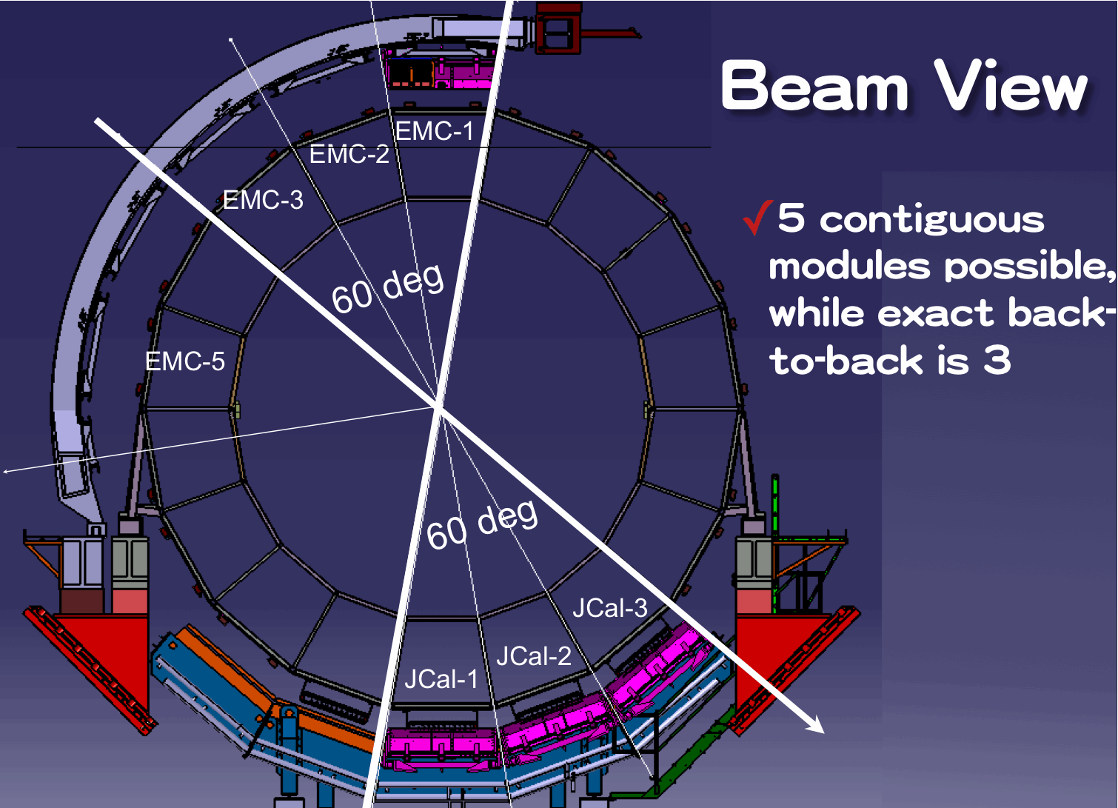
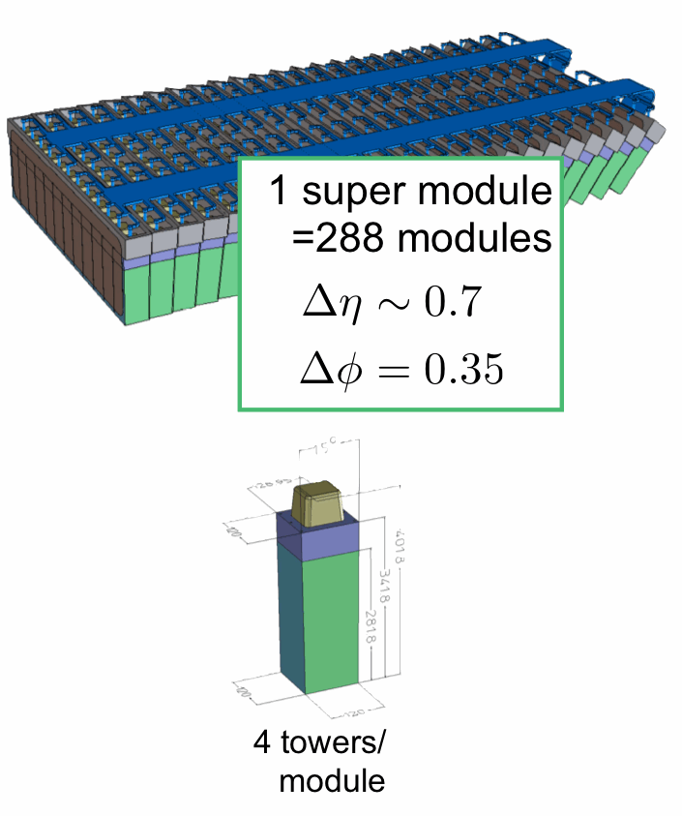
Jet – Calorimeter (J-Cal)
J-cal for LHC-ALICE experiment
for back-to-back jets measurements
J-Cal construction talk by Tatsuya Chujo on Nov. 6

Slide 7
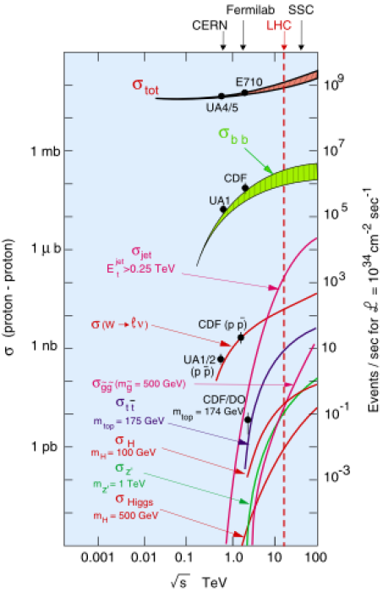
LHC : QCD Machine
Jet Physics
  Inclusive Jet production, Dijet production, Dijet angle distribution, Jet structure
  Monte Carlo Tuning
  Constraints on PDFs and strong coupling constant at ultra high Q²
  Photon + Jets
    Test pQCD
    Monte Carlo Tuning
Underlying Event
  Scaling from lower energy experiments to LHC
  Basis for high p_{T} physics program

Slide 8
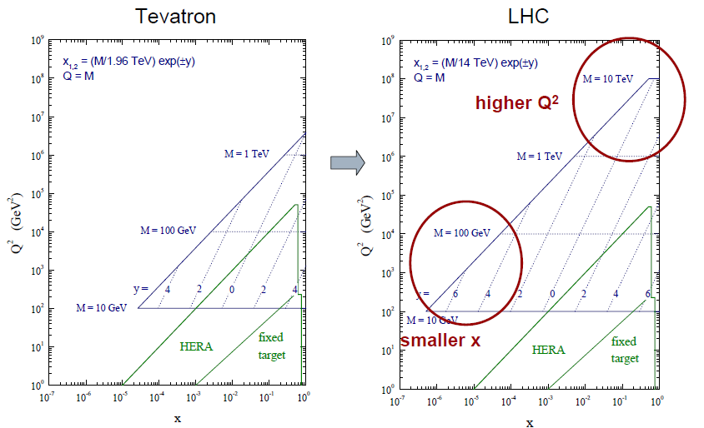
Tevatron -> LHC Parton Kinematics

Slide 9
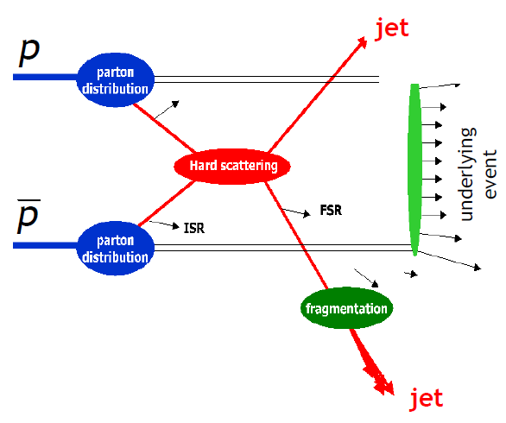
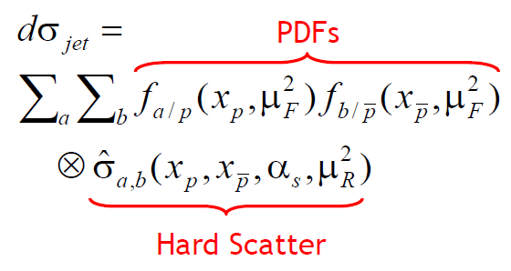
Jet Production @ ALICE
Test pQCD
Based on pQCD
  Extract PDFs
  Strong coupling constant
  Study & test matrix element calculations
Underlying event makes the measurement complicated
Good place to study nature of underlying event

Slide 10
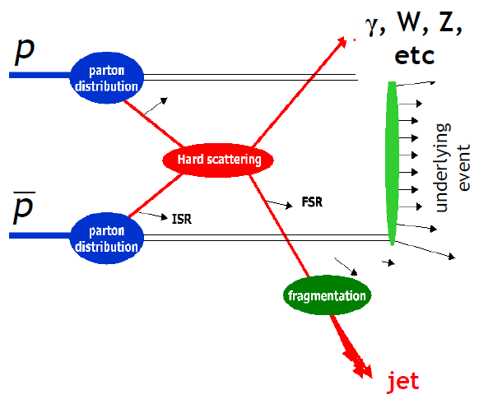
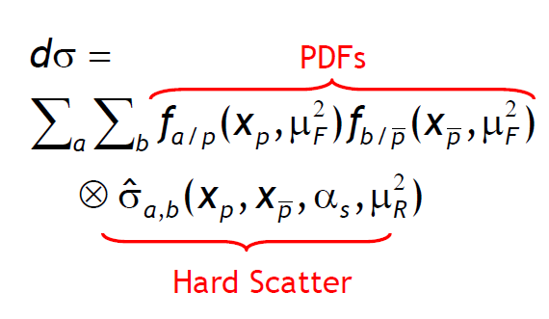
Boson + Jet Production @ ALICE
Test pQCD
Based on pQCD
  Extract PDFs
  Strong coupling constant
  Study & test matrix element calculations
Low statistics, so it’s challenging measurements
For a time, photon-jet will be a main physics topic in a few years
Underlying event makes the measurement complicated
Good place to study nature of underlying event

Slide 11
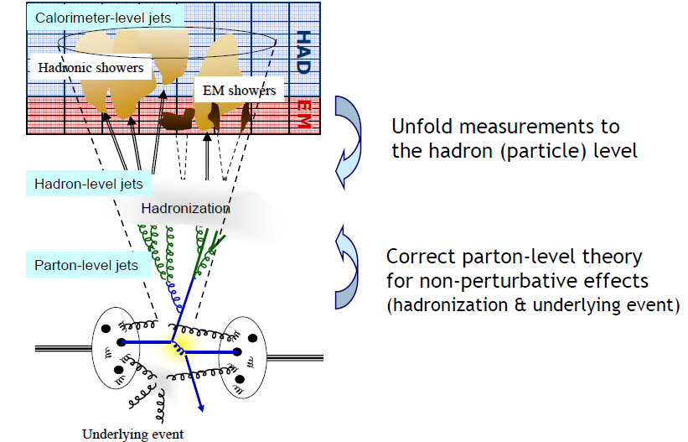
Jet Production & Measurement
EMCAL+PHOS+J-Cal
Tracking Detector (ITS+TPC+TRD)

Slide 12
Jet Finding Algorithm
Two main categories of jet finding algorithms
Cone Algorithms
  Midpoint Algorithm : Extensive use at Tevatron in RunⅡ (hep-ex/0005012).
  Cluster objects based on their proximity η-φ space.
  Identify stable cones (kinematic direction = geometric center).
  Advantage: Simpler for underlying-event & pileup corrections.
  Disadvantage: Infrared-unsafe in high order pQCD & overlapping stable cones.
Successive Combination Algorithms
  K_{t} Algorithms : Extensive use at HERA. A few Tevatron analyses.
  Cluster objects based on a certain metric. Relative Kt for K_{t} algorithm.
  Advantage: Infrared-safe in all order of pQCD calculations.
  Disadvantages: Jet geometry can be complicated. Complex corrections.
A lot of developments in recent years.
SisCone, Cambridge-Aachen, Anti-K_{t}, etc.
  E.g. FastJet : http://www.lpthe.jussieu.fr/~salam/fastjet
Extensively studied in LHC experiments. Will benefit future studies.
K_{T} jet
Cone jet

Slide 13
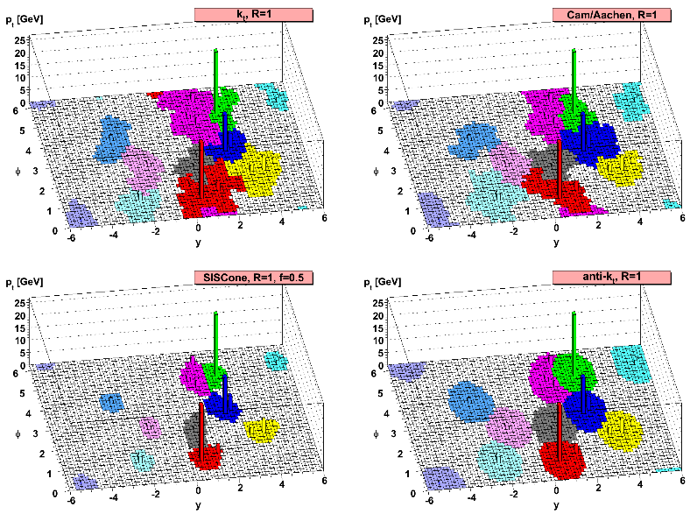
Jet Finding Algorithm
FastJet: sequential clustering algorithms
http://www.lpthe.jussieu.fr/~salam/fastjet
k_{T} algorithm
Cambridge/Aachen algorithm
anti-k_{T} algorithm
K_{T} jet
Cone jet
Algorithm
Calculate particle distance : d_{ij}
Calculate Beam distance : d_{iB}=k_{ti}^{2p}
Find the smallest distance (d_{ij} or d_{iB})
If d_{ij} is the smallest combine particles
If d_{iB} is the smallest and the cluster momentum lager than threshold call the cluster a Jet.
Parameters
- R size
- p_{T} cut
- Jet threshold
arXiv:0802.1189v2
[hep-pn] (2008)

Slide 14
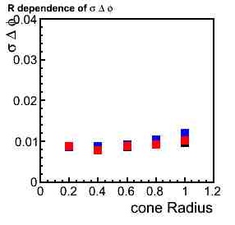
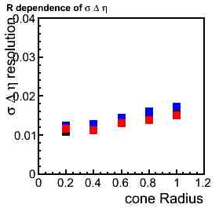
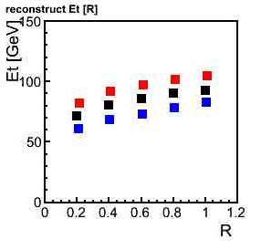
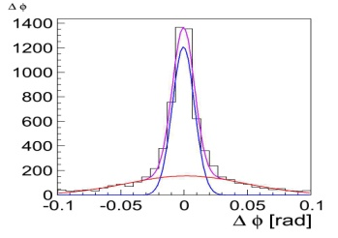
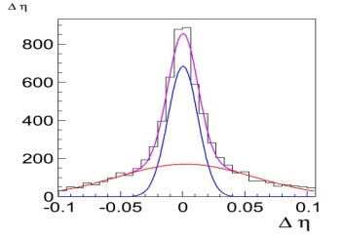
Which is the best algorithm ?
We analyze for closest Jet to parton
Δφ , Δη= parton axis – jet axis
This work has been done by D. Sakata & T. Horaguchi.
p_{T}hard 100GeV/c
Jet threshold 20GeV/c
Δϕ resolution
Δη resolution
measured energy
Resolution : σ of sharp gaussian
k_{T} algorithm
Performance of energy reconstruction of Jet
with anti-k_{T} algorithm is about 50%
better than k_{T} algorithm!
anti-k_{T} algorithm
Cambridge algorithm

Slide 15
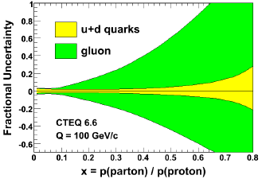
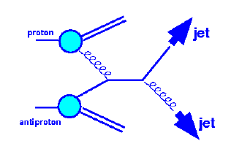
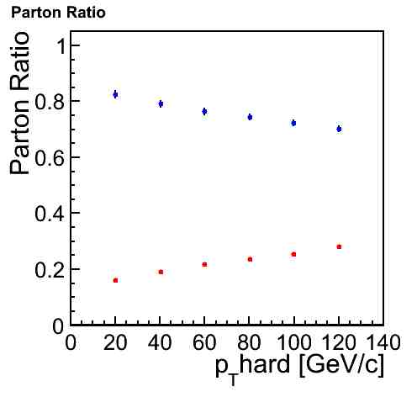
Inclusive Jet Production
Test pQCD at highest Q^2.
Constrain PDFs, especially gluons at high-x.
Measure strong coupling constant
J-Cal enhance the statistics of Jet events
√s=5.5TeV pp
Blue : Gluon
Red: Quark

Slide 16
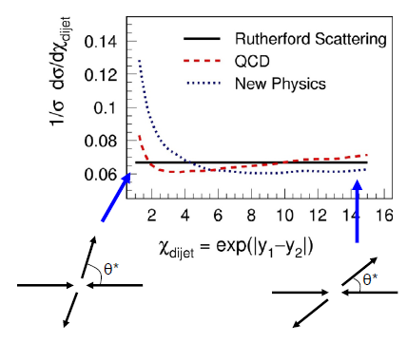
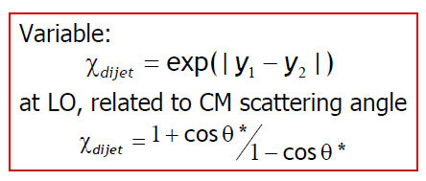
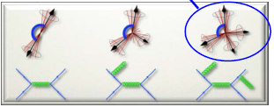
DiJet Production
J-Cal improves the resolution of the dijet measurement.
Dijet angular distribution is sensitive to the jets by pQCD higher order effect.

Slide 17
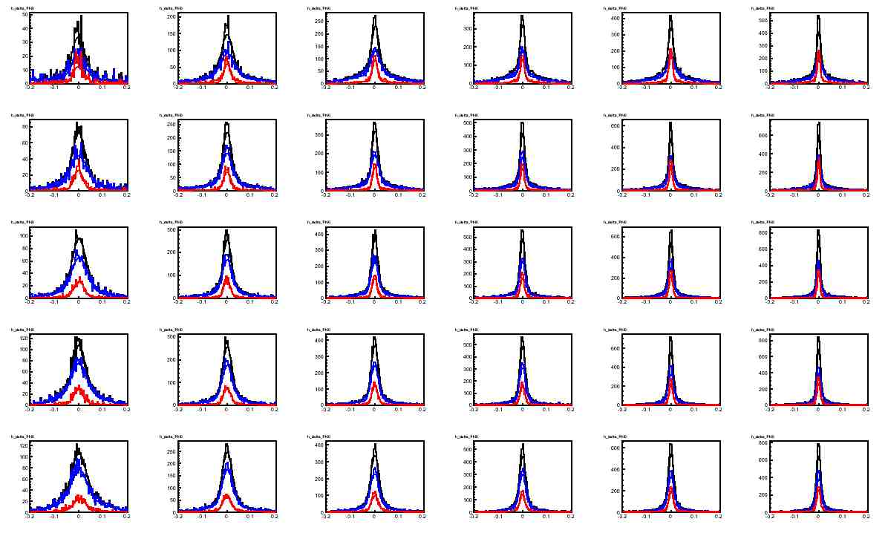
Jet Structure (qg Jet Separation)
pT
Red : Quark
Blue : Gluon
Broadness of the jets in φ direction compared with the closest parton
Gluon jet has wider structure than quark jet.
Precise discussion will be presented by Hiroki Yokoyama on Nov. 7
R

Slide 18
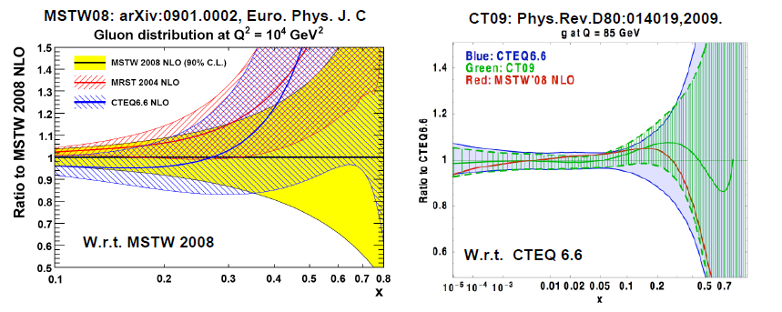
PDF with Recent Tevatron Jet Data
Tevatron data reduced uncertainties of PDFs.
LHC data also will lead to softer high-x gluons and help reducing uncertainties of PDFs.

Slide 19
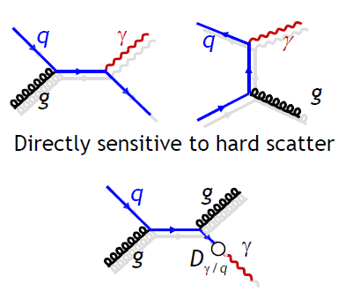
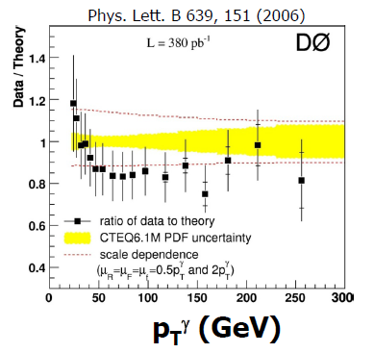
Prompt Photon Production
In Tevatron, Data/NLO pQC is in agreement at high p_{T}, but enhancement at low p_{T}.
Need to treat the fragmentation function carefully.
Wider acceptance of J-Cal can improve the quality of isolation cut, but “fake photon” (from merged 2 photons from π⁰) will increase in high p_{T}.

Slide 20
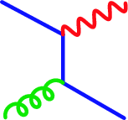
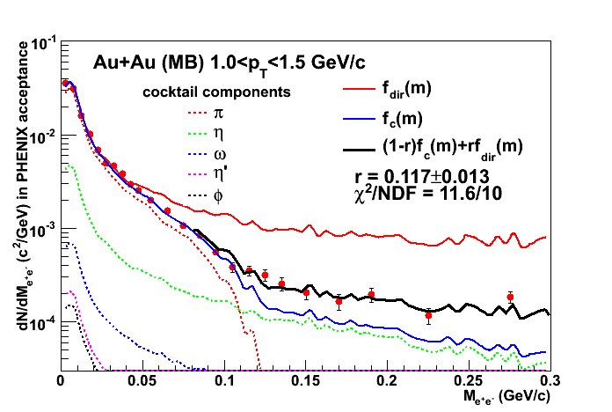
Low pT Photon Measurement
e⁺
q
e⁻
Any source of real γ can emit γ* with very low mass.
Convert direct γ* fraction to real direct photon yield
γ∗
g
q
Kroll-Wada formula
S : Process dependent factor
Direct γ*/inclusive γ* is determined by fitting the following function for each pT bin.
Reminder : f_{direct} is given by Kroll-Wada formula with S = 1.
r : direct γ*/inclusive γ*

Slide 21
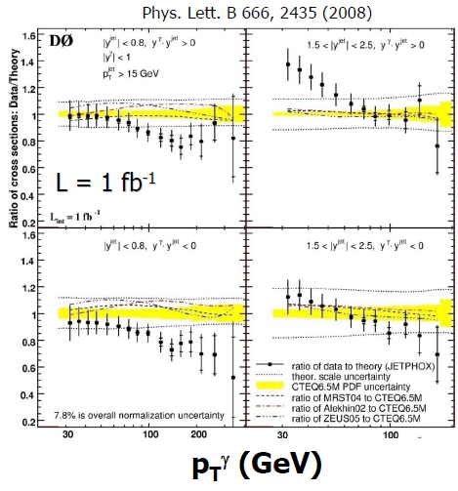
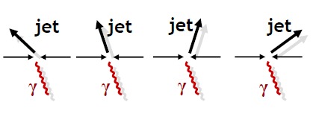
Photon-Jet Production
Data@Tevatron not well described by NLO pQCD calculation
  Intrinsic kt ? Resummation ?
At LHC, fragmentation effect of prompt photon production will increase, so this topic is so important.

Slide 22
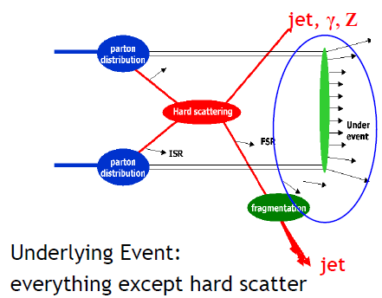
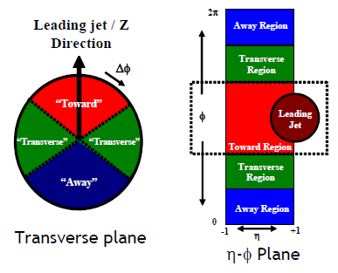
Underlying Event (UE)
Underlying Event = Beam remnant + Multiple Parton Interaction (MPI)
Jet Production
  Transverse region sensitive to UE
  High statistics jet sample
  Studies in Various dijet topologies

Slide 23
Summary
LHC is powerful QCD machine !
  Produced the highest p_{T} particles
  Wider parton kinematics range
Jet production
  Test pQCD at high Q²
  Extract PDFs, especially high-x gluons
  Measure strong coupling constant
  Jet finding algorithm study almost done
Prompt photon & Photon-Jet production
  Test pQCD
  It will challenge and polish the theoretical calculation.
J-Cal will enhance physics message even if pp collisions !
Physics harvests around corner even if initial pp collisions !

Slide 24
Backup Slides

Slide 25
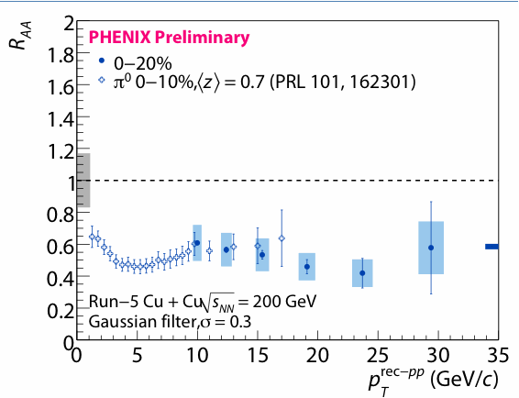
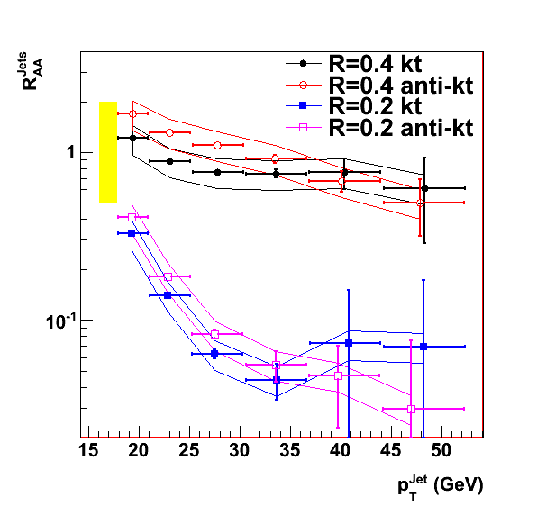
γ,Jet,π⁰ - hadron
correlation
Comparisons are
the most important!
RHIC-AGS’09, Y. S. Lai
Closer and closer to
the initial parton energy
Gamma trigger
Jet (large R) trigger
STAR Preliminary
Jet (small R) trigger
π⁰(hadron) trigger
more and more surface bias
given by energy loss
Au+Au 0~10%
QM09, M. Ploskon

Slide 26
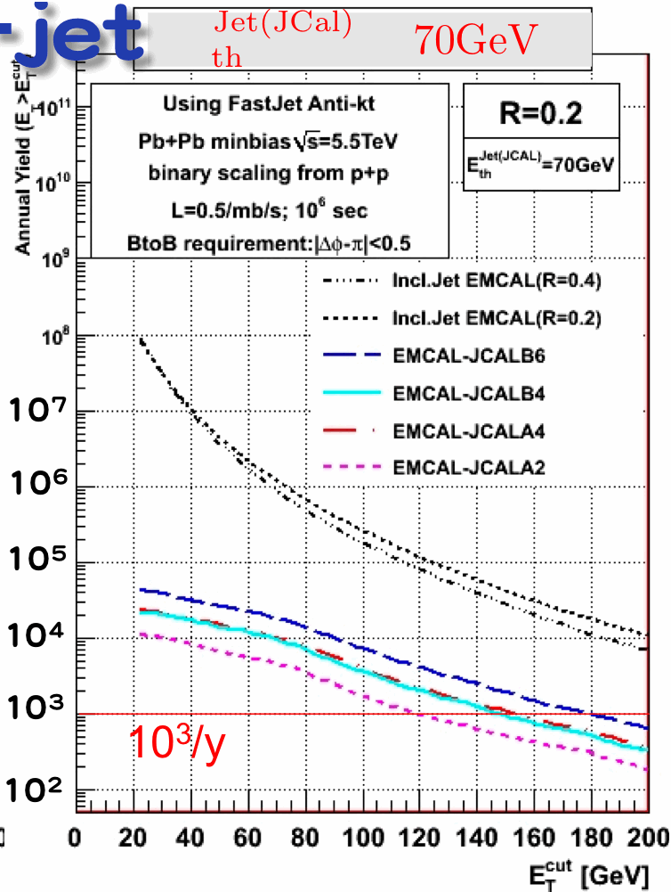
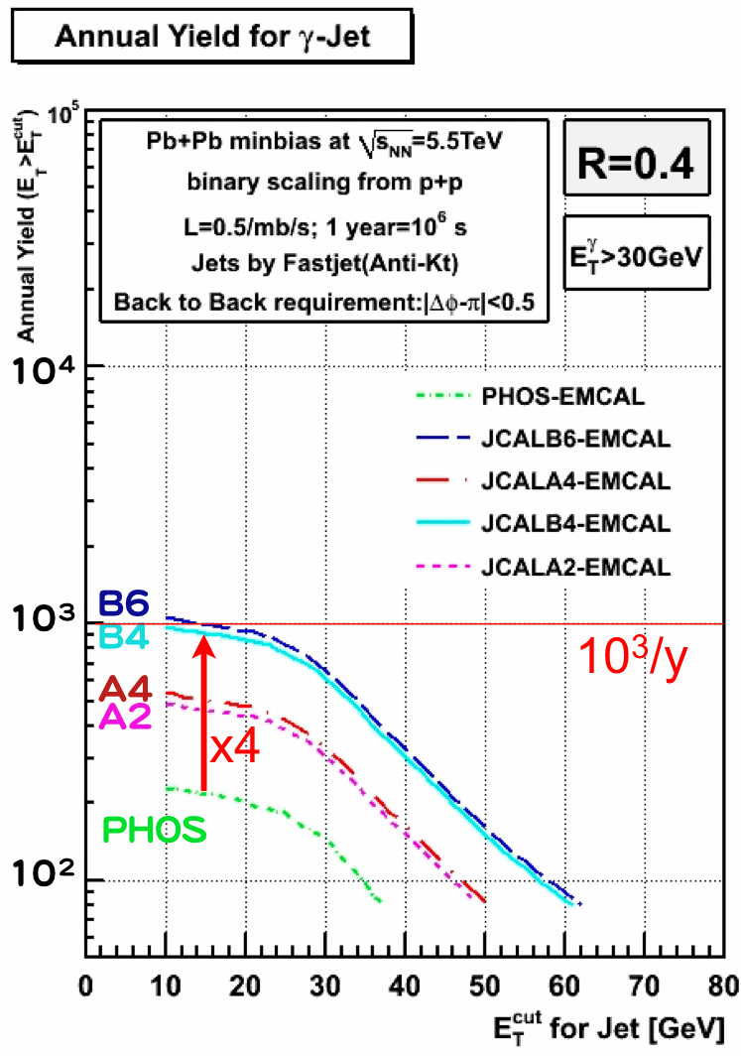
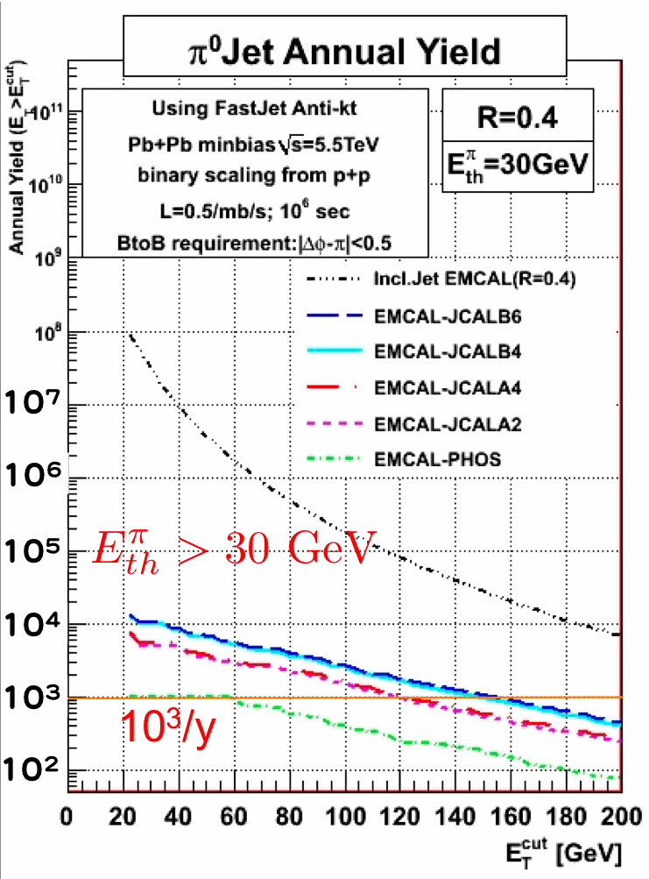
γ in
PHOS/J-cal
Recoil Di-jet E_{T}^{jet1}>70GeV
π0 in
PHOS/J-cal
EM-cal
EM-cal
Recoil γ-jet E_{T}^{γ}>30GeV
Recoil π⁰-jet E_{T}^{π0}>30GeV
jet (R<0.3)
in J-cal
M. Sano,
H. Yokoyama,
Grad. Student of Tsukuba
EM-cal

Slide 27
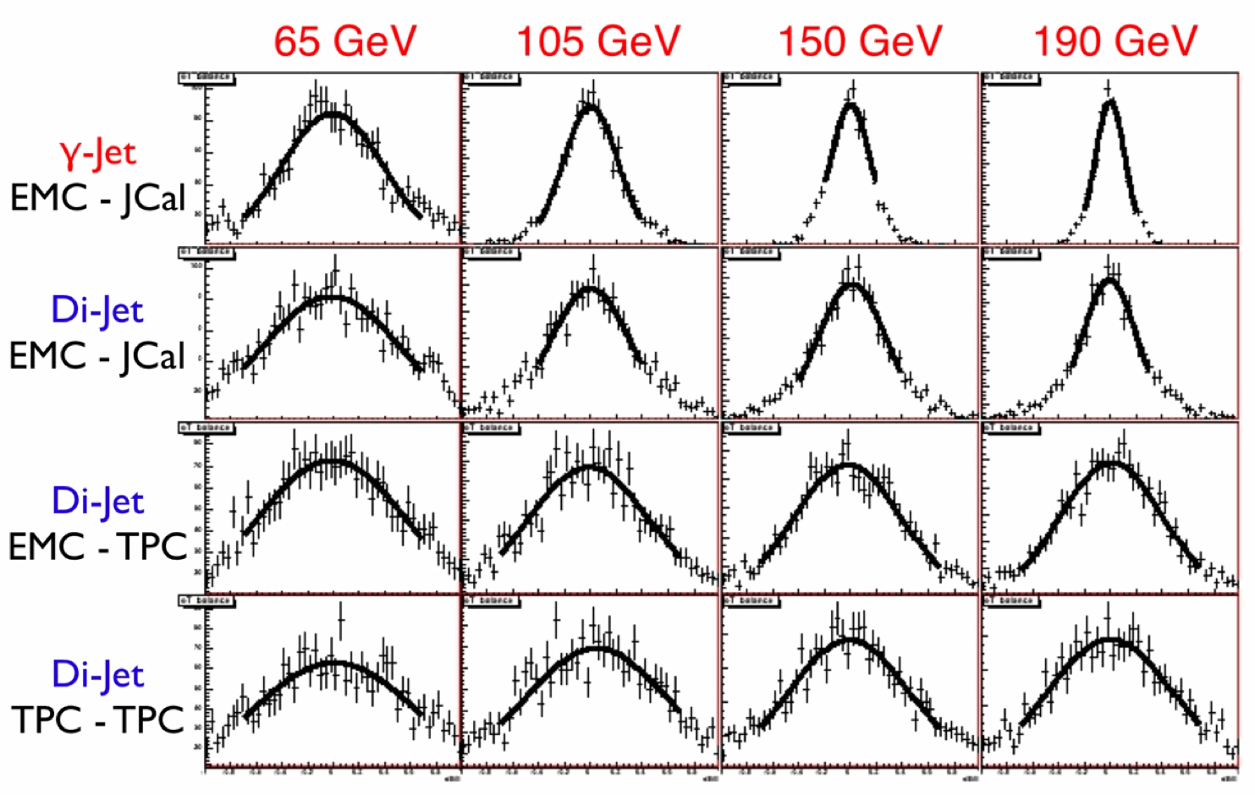
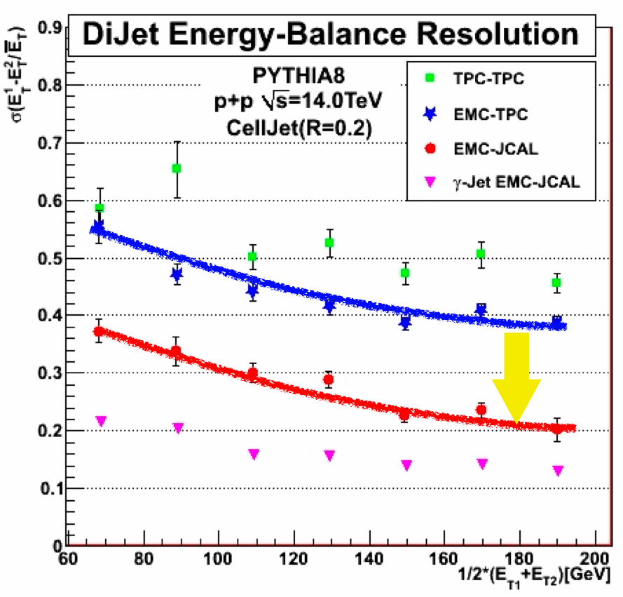
M. Sano,
H. Yokoyama,
Grad. Student of Tsukuba
Improvement in jet energy resolution

Slide 28
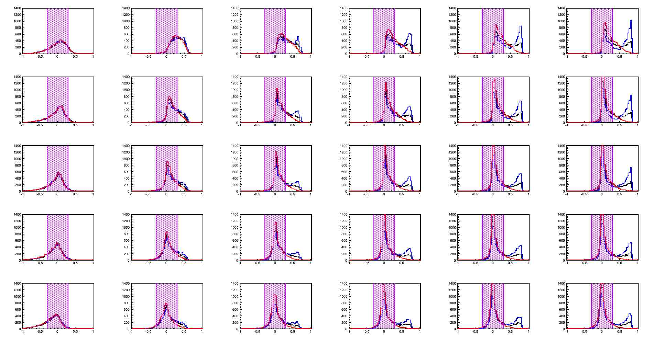
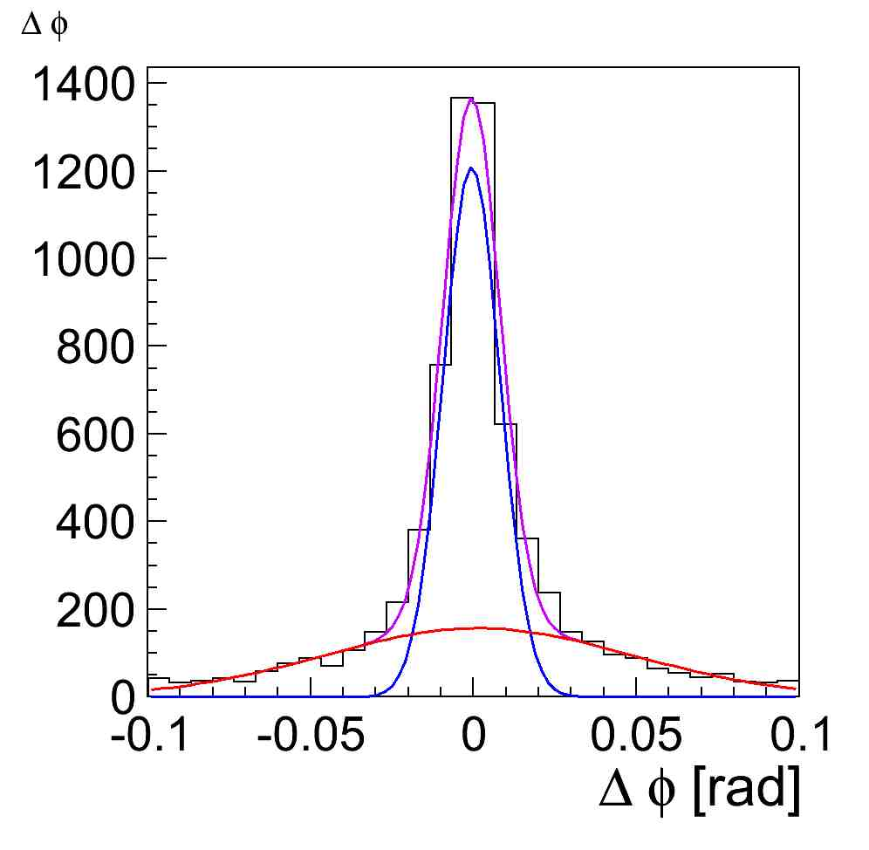
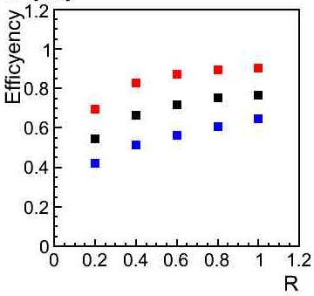
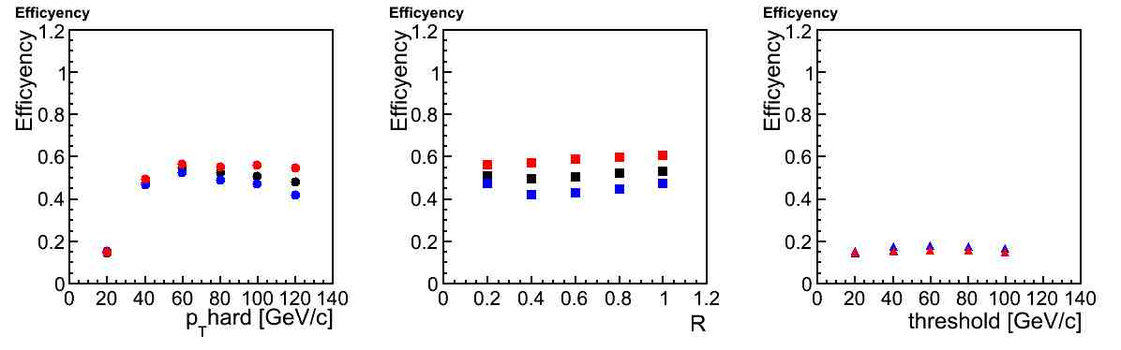
Difinition of Efficiency
|η of parton|<1.
|η of Jet|<1.
Efficiency =
# of Jets / # of partons
|(parton Et – Jet Et)/(parton Et)|<0.3
&
In 3σ of broad gaussian for dϕ
&
In 3σ of broad gaussian for dη
k_{T}
anti-k_{T}
Camb
p_{T} hard = 100 GeV/c
threshold = 20 GeV/c
k_{T}
anti-k_{T}
Camb
ΔEt/parton Et
Next Page

Slide 29
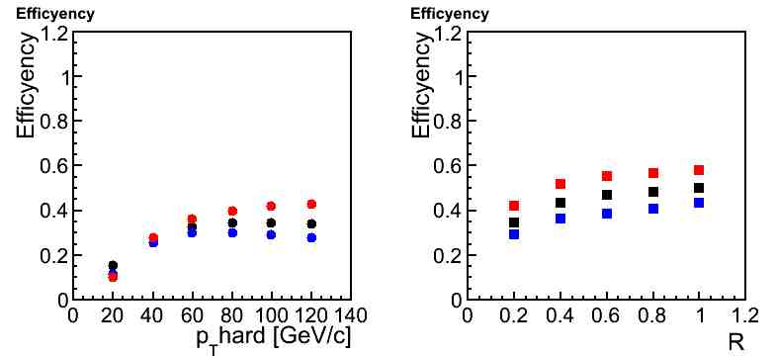
Efficiency of PYTHIA
R = 0.2
threshold = 20 GeV/c
p_{T} hard = 100 GeV/c
threshold = 20 GeV/c
k_{T} algorithm
anti-k_{T} algorithm
Cambridge algorithm
60% of Jets has correct energy & correct direction
for 100GeV/c Jets at R=1.0
Efficiency of Jet Finding with anti-kt algorithm is
about 30% better than kt algorithm
Anti-kt is useful for PYTHIA!

Slide 30
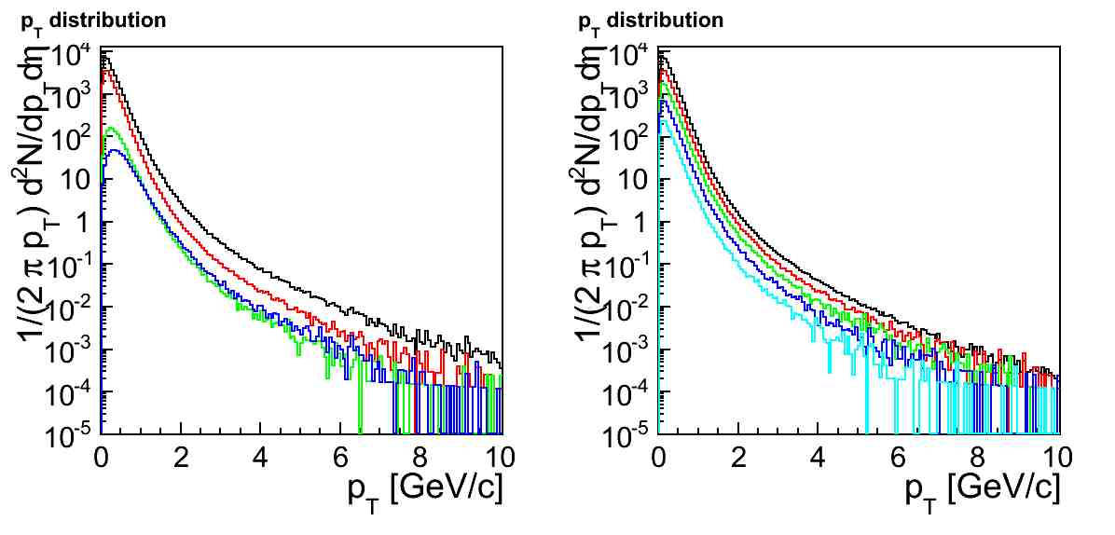
HIJING with PYTHIA
We embed PYTHIA Jets in HIJING event
centrality
0-20
20-40
HIJING 40-60 + PYTHIA Jets (same Jets)
60-80 10000 Jets
80-100
Pb+Pb 5500GeV
Centrality : 0-20
20-40
40-60
60-80
80-100
Centrality : 0-20
AliRoot | v4-16-Rev-03
# of event | 10000
p_{T}hard min | 2GeV/c
Jet Quenching | on
Shadowing | on
Total
charged π
charged K
proton + p-bar

Slide 31
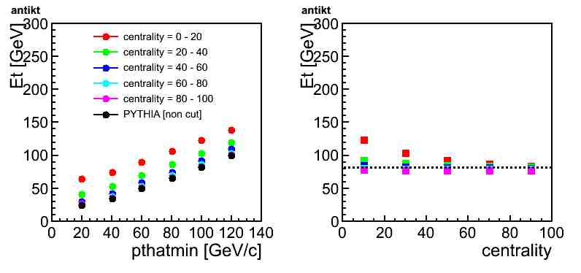
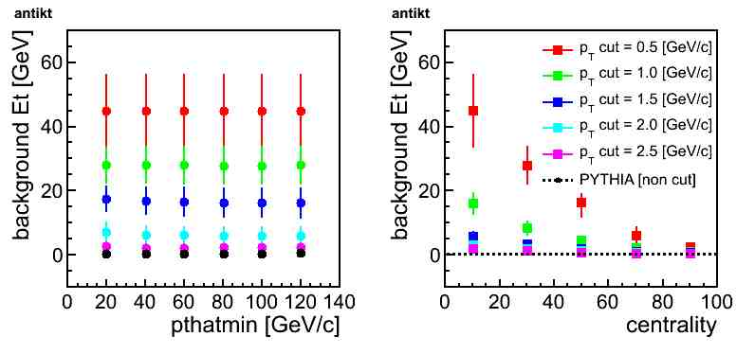
Energy reconstruction with HIJING
anti-k_{T} algorithm
R :0.2
p_{T} cut : 0.5GeV/c
Jet threshold :20 GeV/c
p_{T} hard :100GeV/c
R :0.2
Jet threshold :20 GeV/c
Jets has about 40GeV background
at central collision at p_{T}cut=0.5

Slide 32
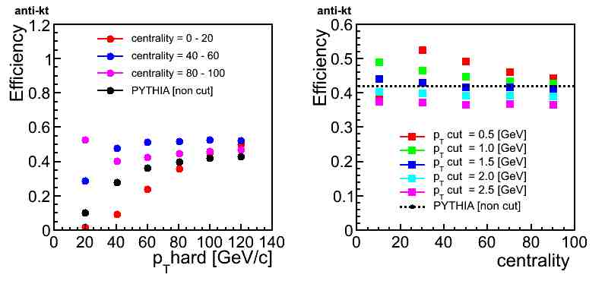
Efficiency of HIJING
anti-k_{T} algorithm
R :0.2
p_{T} cut : 0.5GeV/c
Jet threshold :20 GeV/c
p_{T} hard :100GeV/c
R :0.2
Jet threshold :20 GeV/c
Low energy jets
are affected by background.
We should set p_{T}cut
1.0GeV/c at most central,
0.5GeV/c for the other centrality.

Slide 33

dE/parton Et distribution
anti-kt
Camb
kt
PYTHIA
threshold = 20GeV/c
|dE/parton Et|<0.3
p_{T}hard = 20GeV/c 60GeV/c 100GeV/c
R =0.2
R =0.6
R =1.0
dE/parton Et

Slide 34


Area of Jet & background Et in PYTHIA Jet
R = 0.2
threshold = 20 GeV/c
p_{T} hard = 100 GeV/c
threshold = 20 GeV/c
Jet Area
background Et =
(Jet Area)*(Et_{JET}/dϕdη)
Et_{JET}:ΣEt(exclude JetArea)

Slide 35

Measured Energy and Energy Correction
E_{T}^{corrected} = E_{T}^{reconstructed} - E_{T}^{background}/dΦdη*Area^{Jet}
Back ground :
Multiple parton interaction
Beam remnant
threshold:20GeV/c
Black : Cam/Aachen
Blue : k_{T}
Red : anti-k_{T}
p_{T}hard 100-120GeV/c
p_{T}hard 60 – 80 GeV/c

Slide 36

Number of Jets
# of event of N-jets / total events
Using particles:
StatusCode of PYTHIA =1
(final state particles)
1-Jet
anti-kt algorithm
p_{T}hard = 100GeV/c
Jet threshold = 20GeV/c
All on |η|<1
All on |η|<3
initial on |η|<3
final on |η|<3
2-Jets
4-Jets
ini-fin on |η|<3
BR-MPI on |η|<3
All off |η|<3
η cut of particles
3-Jets
5-Jets
70% of total events has less than 2-jets
for setting of all radiation on

Slide 37

Radiation effect for dϕ resolution
anti-kt algorithm
p_{T}hard = 100GeV/c
Jet threshold = 20GeV/c
Using particles:
StatusCode of PYTHIA =1
(final state particles)
All on |η|<1
All on |η|<3
initial on |η|<3
final on |η|<3
ini-fin on |η|<3
BR-MPI on |η|<3
All off |η|<3
η cut of particles

Slide 38

Radiation effect for Energy reconstruction
anti-kt algorithm
p_{T}hard = 100GeV/c
Jet threshold = 20GeV/c
Using particles:
StatusCode of PYTHIA =1
(final state particles)
All on |η|<1
All on |η|<3
initial on |η|<3
final on |η|<3
ini-fin on |η|<3
BR-MPI on |η|<3
All off |η|<3
η cut of particles

Slide 39


Efficiency & Purity for Axis
Efficiency:
# of Jet in 3σ of “broad” gaussian / # of parton
S/(S+N)(pulity):
# of Jet in 3σ of “sharp” gaussian/
# of Jet in 3σ of “broad” gaussian
3σ
3σ
anti-kt algorithm
p_{T}hard = 100GeV/c
Jet threshold = 20GeV/c
anti-kt
kt
Cambridge

Slide 40


Low pT Photons
Experimental determination is very important since applicability of pQCD is doubtable in low pT region
In ‘real’ photon measurement
Measured yield with a large systematic error
Difficulty on measuring low pT “real” direct photons
  Finite energy resolution of the EMCal
  Large hadron background
Advantages on measuring ‘virtual’ photons
  High momentum resolution of the TPC
  Reliable estimation of the hadron decay components using Kroll-Wada formula

Slide 41

Virtual Photon Measurement
e⁺
Any source of real γ can emit γ* with very low mass.
Convert direct γ* fraction to real direct photon yield
q
e⁻
γ∗
g
q
Kroll-Wada formula
S : Process dependent factor
Possible to separate hadron decay components from virtual photon in the proper mass window.

Slide 42

Electron ID with TRD (1)
TRD 1
TRD 2
TRD 3
TRD 4
TRD 5
TRD 6
Blue : pion
Gleen: materlal conversion
Red : hadron decay
pT(GeV/c)
Used the production of ALICE full detector simulation with PYTHIA .
The fraction of electron (material conversion or hadron decay) increase with increasing TRD layer.

Slide 43

Electron ID with TRD (2)
Magenta : purity
Blue : efficiency
Red : efficiency x purity
The “efficiency x purity” is the highest with using more than 4 layer of TRD, so we decided to apply TRD 4 layer cut in current analysis.

Slide 44


Invariant Mass Spectrum
Combinatorial background and Conversion electron pair dominates in the invariant mass spectrum.
Total mass yield is almost described by the combinatorial and material conversion background within the statistical error. But it indicates to need more statistics and analysis is ongoing.

Slide 45

Evaluation the Statistics in First Year
Evaluation from NLO pQCD calculation
  Used INCNLO
    http://wwwlapp.in2p3.fr/lapth/PHOX_FAMILY/readme_inc.htm
    CTEQ6M, BFG
    √s : 7TeV pp
    μ : 0.5p_{T},1.0p_{T},2.0p_{T}
Evaluation of the number of the virtual photon
  Error propagation of background subtraction included.
  Required Trigger : MB
  Assumed DAQ rate :100Hz & Duty factor : ~25%
  100M event ~ 2 Month
  1G event ~ 20 Month
  Measured pT will reach ~5GeV/c
Red : 100M event
Blue : 1G event

