Slide 1
Identified particle v₃ measurements at 200 GeV Au+Au collisions at RHIC-PHENIX experiment
Sanshiro Mizuno for PHENIX Collaboration
University of Tsukuba
WPCF 2011 at Tokyo University

Slide 2
Outline
Introduction and Motivation
Azimuthal anisotropy
Triangular anisotropy
Analysis method
Data Set and PHENIX detector
Measuring method
Results
Particle Identified v₃
Comparison with model calculation
Summary and Outlook

Slide 3
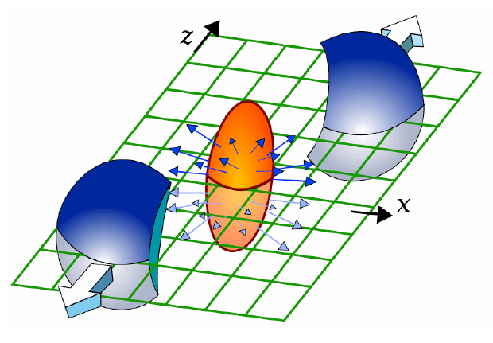
Azimuthal anisotropy
Azimuthal anisotropy is sensitive to initial participant geometry, and provides the early information of generated matter in collisions.
Azimuthal correlation with the reaction plane.

Slide 4
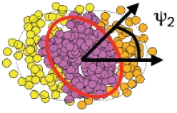
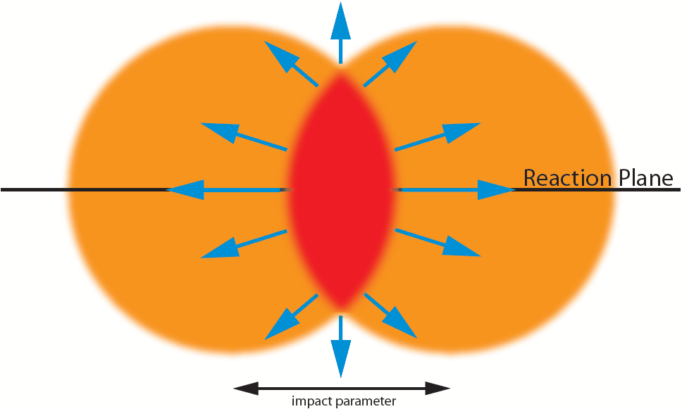
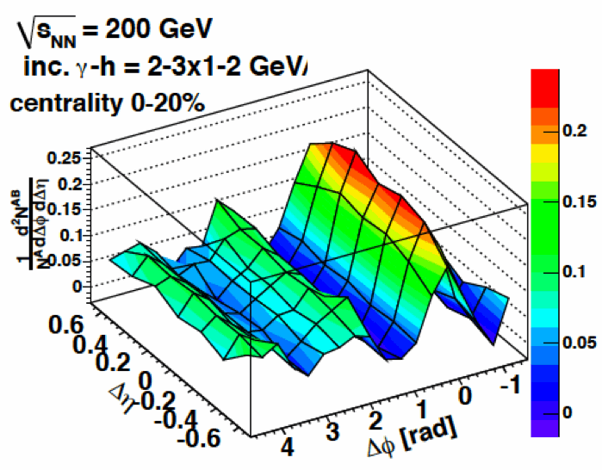
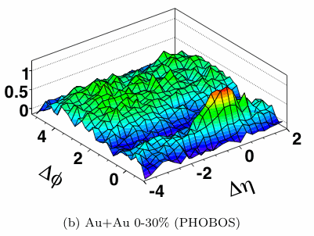
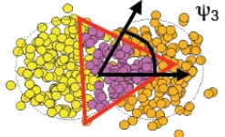
Triangular flow
In the Glauber picture, participant deformation is caused by finite number of participants.
Triangular flow is generated by initial participant deformation.
Magnitude of (final state)v₃ is thought to be sensitive to η/s.
Ridge and shoulder seem to be caused by v₃.
almond shape
shoulder
ridge
triangular shape

Slide 5
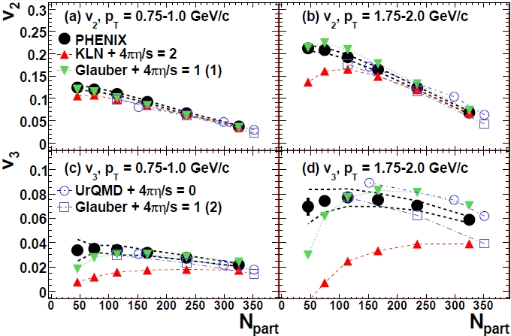
charged particle anisotropy
v_{n}
p_{T}[GeV/c]
arXiv:1105.3928v1[nucl-ex]
v₂ and v₃ centrality dependence is strong and weak, respectively.
While results of v₂ can be described by
Glauber model + η/s=0.08
CGC model + η/s=0.16
v₃ can only be described by
Glauber model + η/s=0.08

Slide 6
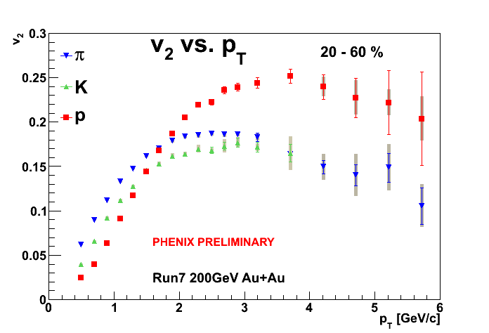
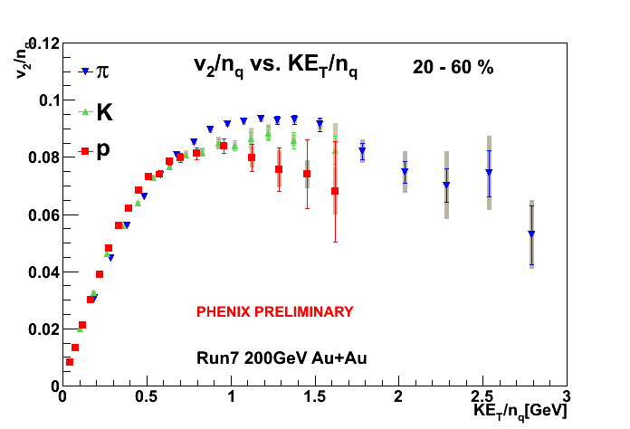
Partonic elliptic flow
v₂ of π, K, p as a function of p_{T} have different behavior.
This indicates hydrodynamics behavior.
In low p_{T} range, mass ordering is observed.
v₂ as a function of KE_{T} is scaled by the number of constituent quarks for KE_{T}/n_{q} < 1GeV.
This indicates the existence of partonic flow in QGP.
How about v₃?
Is mass ordering observed?
Does quark scaling work?

Slide 7
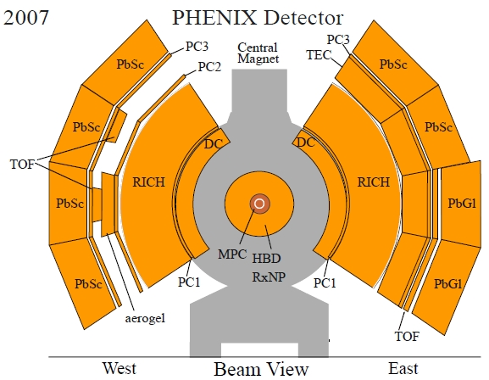
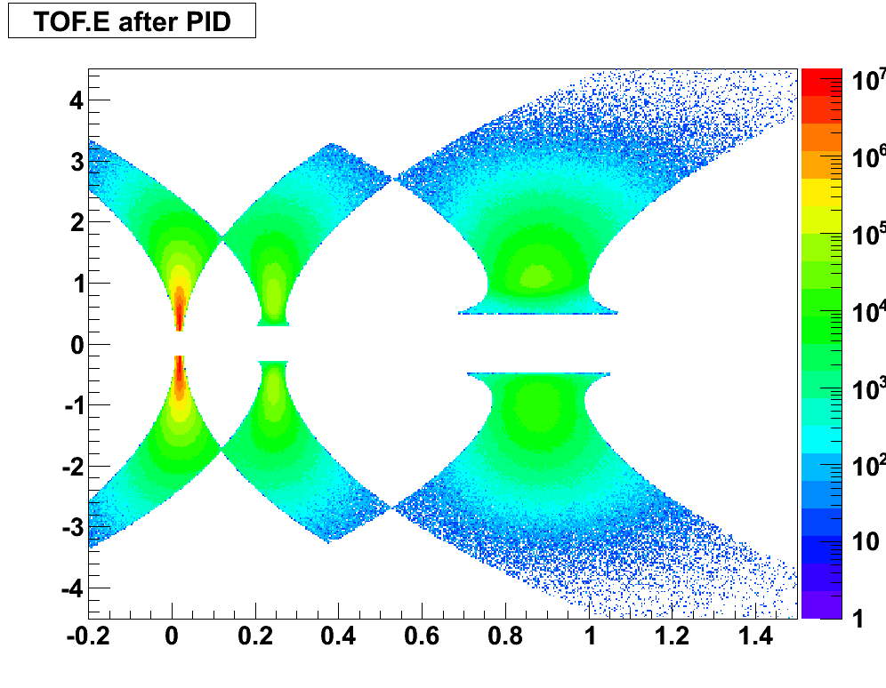
Data Set
200GeV Au+Au events obtained with the PHENIX
detector during the 2007 running period.
PHENIX detector
Charged particle momentum & tracking
Drift Chamber (DC)
Pad Chamber(PC)
Hadron particle identification
Time of flight detector(TOF)
Electromagnetic Calorimeter(EMCal)
Reaction Plane
Reaction Plane detector(RxN)
Inner 1.5<|η|<2.8
Outer 1.0<|η|<1.5
|η|< 0.35
momentum×charge[GeV/c]
π
K
p
mass²[(GeV/c²)²]

Slide 8
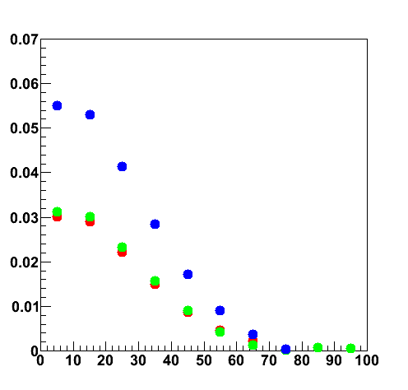
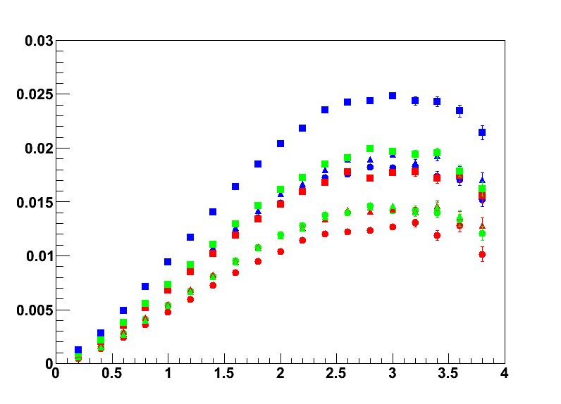
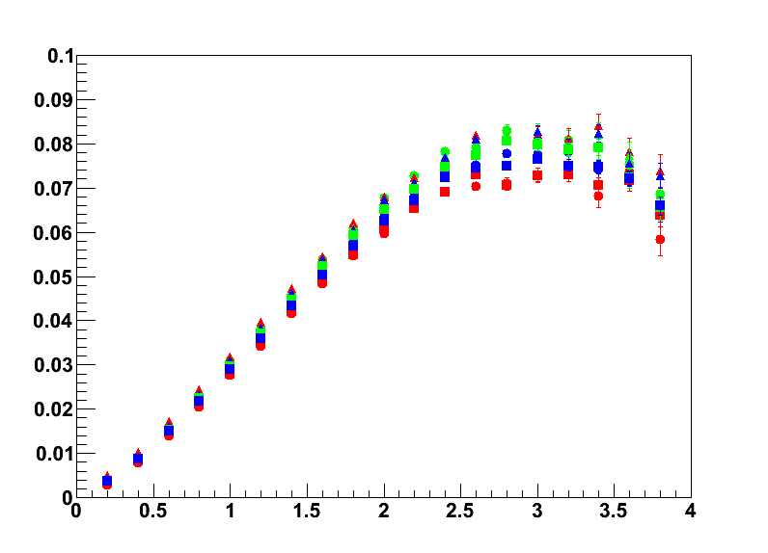
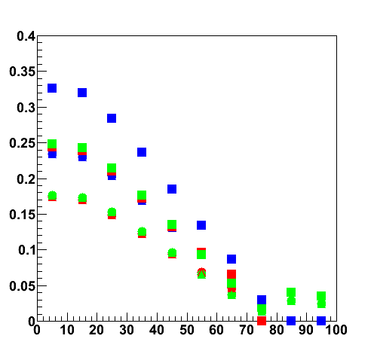
Measurement v_{n} method
correlation <cos{n(Ψ_{n,A} - Ψ_{n,B})}>
v_{n} = <cos{n(φ - Ψ_{n})}>
v_{n,true} = v_{n,obs} / Res(Ψ_{n})
1. Reaction Plane Calibration
1. Gain correction
2. Re-centering
3. Flattening
2. Reaction Plane Resolution
Correlation with two Reaction Plane
defined by different detector is used.
RxN In 1.5<|η|<2.8
RxN Out 1.0<|η|<1.5
RxN In+Out 1.0<|η|<2.8
centrality[%]
RxN In S
RxN In N
RxN In S+N
RxN Out S
RxN Out N
RxN Out S+N
RxN In+Out S
RxN In+Out N
RxN In+Out S+N
resolution
v_{n,obs}
v_{n,true}
p_{T}[GeV/c]
p_{T}[GeV/c]
centrality[%]

Slide 9
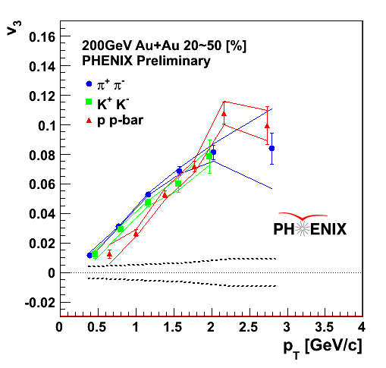
Result(PID v₃)
PID v₃ has been measured.
Mass ordering has been observed for v₃ in low p_{T}.
Baryon and mesons v₃ seems to be reversed at intermediate p_{T}.

Slide 10
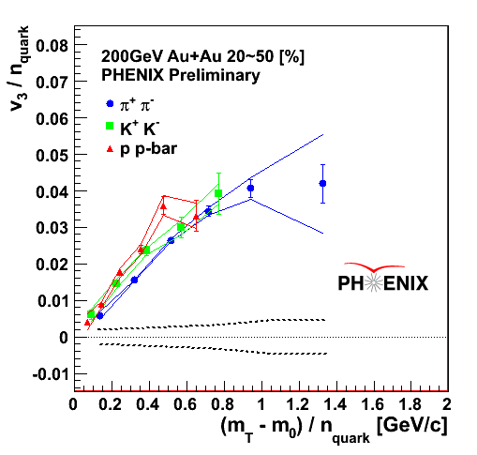
Result(quark scaling)
KE_{T}/n_{q} =
[GeV]
The number of constituent quark scaling has been tested for v₃ for KE_{T}/n_{q}.
n_{q} scaling of v₃ is not as good as v_{2.}
Some small deviation on the KE_{T}/n_{q} scaled v₃ appeared.

Slide 11
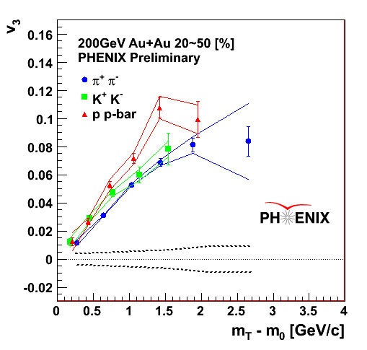
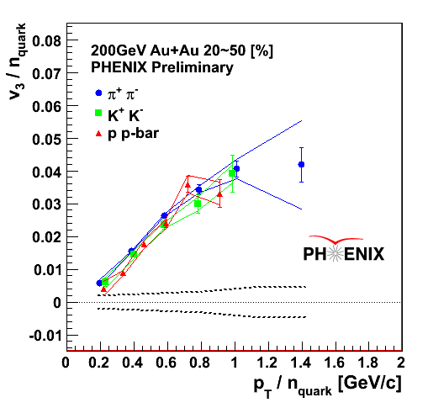
PID v₃
v₃ as a function of p_{T}, KE_{T}, p_{T}/n_{q} and KE_{T}/n_{q} have been measured.
v₃ as a function of p_{T}/n_{q} seems to be scaled better than KE_{T}/n_{q}.

Slide 12
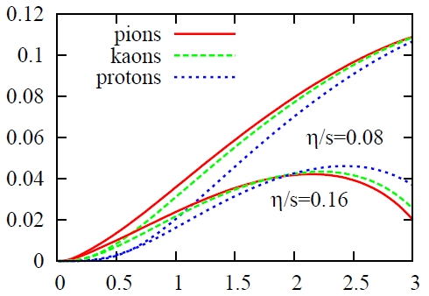
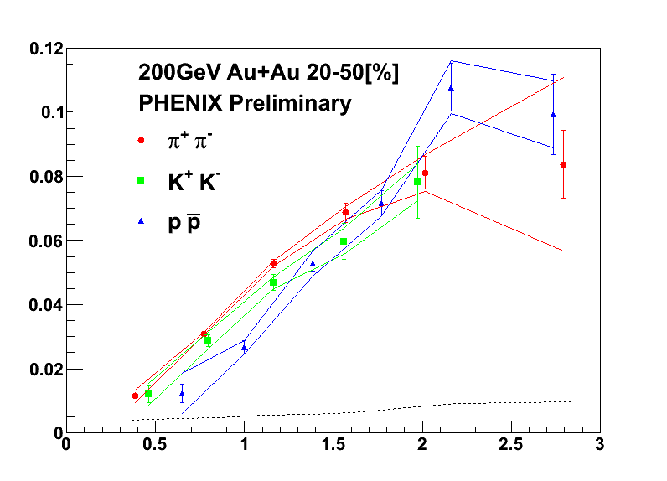
Comparison with Model Calculation
Burak Han Alver, arXiv:1007.5469[nucl-th]
v₃
v₃
5 - 10[%]
CGC model + η/s=0.16
p_{T}[GeV/c]
p_{T}[GeV/c]
Glauber model + η/s=0.08
Glauber model + η/s=0.08 works better.

Slide 13
Summary
Identified charged particle v₃ have been measured.
Mass ordering has been observed in low p_{T} range.
Baryon/meson v₃ seems to be reversed at intermediate p_{T}.
The number of constituent quarks scaling has been tested.
v₃ of π, K, p as a function of KE_{T}/n_{q} are not well scaled.
v₃ of π, K, p as a function of p_{T}/n_{q} seems to be scaled better than KE_{T}/n_{q}.
Comparison with model calculations
Glauber + η/s = 0.08 seems to be better
Outlook
Look at finer centrality and p_{T} dependence.
Using full statistics study
Higher order harmonics measurement

Slide 15
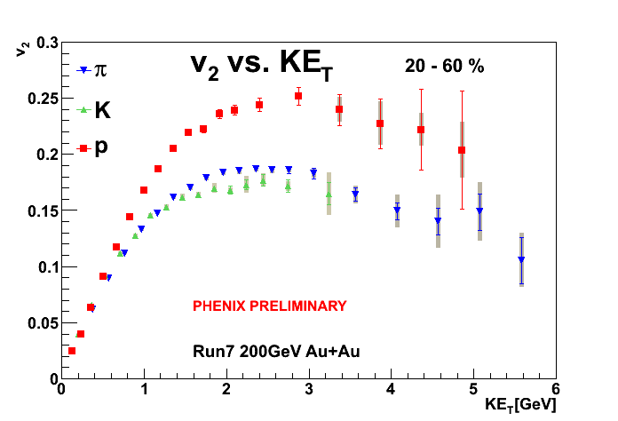
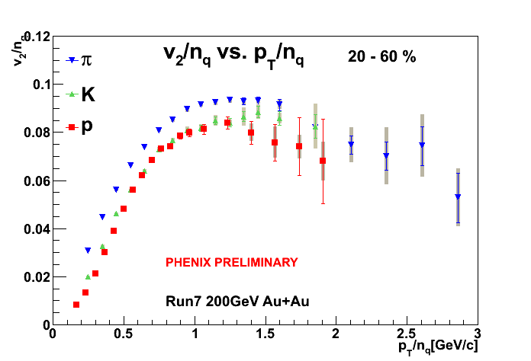
PID v₂

Slide 16
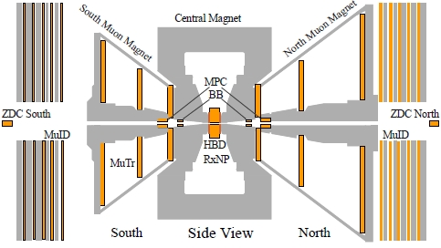
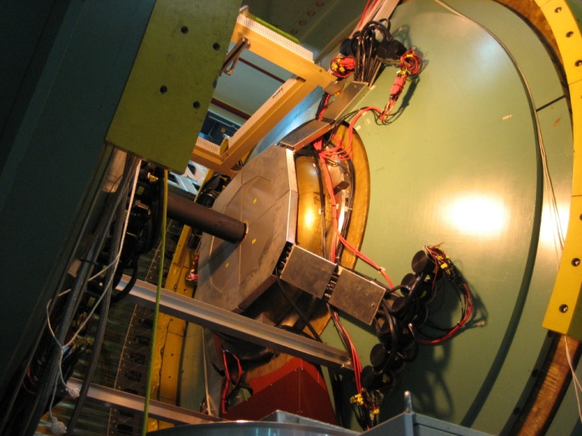
Reaction Plane Calibration
1. Gain correction
w_{i} = adc_{i}/<adc>
Q_{x,n} = Σw_{i}cos(nφ_{i}) , Q_{y,n} = Σw_{i}sin(nφ_{i})
Φ_{n} = atan2(Q_{x,n} , Q_{y,n}) / n
2. Re-centering
Q’_{x,n} = (Q_{x,n}-<Q_{x,n}>)/σ_{Qx,n} , Q’_{y,n} = (Q_{y,n}-<Q_{y,n}>)/σ_{Qy,n}
Φ’_{n} = atan2(Q’_{x,n} , Q’_{y,n}) / n
3. Flattening
nΦ”_{n} = nΦ’_{n} + Σ2/i{-<sin(inΦ’_{n})>cos(inΦ’_{n})+<cos(inΦ’_{n})>sin(inΦ’_{n})}
φ_{i}
reaction plane detector(RxN)
inner 1.5 < |η| < 2.8
outer 1.0 < |η| < 1.5

Slide 17
Method (v_{n} measurement)
v3 are measured using function.
v_{n,true} = <cos{n(Ψ_{n,part} - Ψ_{n,Event Plane})}>
v_{n,obs} = <cos{n(Ψ_{n,part} - Ψ_{n,Reaction Plane})}>
v_{n,true} = v_{n,obs} / Res(Ψ_{n,Reaction Plane})
v_{n,true} : true v_{n}
v_{n,obs} : observed v_{n}
Ψ_{n,part} : azimuthal angle of particle
Ψ_{n,Event Plane} : azimuthal angle of Event Plane
Ψ_{n,Reaction Plane} : azimuthal angle of Reaction Plane
Res(Ψ_{n,Reaction Plane}) : Resolution of Ψ_{n,Reaction Plane}

Slide 18
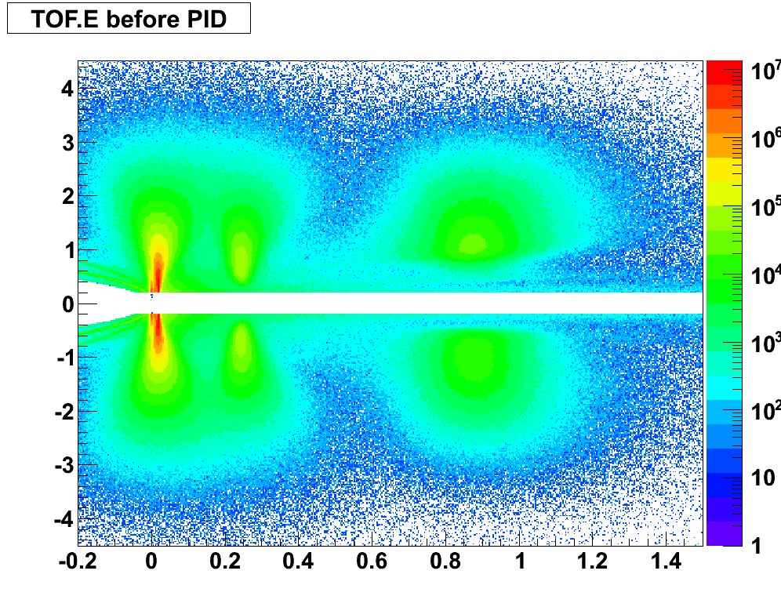

Slide 19
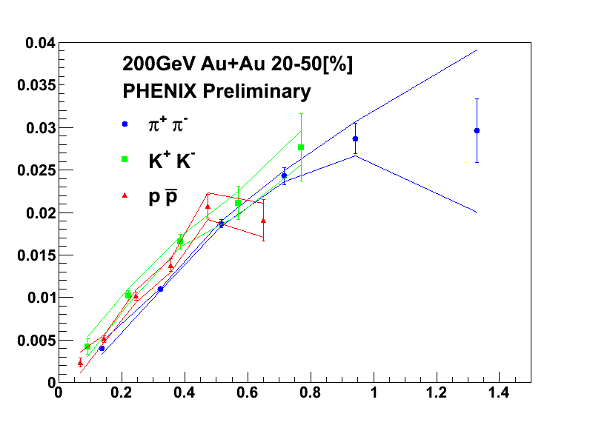
Result(KE_{T}/(n_{q})^{3/2})

Slide 20
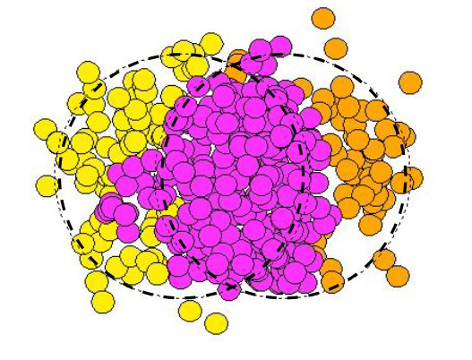

Slide 21
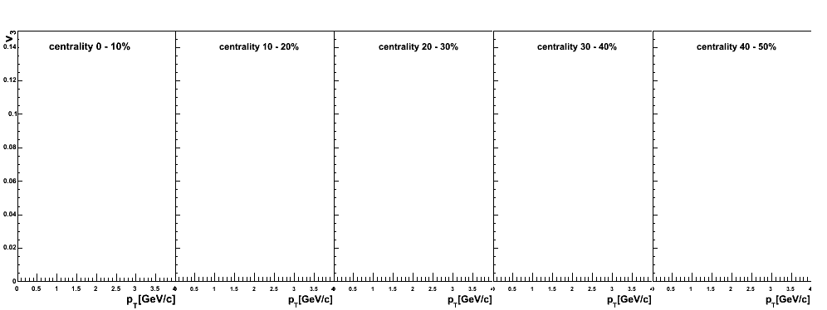
Result(identified v₃ using full statistics)
Not Showing
Not Showing

